Slide 1
EDI + Social Justice@ OSUL
designing an EDI strategy for OSUL
University Libraries
The Ohio State University
Dan Noonan
Associate Professor
Digital Preservation Librarian
noonan.37@osu.edu

Slide 2
Objective:
Librarianship with EDI in mind
Notes:
[Acknowledging the challenge of EDI conversations and setting the workshop’s tone]
I want to start our workshop by acknowledging that for many of us, the topics of today’s discussions are not easy.
We may feel that we cannot speak to these issues or conversely, are the only ones that can speak to these issues because of an identity and affiliation with a minority or majority group.
In advance, we want to thank you for being here and participating in a candid discussion with your colleagues.

Slide 3
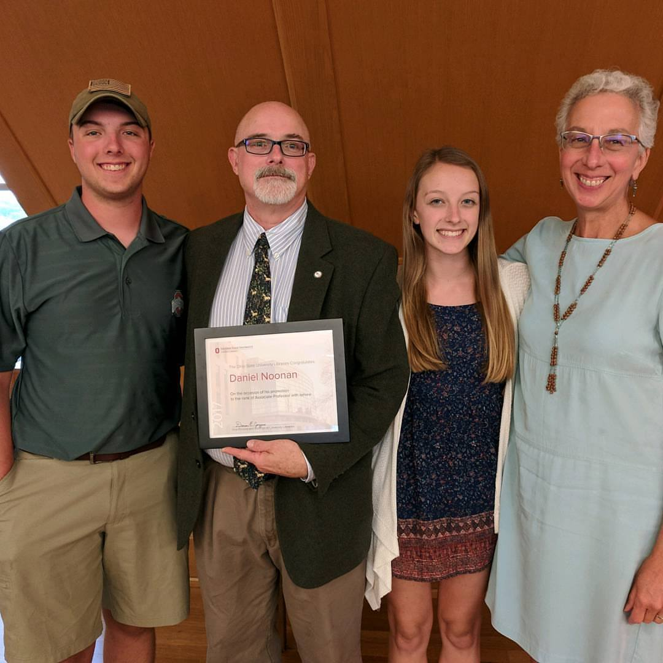
Introduction
Notes:
[Facilitators Introduction/ Connection to global narratives and identity]
I am, Dan Noonan, a middle-aged white male of mostly Irish-English-French descent.
This is my wife of almost 23 years, Carolee, and my kidz, Benedict and Cordelia.
This was two years ago when I was promoted to Associate Professor.

Slide 4
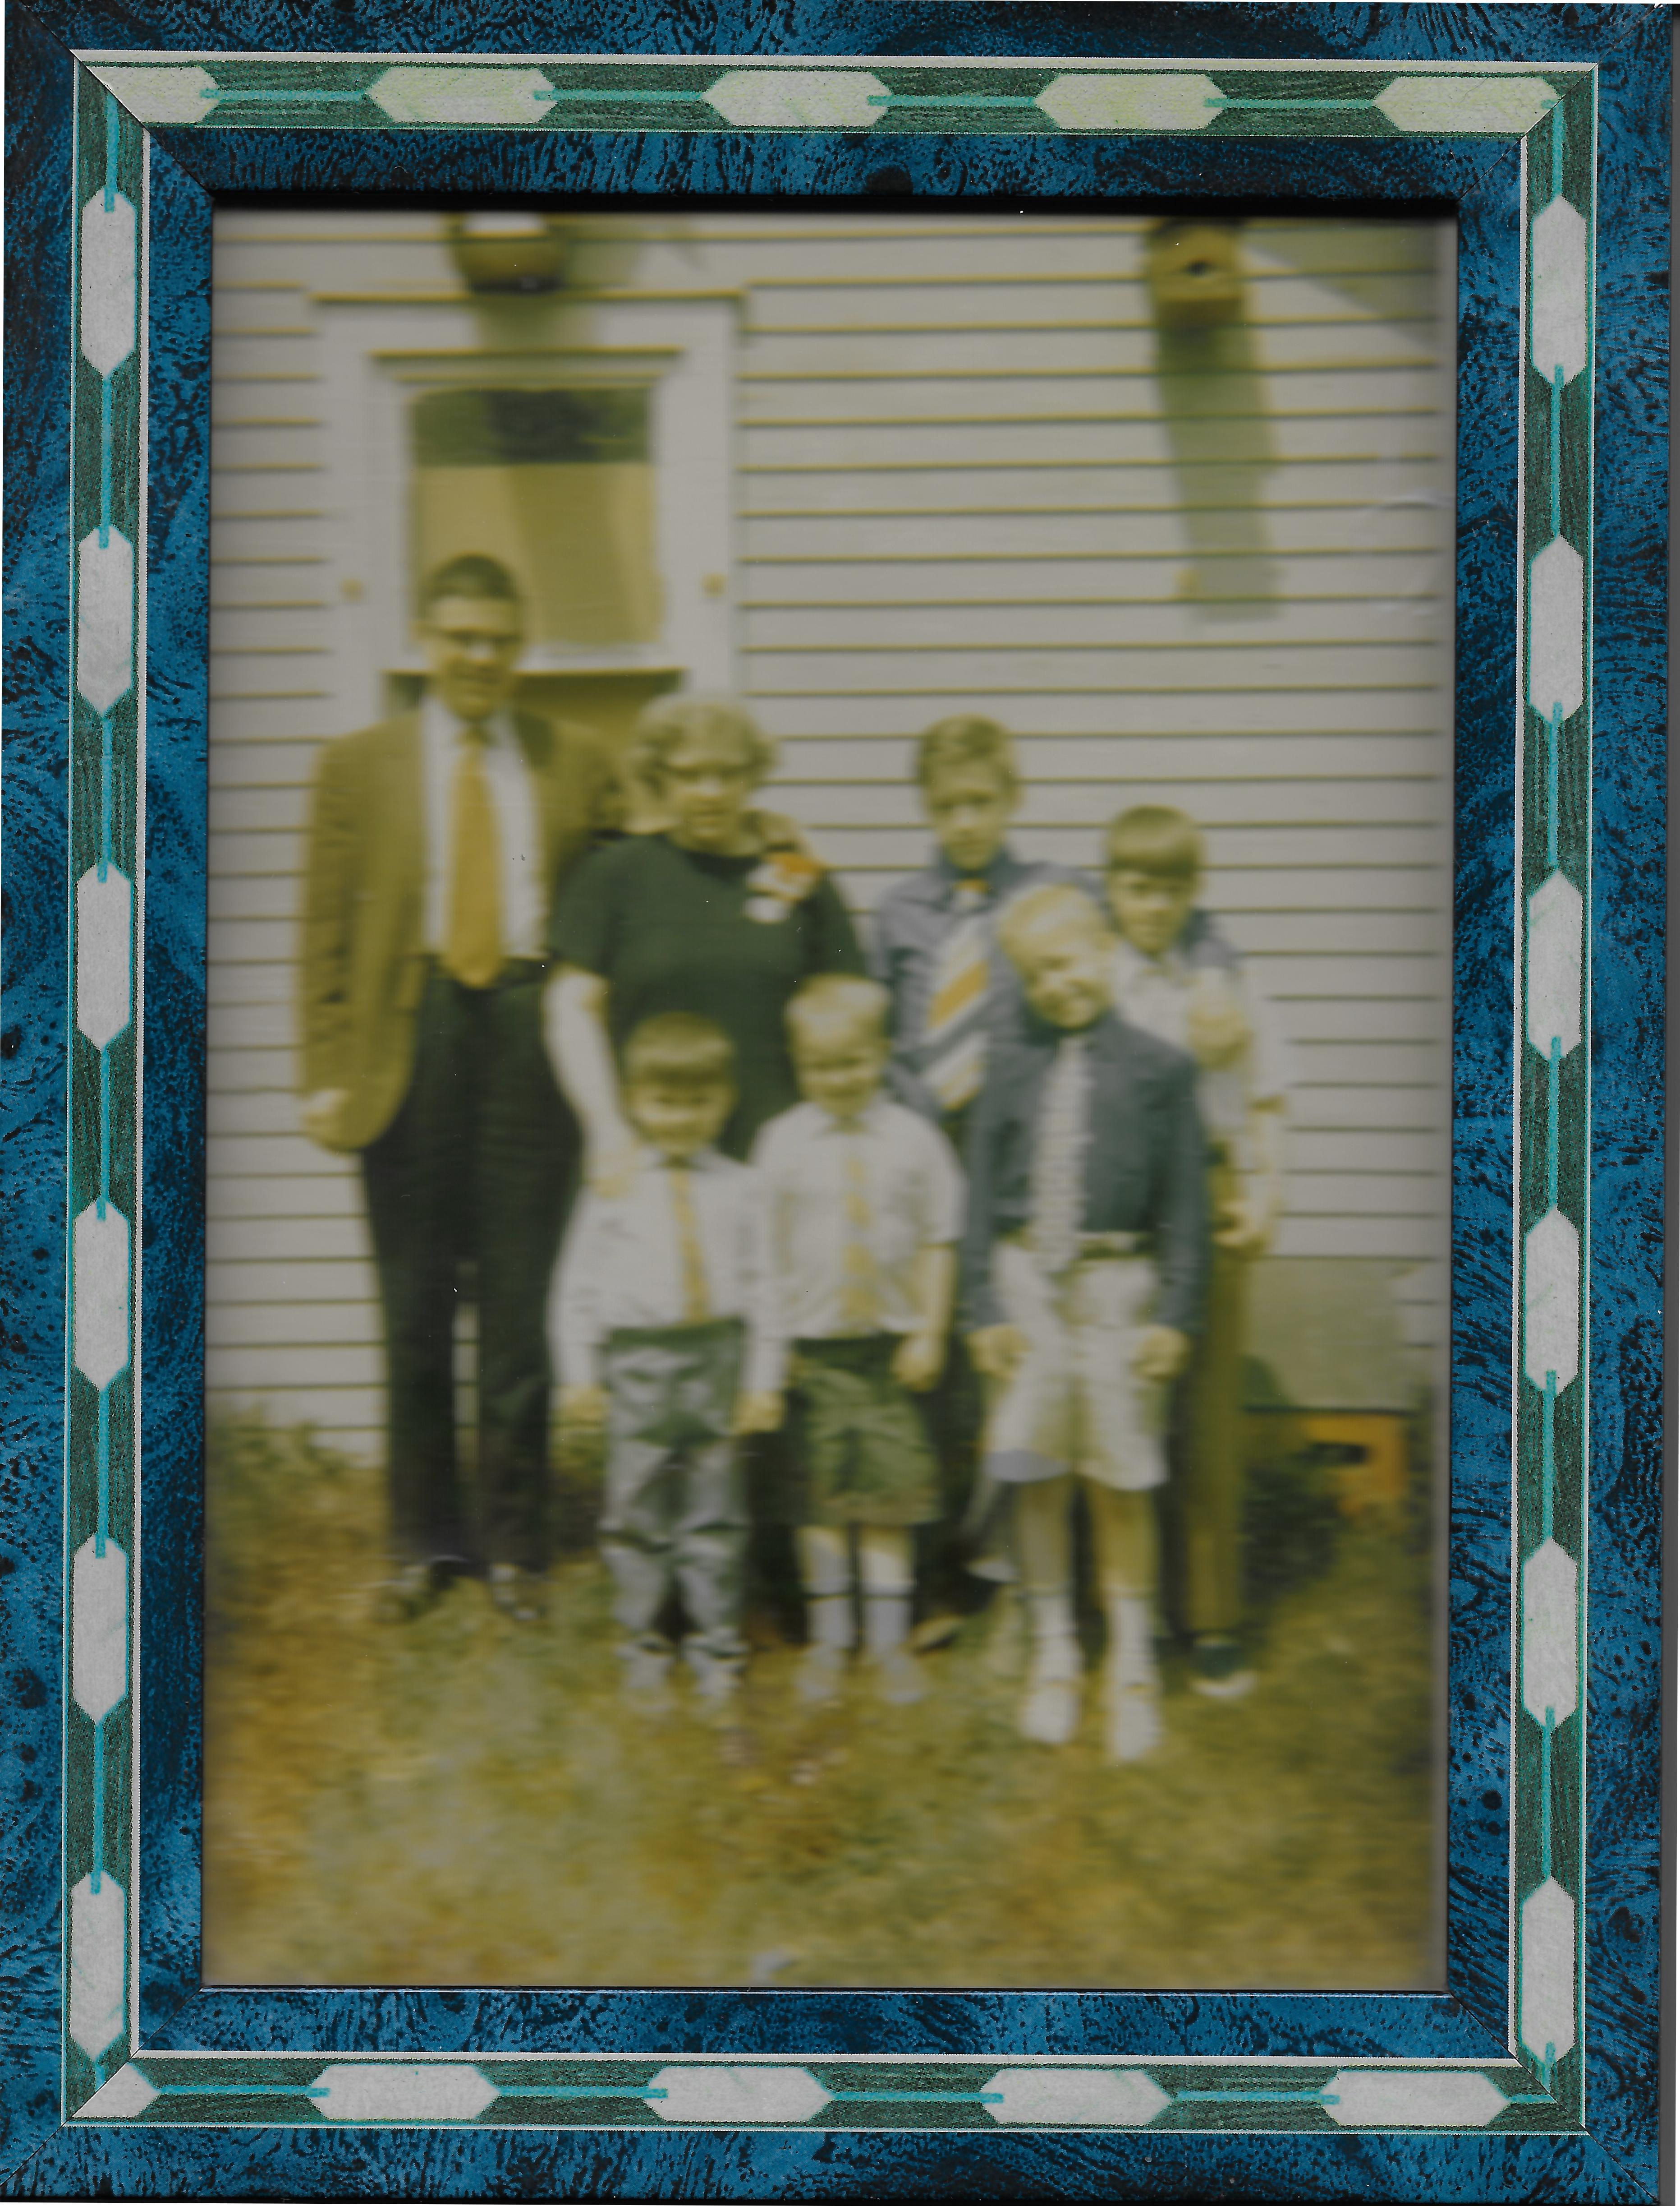
Introduction
Notes:
A bit of historical perspective, this is my family in our backyard, and I’m guessing 4th of July (and my brother Tim’s Birthday) based on our attire. And I’m guessing probably 69, 70 or 71, because by 72 my Father had passed. So I’d be 7 – 9 years old.
My Father James, an almost Roman Catholic Diocesan priest, my mother Mary, older brother Joe, and my younger brothers Tim, Pat & Mike. Of the back row, I am the only one still alive, and for that matter, I am the oldest person in my family period.
And oh fun fact. I mentioned Tim was born on the 4th of July, Well Joe was born on T-Day, I was on New Years Day, Patrick on Feast of the Epiphany or Orthodox Xmas and Mike on Memorial Day when it was celebrated on the 30th.

Slide 5
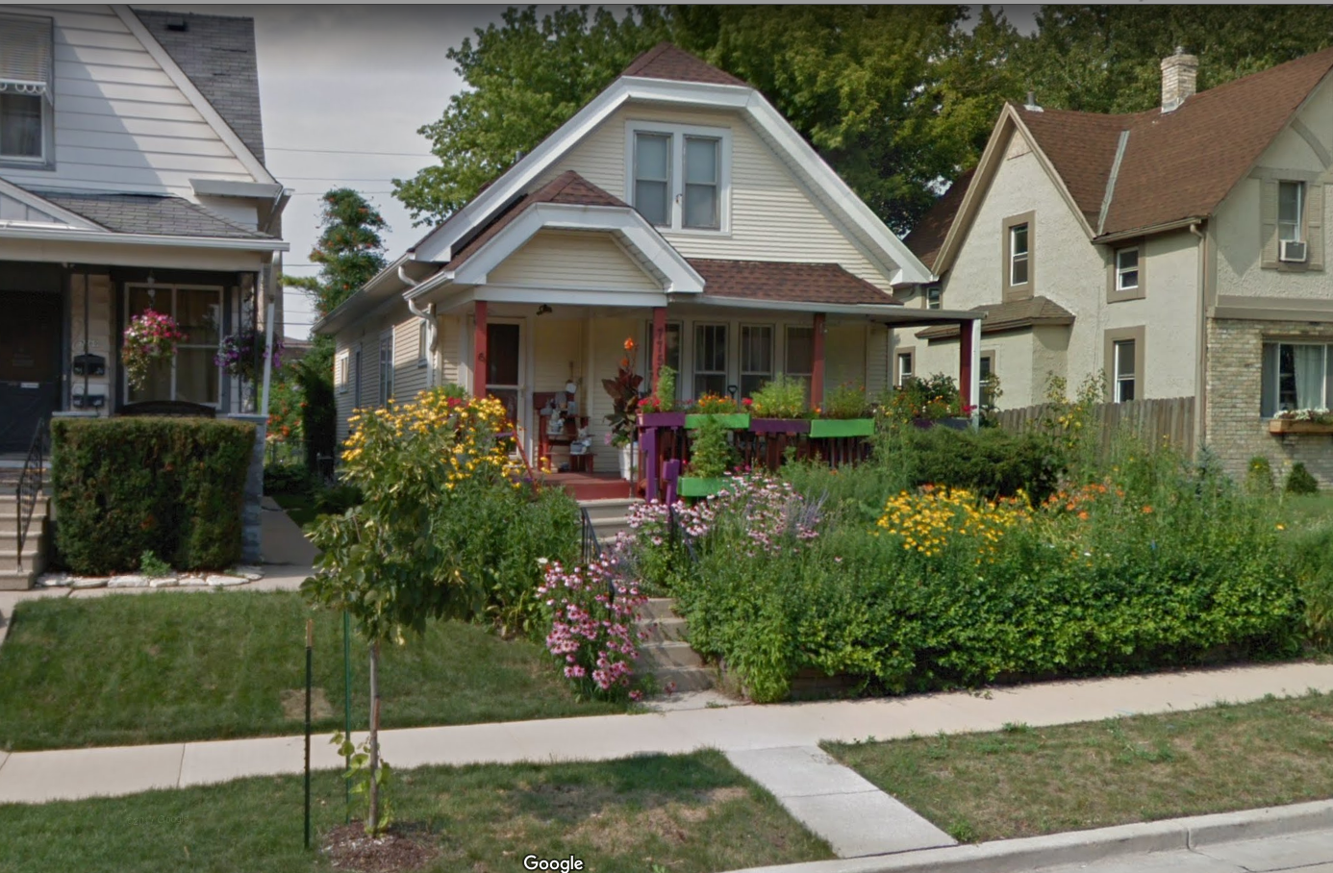
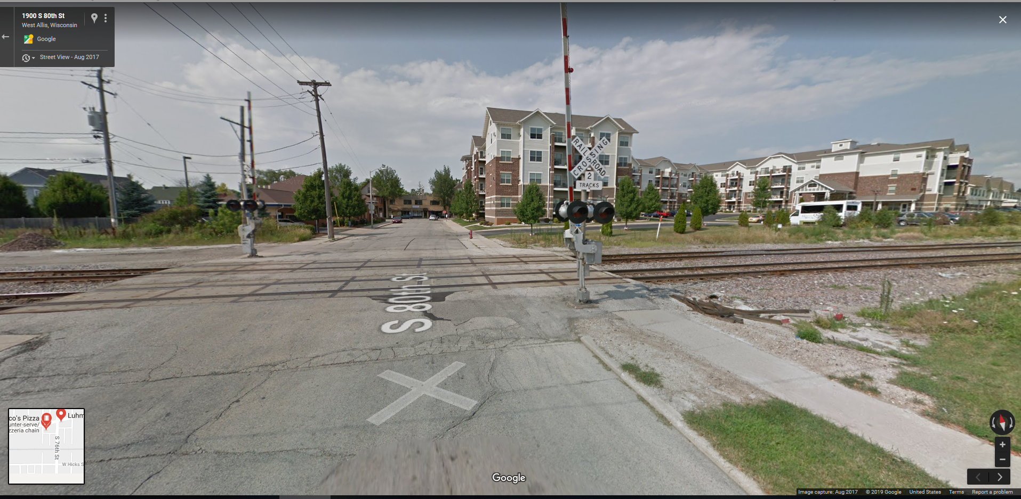
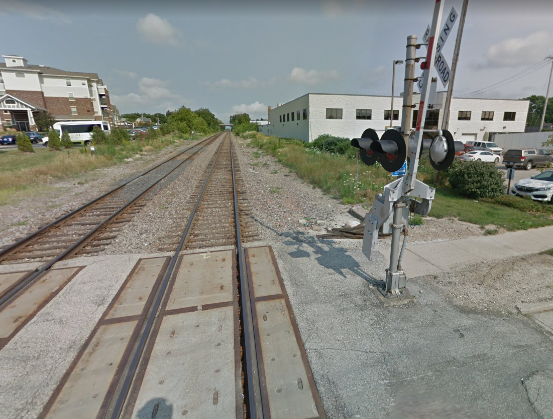
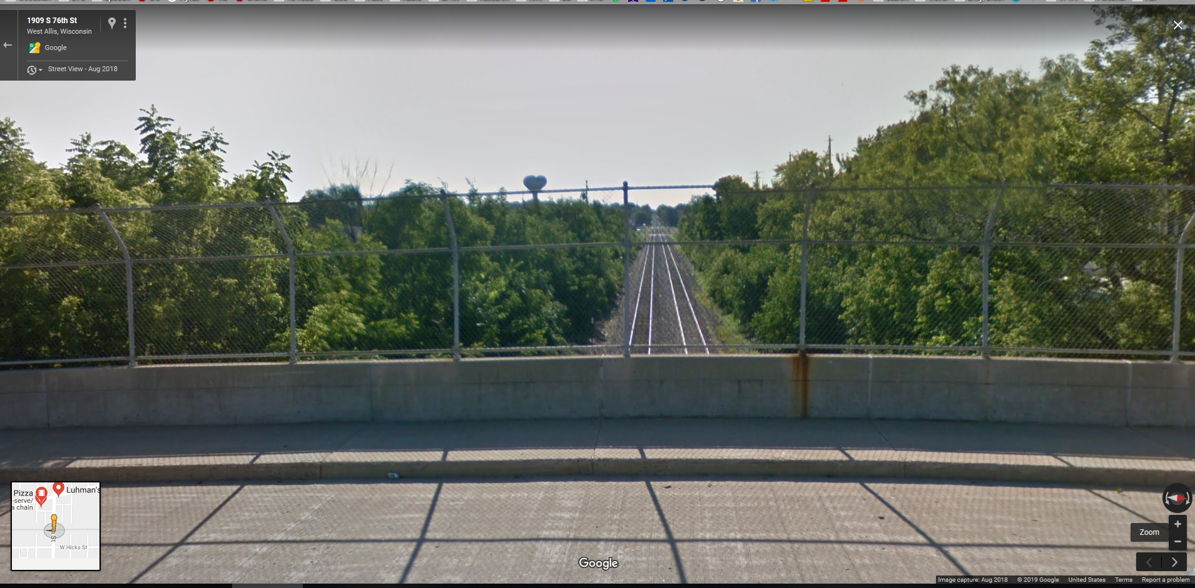
Literally grew upon the wrong side of the tracks…
© Google.com and Wikipedia.org
Notes:
I grew up in West Allis, WI, a 1st ring industrial suburb of Milwaukee.
Ours was a lower middle class family, where my father was the Principal and English teacher for a Catholic High School for so called “wayward girls” and then a vocational counselor for drug addicts and alcoholics.
My Mom was a stay-at-home mom, and a store clerk and admin assistant after my father passed. If not for insurance and Social Security, we would have been homeless after my father died.
I had just turned 10, my older brother was 12 and my youngest brother 5, when my dad died.
We were that family that received the care packages from our parish at holidays.
My Parents valued education, reading and being informed. They were activist parents, door-to-door stumping for candidates like Eugene McCarthy in 1968, and liberal activists within the Catholic church.
After my father passed we switched parishes for a variety of reasons, joining and going to school in a parish in one of the upper middle class communities, where a couple of my father’s seminary classmates taught.
I definitely felt like I was from the wrong side of the tracks, ; and it didn't help that the name of the street I grew up on is Hicks. This is a picture of the house I grew up and my brother Pat still lives in. We had factories across the ally behind our house, and these are the CNW tracks behind them, the last one being the bridge that looks back at this other intersection. The bridge is significant, because I was able to prove to my kidz that I walked uphill both ways in the snow and cold in winter to school.
But more seriously, I remember when I was probably 6 or 7 seeing an African-American gentleman standing at the bus-stop at our street at the base of the bridge. I remember still to this day that it felt odd, not wrong, just odd because people of color did not live in my neighborhood.
And for as liberal as my parents were in bringing us up anti-war and with a sense of social justice and activism, I still remember my maternal Grandmother frequently using N-word and not thinking twice about it. In retrospect, just as bad, was participating in neighborhood and at school games like “N______-word pile” or “smear the q____-word."

Slide 6
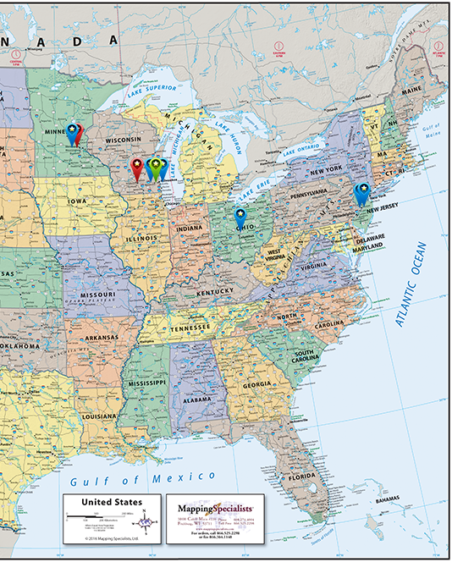
Where I’m from and lived…
1962: West Allis, WI
1980: U of MN
1981: UW Madison
1985: Milwaukee, WI
1986: Hamilton Twp, NJ
1988: Minneapolis, MN
1989: Milwaukee, WI
1990: Trenton, NJ
2006: Columbus, OH
© Copyright Mapping Specialists 2019
(https://www.mappingspecialists.com/store/classic-political-usa-map/#prettyPhoto/0/)
Notes:
[Facilitators Introduction/ Connection to global narratives and identity]
After graduating high school, I became a bit more itinerant. Between 1980 and 1996 making 7 major moves and living in 3 different states. MN-WI-NJ-MN-WI-NJ.
What this doesn’t show is all the places I’ve been in the period of ‘85 thru ‘97 I traveled to nearly 40 states and Canada conducting insurance appraisal for public sector entities and private industry, and 4 countries for vacation.
I have had 2.25 careers with nine employers and have been here at osu for more than 12 years -- the longest with any employer.

Slide 7
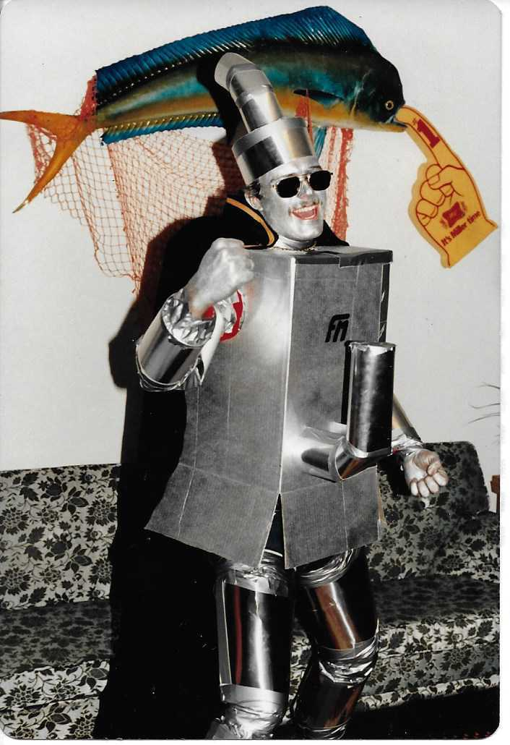
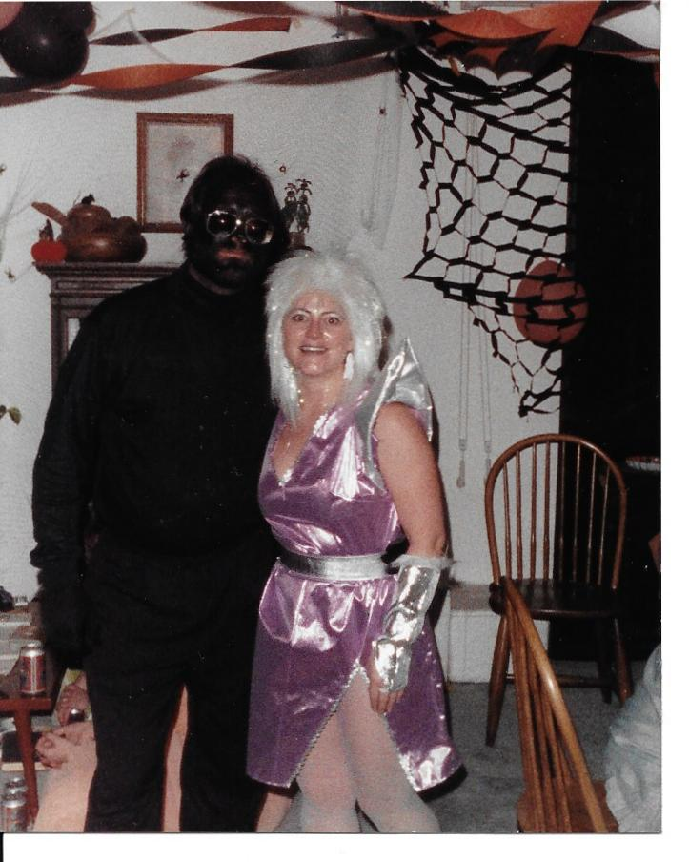
A lesson in tone-deafness
Notes:
I want to recount an event, nearly 30 years ago, that only recently did I realize how tone-deaf I was. At Halloween I try to be creative. Here I am in ‘83, no not the Tin Man, but “Furnace Man” righting the wrongs to furnaces worlds-wide. OK lame, but a junior in college who drank a lot.
This is actually more for context to show that I more than once painted myself for Halloween. Also what you can’t see is that I shaved stripes into my mustache for some bizarre reason, which meant I shaved it completely off the next day and that was the last time I shaved it off. But enough goofing, time for being serious.
In 1989, I was in phase that would last for several years, where I wore mostly black attire, shirts, pants, trenchcoat, etc. not goth, but an attempt at being hip. Not really sure I was that effective at it. Anyway, while struggling to come up with a costume for Halloween that year, I finally decided to be completely black—Mr. Dark or a Black hole—no real character or persona, just dressed completely black, including, shirt pants, shoes, gloves, sunglasses and makeup.
My intent was not “blackface”, and even after seeing myself all done up, I still had no thought that I was doing blackface.
I was confronted by an African-American gentleman at the party who told me he was offended by my costume. I was taken a-back because just as I laid it out for y’all now, that was my mindset, and I tried to explain it to him. He wasn’t having any of it and walked away in disgust, and I was left ignorantly baffled.
However, it wasn’t until recent events, that it finally began to dawn on me how completely self-righteous and tone-deaf I was on that evening nearly 30 years ago. And when I finally decided that to be real, and share this with y’all and found the picture Sunday night, I really cringed; in my memory, I wasn’t nearly as offensive looking as I am in this picture.
If I had taken the time 30 years ago to put myself in the other person’s shoes and see how I looked to him, and regardless of my intentions, realize how offensive it was, I could have made amends then and there.
This was one of my many blindspots. We all have them.

Slide 8
EDI and Social Justice at OSUL
My reason(s) for being here…
© 2019 Pivot Point
Notes:
[Facilitators Introduction/ Connection to global narratives and identity]
I have been on a journey for few years, identifying my blindspots and microagressive tendencies, and getting off the sidelines, only cheering everyone else on in EDI initiatives, and to be a real ally. This is my first formal work with EDI.
In my mind, this is an either or; there is no neutral ground we have to take a stand.
We have to be ready to have uncomfortable conversations.

Slide 9
EDI and Social Justice at OSUL
Developing a digital preservation ethos that embraces all users
Notes:
[Facilitators Introduction/ Connection to global narratives and identity]
In my role here, as I look to define our digital preservation ethos, I need to be cognizant of how to bring EDI to bear in how we approach digital preservation.

Slide 10
STATUS CHECK 12+ years @ OSU: Observations
Notes:
Part 3: Placing EDI in the library
I want to start our discussion with some subjective observations as a librarian and archivist, and a staff and faculty member, working 12+ years in the organization.

Slide 11
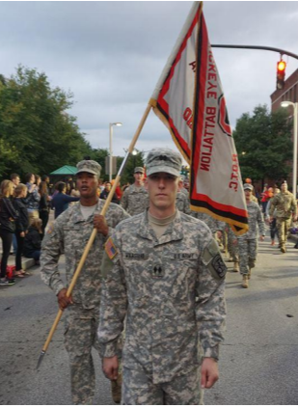
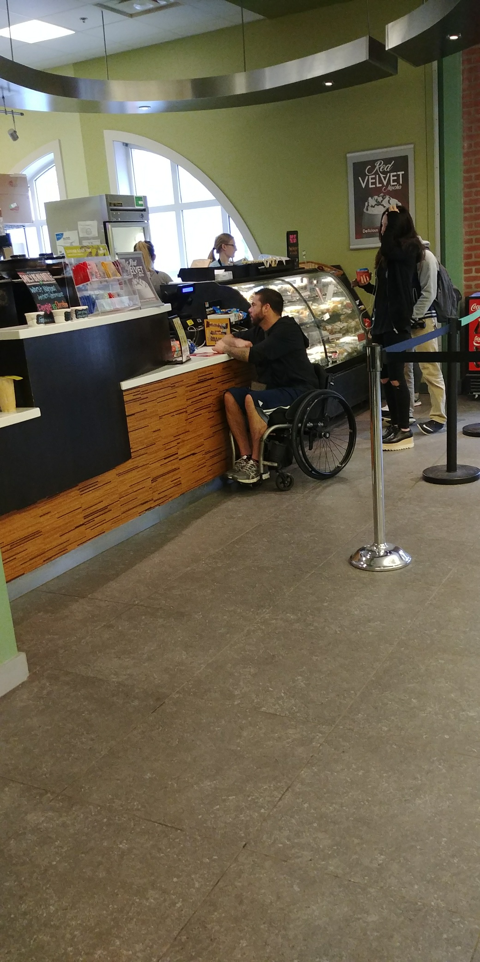
Who are our users?
Notes:
[Library as place - broadening the definition of diversity/inclusion]
I want us to consider our library community and reflect on who are our users, who uses our collections, our spaces, our services. What does diversity look like among our users?
Diversity is a 27-year-old marine with a traumatic brain injury explaining to their librarian the limitations they may encounter in the classroom.
Diversity is an undergraduate student maneuvering through narrow ropes juggling his wallet and chips while reaching for a drink that was not designed with him in mind.
A Japanese international student misreading an active shooter text and a lock down in the library. That student would later ask to stay in the area studies suite because they did not want to go home to an empty apartment.

Slide 12
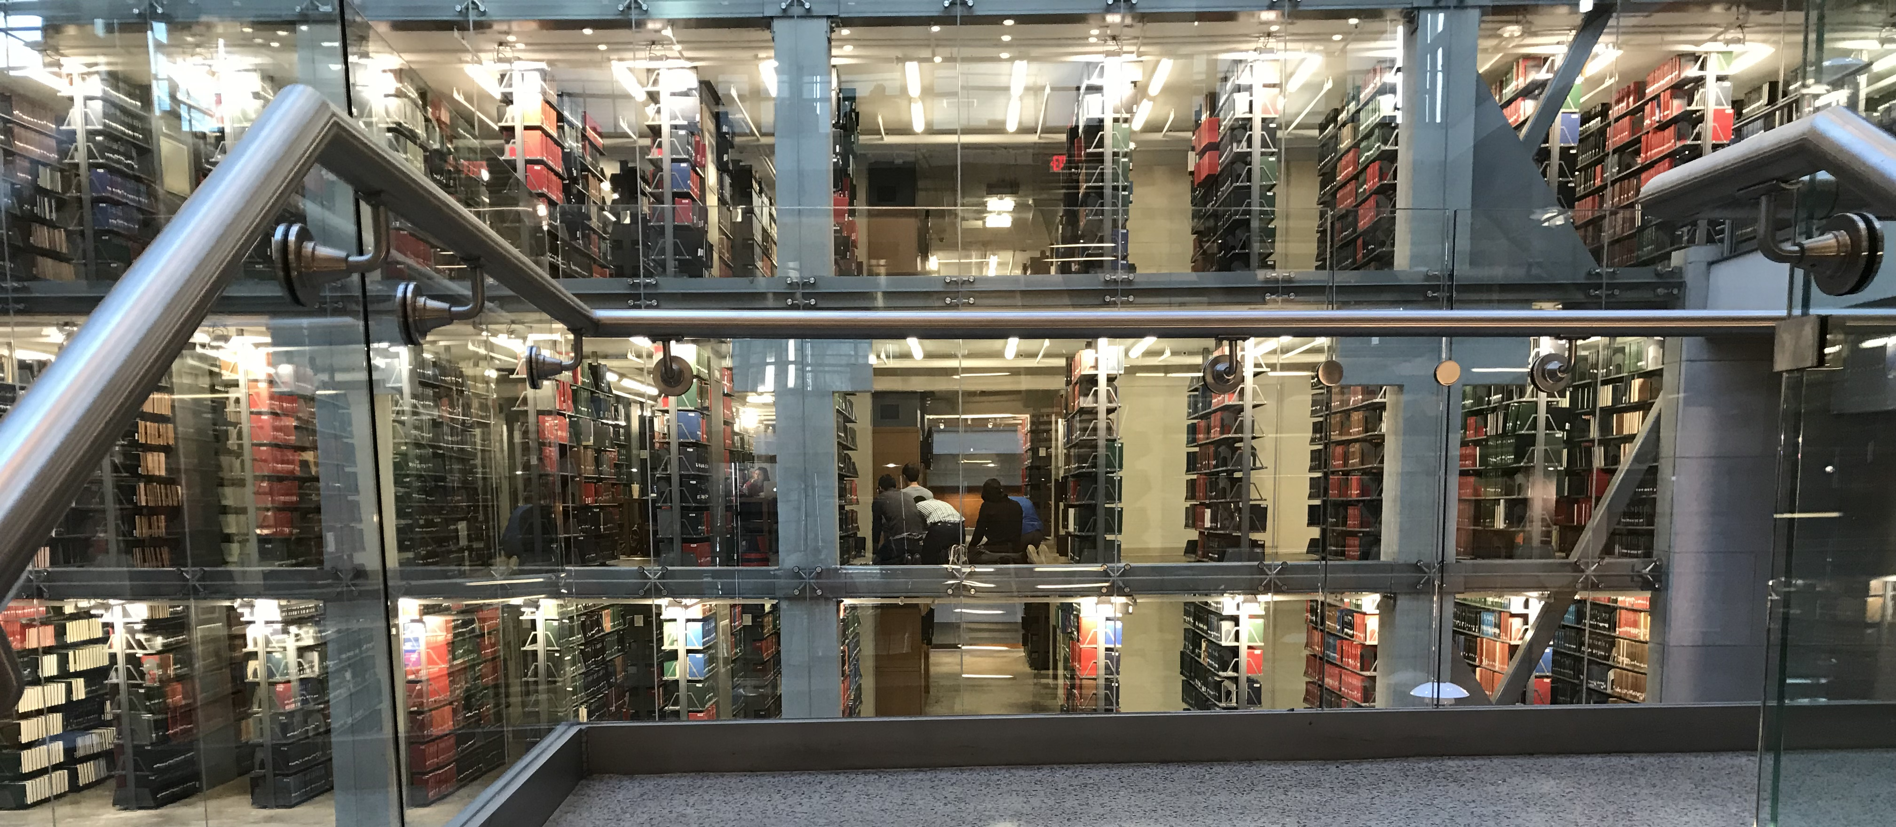
Who are our users?
Notes:
Diversity is a group of Muslim men praying openly in the stacks during finals week

Slide 13
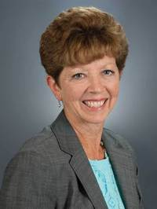
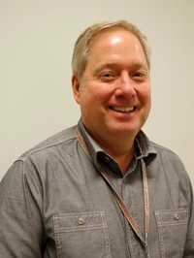
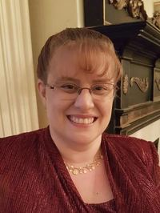
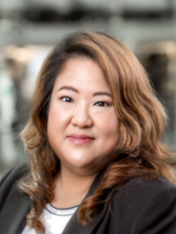
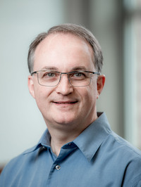
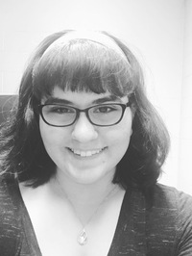
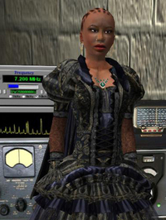
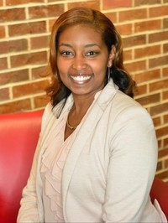
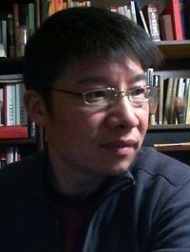
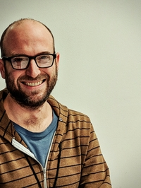
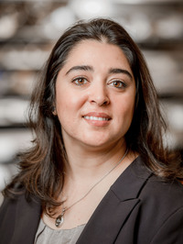
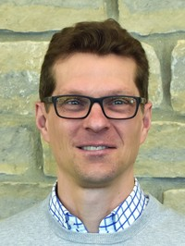
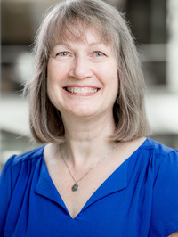
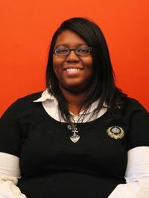
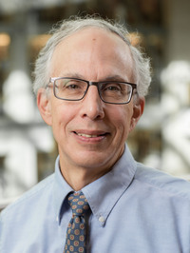
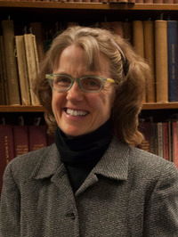
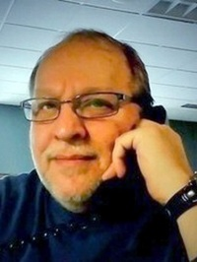
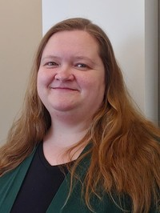
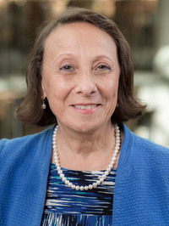
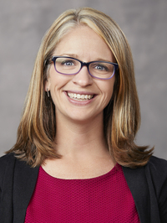
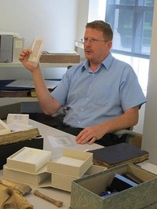
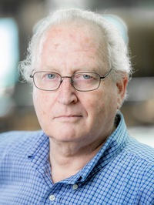
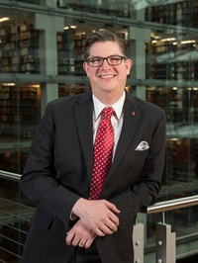
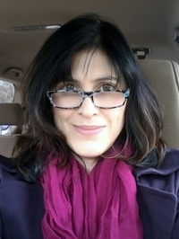
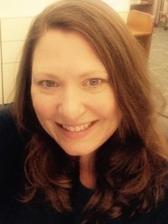
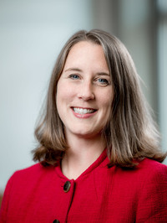
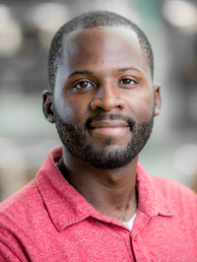
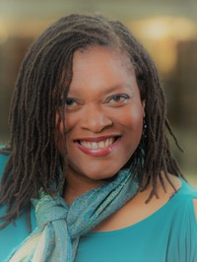
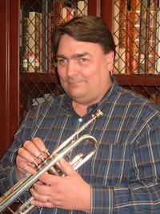
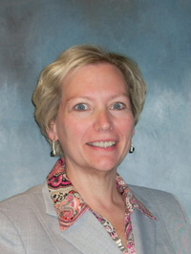
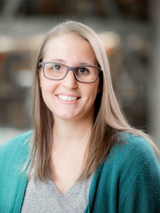
Who are our Colleagues?
Notes:
Now I want you to think about who are our co-workers; and this is just a few of them. Who are the leaders (formally and informally) that thrive in our organizations. Who is successful in this organization?

Slide 14
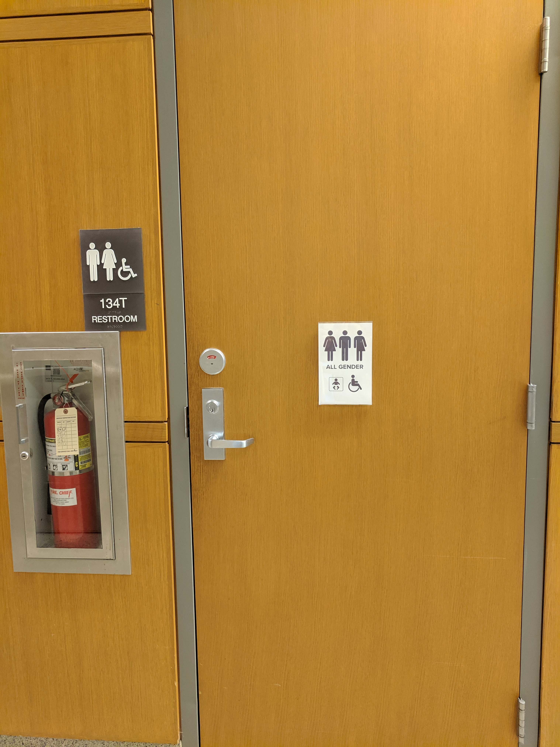
Notes:
[2 examples of EDI challenges in Ohio and on-campus]
Progress towards inclusion and equity means that we established all gender bathrooms.
And now our trans and genderqueer colleagues and patrons no longer have to go to the 11th floor to access all-gender restrooms.
But we still have work to do as the signage has not been updated, nor is this truly handicap-accessible.

Slide 15
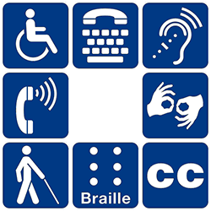
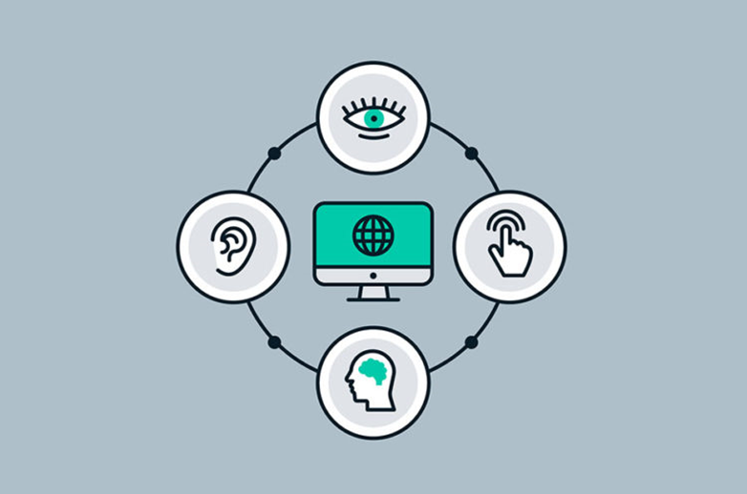
Notes:
[2 examples of EDI challenges in Ohio and on-campus]
How successful are we for being inclusive of these communities?

Slide 16
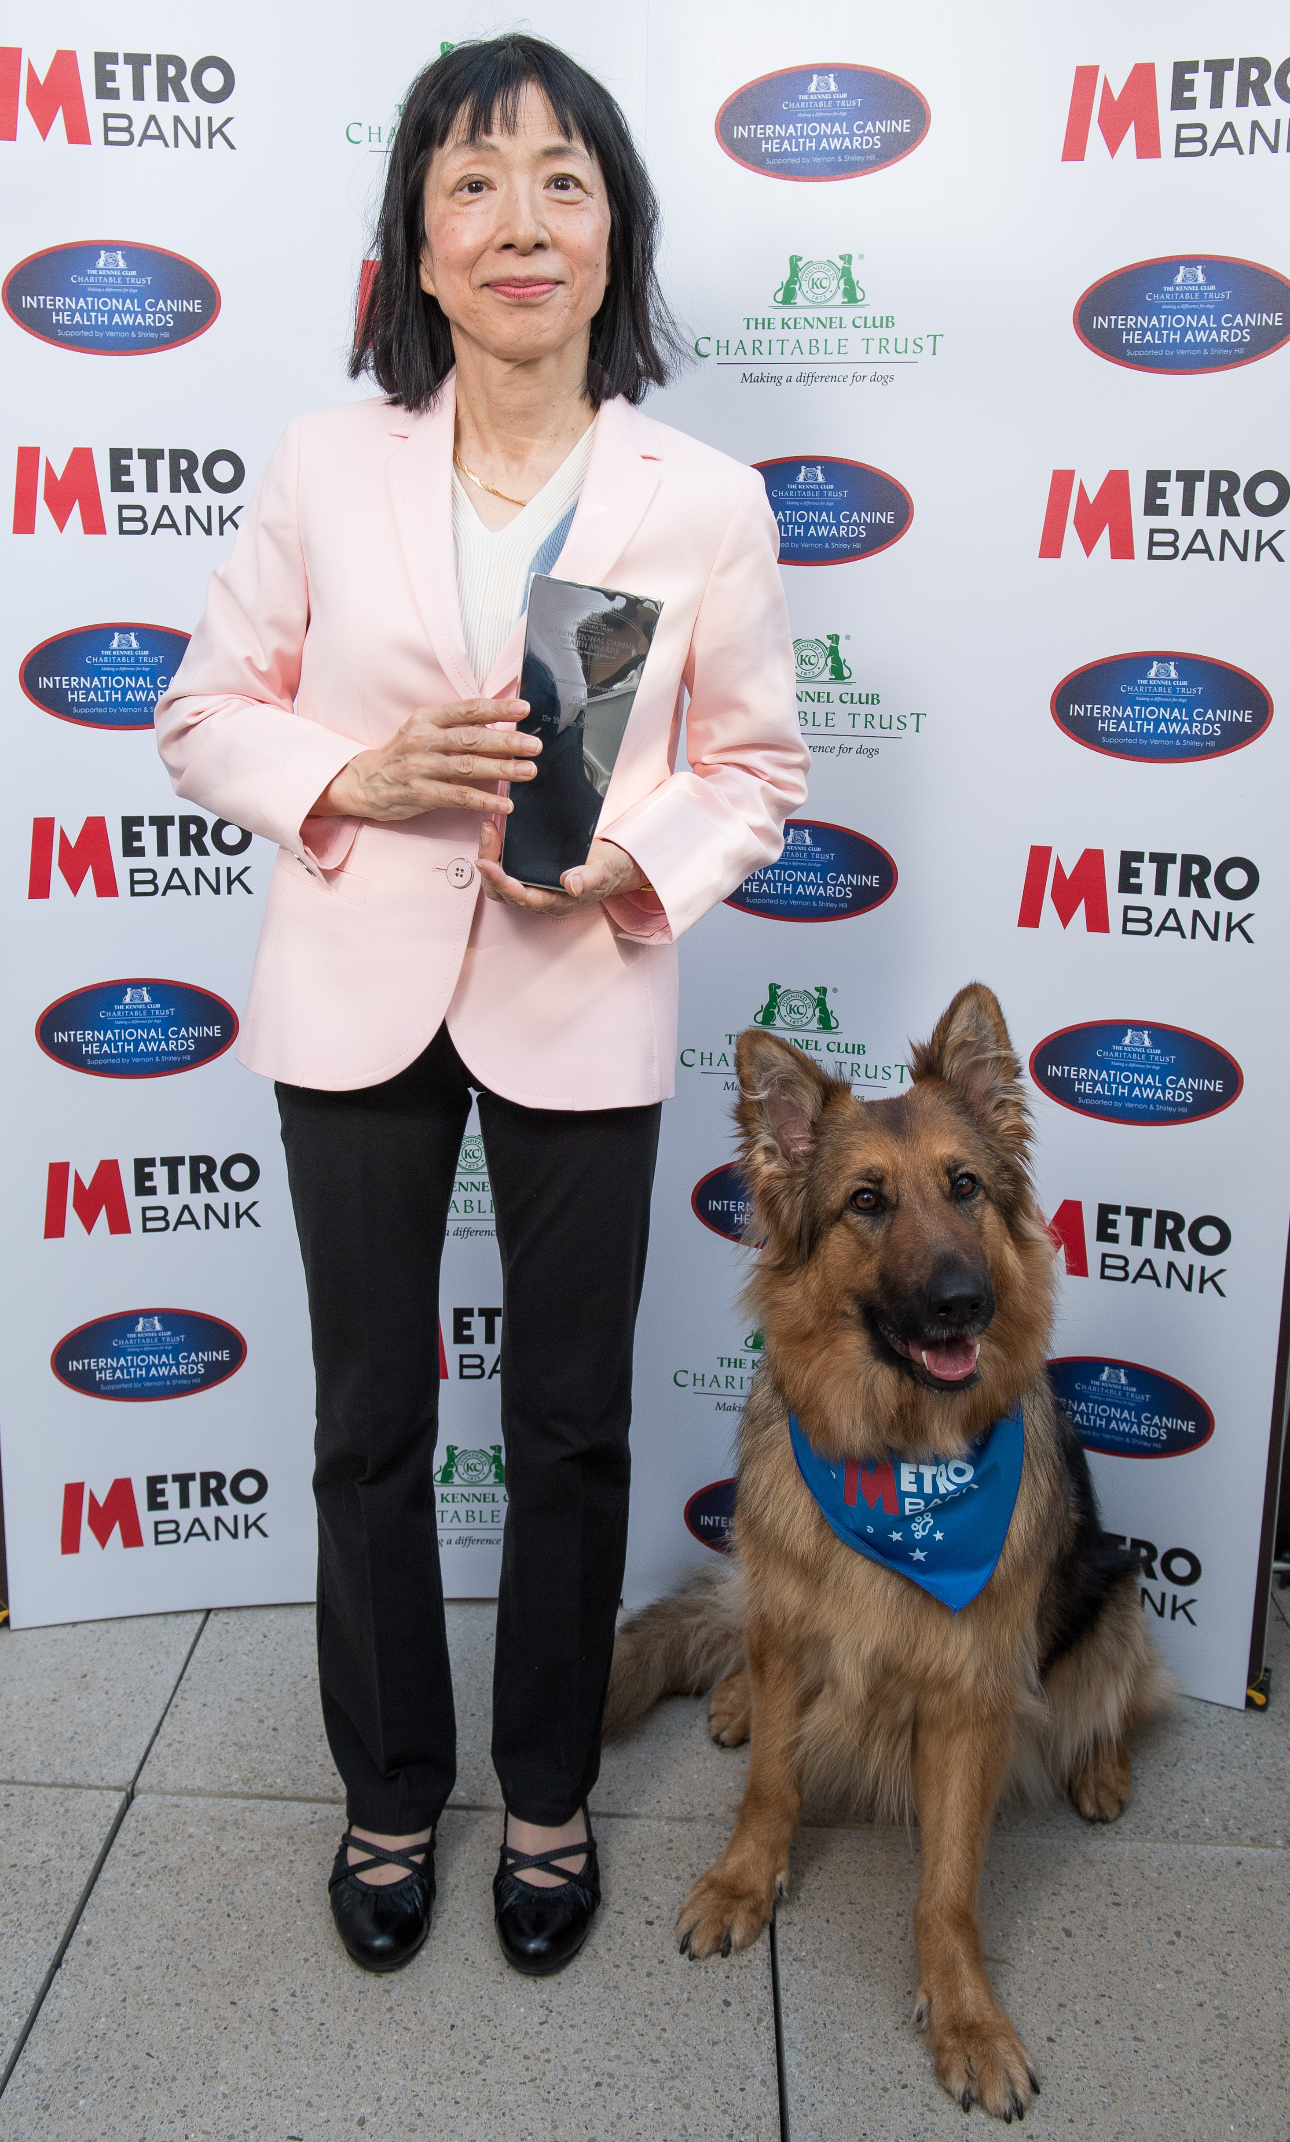
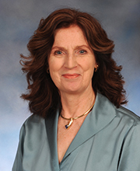
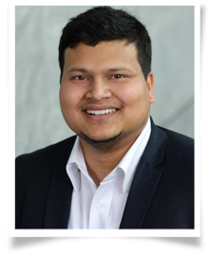
Who are our faculty?
2018 International Prize in Canine Health
2018 Innovator of the Year @ OSU
Yasuko Rikihisa
University Distinguished Professor, College of Veterinary Medicine
Katrina Cornish, PhD
Professor
Ohio Research Scholar/Endowed Chair, Bioemergent Materials
Department of Horticulture and Crop Science
College of Food, Agricultural, and Environmental Sciences
2019 President’s Postdoctoral Scholar
Wasiur R. Khuda Bukhsh
Wasiur holds a bachelor’s degree in statistics from the University of Calcutta, a master’s degree in statistics from the Indian Statistical Institute and a PhD from the Technische Universitat Darmstadt. H
Notes:
[University-International aspect of the people that work at OSU]

Slide 17
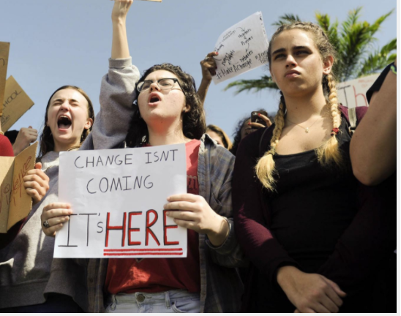
Credit: Courtesy of TNS, 2018
Notes:
[Conclusion Part 3 and Transition]
The question is not preparing for diversity, but rather diversity is here…..and how are we building capacity for our organization to thrive.
[Why do we care…action/motivator]
Unlike other eras, we are living in a time where we can design or redesign our systems and institutions to be more inclusive and equitable. Systems that may have previously been design to ignore, exclude or at worse oppress, can now be upgraded be inclusive of all people that work and serve them. We have immense power, like never before to do this, but to get started we have to first get on the same page, we first have to start with our definitions regarding equity diversity and inclusion.

Slide 18
PERCEPTION AND DEFINITIONS FOR
EQUITY
DIVERSITY
INCLUSON
SOCIAL JUSTICE
Notes:
Part 4: EDI Definitions-
We each come to the table with our own definitions for these words. What they mean to us personally and in turn subjective definitions that may influence our professionally behavior and contributions to EDI work.

Slide 19
PERCEPTION AND DEFINITIONS FOR
EQUITY
DIVERSITY
INCLUSON
SOCIAL JUSTICE
Notes:
[Uncording language in order to develop a collective strategy]
Diversity can mean many things. The definition itself is a form of diversity.
Diversity can refer to a demographic variable (such as race, religion, gender, nationality, sexual orientation, age, education and skills). Diversity can refer to visible or invisible individual characteristics. In the context of EDI, diversity refers to accounting for the differences that may exist between people and among group of people, and placing a positive value on those difference.
Part of what will help us move forward with a strategic direction of EDI goals is to define what diversity is going to mean for us (the organization).
Does it mean hiring individuals that are minorities or specifically individuals from underprivileged background*, serving international students, inclusion of staff personnel in library decision making?
In essence, what does diversity explicitly mean for this organization? A collective definition may assist to inform a strategic direction for our organization and help prioritize actionable steps towards EDI goals.
https://www.unionlearn.org.uk/equality-and-diversity-whats-difference
As you consider your own definitions, I want you to ask yourself if these definitions are improving our cultural and international competencies and advancing understanding.

Slide 20
From Variety…
Notes:
[Diversity vs. Variety]
I also want to make a distinction between diversity and variety.
Variety is what Dr. Peter Hershock (2012) refers to as superficial variation-”a function of simple co-existence that implies nothing about the quality of relationships or interaction among whatever happens to be present together”. Like a zoo, animals that are lumped together and share the same space, but that’s it.
Valuing Diversity: Buddhist Reflection on Realizing a More Equitable Global Future. By Peter D. Hershock. Albany: State University of New York Press, 2012.

Slide 21
From Variety…
Notes:
[Pitfalls of Diversity-Assimilation]
At its worse, diversity, without inclusion or equity, can be the arbitrary and limited inclusion of anyone, especially those that look “different” with the expectation that these individuals will thrive in the same environment and will think and be like the majority group.

Slide 22
…To Diversity
A la diversitat
多元化
မတူကွဲပြားခြင်းမှ
Al Diverseco
تنوع ته
Naar diversiteit
إلى التنوع
Go hÉagsúlacht
Към разнообразието
I Amrywiaeth
Notes:
[Pitfalls of Diversity-Charity]
But diversity is not charity, it is a reciprocal investment that benefits the individual and the team.
It is an interdependent relationship in which distinct members bring distinct perspectives and skills to the organization and in-turn all the organizational members learn and grow from working with a diverse population.
Using the X-Men Team as an example (provide some context if necessary)
Catalan, Burmese, Bulgarian, Chinese, Esperanto, Pashto, Irish, welsh, Arabic, dutch
It is not just the most powerful character that fight the bad guys. Instead the leaders of the group actively include and leverage the unique powers of each member to overcome insurmountable obstacles. The collective participation of all its members, regardless of their position, abilities, limitations and at-times weaknesses, contributes to the collective strength of the team.
The goal is to develop an ecosystem, an organization, that is enhanced by diversity. Along with it, we create a system that provides the resources for difference/diversity to thrive in a collective community.

Slide 23
Inclusion
Notes:
[Accommodating different strengths and abilities]
As a public serving institution, our cultural intelligence and competency is very important, as it is often our task to design the conditions and the manners in which our users and colleagues will work and perform.

Slide 24
Notes:
[Error of lumping all minorities together]
As considerate colleagues, we also need to understand that inclusion is not a one size fits all approach; different people need different tools to gain access and have equal opportunity.

Slide 25
Social Justice
Notes:
[Defining social justice]
Those working actively in EDI will seek to address systemic barriers of exclusion.
Hence our new strategic vision towards social justice is an attempt to build tools to approach discrimination and unfavorable conditions in systems. To get to the root of the problem instead of treating the symptom.

Slide 26
Notes:
[Cultural intelligence as an individual and internal process]
When thinking about cultural intelligence for our organizations, it is important to consider that cultural competency only works if we all have it. This is not what black and brown people do in a corner. My cultural competency or presence in this organization, does little to nothing for all users in the organization at all times.

Slide 27
Notes:
[Broadening the narrative of cultural competency/intelligence and the idea that this work is on-going.]
This is an artwork titled “Jungle” by La Selva Carnovsky. I use this art piece as a metaphor for describing identity and culture.

Slide 28
Notes:
Depending on our cultural lens we may see, perceive and experience the world in a particular way...

Slide 29
Notes:
..We all have blind spots, we all see and know different things about our world,

Slide 30
Notes:
...We do not see the world like others because we are bad or stupid people...We are limited to experience the world as an individual, limited by our experiences, our preferences, our education, and sometimes by how other perceive us.

Slide 31
Notes:
...EDI work and cultural competency is the work of seeking to see the world like this, instead of like...

Slide 32
Notes:
... like this….

Slide 33
Cultural Intelligence
The knowledge to understand cross-cultural phenomena.
The mindfulness to observe and interpret particular situations
The skills required to adapt behavior to act appropriately in a range of situations.
Notes:
[Cultural Intelligence- Is not an identity or innate quality]
So what is Cultural Intelligence? Cultural Intelligence is:
The knowledge to understand cross-cultural phenomena.
The mindfulness to observe and interpret particular situations
The skills required to adapt behavior to act appropriately in a range of situations.

Slide 34
What is Cultural Intelligence?
“Our North is the South.”América Invertida (Inverted America), Joaquín Torres-García, The School of the South
Notes:
Unlike IQ and ethnic/racial identity, cultural competency/intelligence is something that can be learned and mastered.
Contrary to popular belief, cultural competency/intelligence does not require you to learn and be proficient in all the languages and cultures of the world, frankly who has time for that.

Slide 35
Cultural Awareness
Institutional Collectivism
In-Group Collectivism
Power Distance
Uncertainty Avoidance
Gender Egalitarianism
Assertiveness
Humane Orientation
Future Orientation
Performance Orientation
Notes:
The best way to get started it actually by learning about one’s own culture, what is it? when is it a strength? when is it a weakness? How do I like to learn and receive information? What are my expectations of the world around me? Do I communicate or extend these assumptions to my colleagues? Do I assume people around me have the same interpretations of our shared environment?
GLOBE (Global Leadership & Organizational Behavior Effectiveness) seeThomas & Inkson’s Cultural Intelligence, 3rd edition © 2017, pages 33-39.

Slide 36
EDI Work as Action
Notes:
[EDI work as action and EDI work in relation to our users]
The next thing to remember is that EDI is not the work of words, it’s the work of action. In fact, its best to come to this line of work with an open mind and not strong opinions.

Slide 37
The World in Change…
Notes:
Why do we do this work? Well we do this work because the world that we know and grew up hearing about it changing. Before it used to be the west dominated in resources and wealth.

Slide 38
The World in Change…
Notes:
Today it’s about 50/50

Slide 39
The World in Change…
Notes:
By 2035 73% of the rich consumers are going to live outside of North American and Europe.
These predictions were developed by the research of Dr. Hans Rosling and his son. They looked at International Monetary Fund forecast for GDP growth per capita for the next 20 years, assuming the same level of inequality. Based on these models, Dr. Rosling research predicts that by 2035 the west will be outnumbered in the rich consumer markets.
It is in our benefit that we prepare ourselves and our students to be culturally competent

Slide 40
Notes:
[EDI work as a proficiency that is learned and modeled]
For many student's college will be the first encounter to a diverse environment. Here they will start to formulate their ideas about the world.

Slide 41
Notes:
And some will venture to see it. Here you can see the top study abroad destination of our students?

Slide 42
OSU Demographics
Notes:
[OSU and LIS Demographics]
Let’s pause for a moment and recap some of the key demographic figures about the LIS profession and our university campus. Where are our students coming from?

Slide 43
LIS Demographic
RACE or Family Origin: WHITE
Degree: MLS
*Hispanic/Latino 3.9% 4.7%
*In 2014 2.8% disclosed a disability; 2.91% in 2017
Notes:
Let’s compare these demographics to those of the LIS profession

Slide 44
OSU Demographics
Notes:
[OSU and LIS Demographics]
Let’s pause for a moment and recap some of the key demographic figures about the LIS profession and our university campus. Where are our students coming from?

Slide 45
LIS Demographic
GENDER: FEMALE
AGE: 55-64
Notes:
Demographic slide-OSU demographics and LIS demographics.
What do these statistics tells us? They do not say the organization is bad because majority demographics dominate. However, it does tell us that as an organization and profession, our strengths/perceptions may be dominated by a majority culture view.
[Conclusion Part 4 and transition to workshop]
If it is important for us to be inclusive, then we may need to reflect on systems and active practices that will help all voices to come through in order account for their needs, ideas and services of users that use our services and colleagues that work here.

Slide 46
“We have come to this hallowed spot to remind America of the fierce urgency of now. This is no time to engage in the luxury of cooling off or
to take the tran­quilizing drug of gradualism. Now is the time to make real the promises of democracy.”
- Martin Luther King, Jr. (1963)
(Stephen F. Somerstein/Getty Images)
Notes:
(Read quote) “We have come to this hallowed spot to remind America of the fierce urgency of now. This is no time to engage in the luxury of cooling off or to take the tranquilizing drug of gradualism. Now is the time to make real the promises of democracy.”- Martin Luther King, Jr. (1963).

Slide 47
Tá tús maith curtha leis an tús
__________
Well begun is half done
Notes:
Ta Tus Ma cur-ha lish on tus
Let’s get started

Slide 48
Brainstorming Vision
1. What does it mean to you to have an inclusive, equitable and divers organization?
2. What are ways you can personally advance equity, inclusion and diversity in your department?
3a. What have been OSUL’s biggest challenges in advancing EDI efforts?
3b. What are the Libraries’ gaps in resources for supporting EDI?
4. What EDI-related programs, activities or training have been successful, and have made a positive impact towards EDI organizational goals?

Slide 49
Questions
Dan Noonan
noonan.37@osu.edu

