Slide 1

EDI + Social Justice@ OSUL
designing an EDI strategy for OSUL
University Libraries
The Ohio State University
Stephen Cassidy & Amanda Folk

Slide 2
OBJECTIVE
Library work with EDI in mind

Slide 3
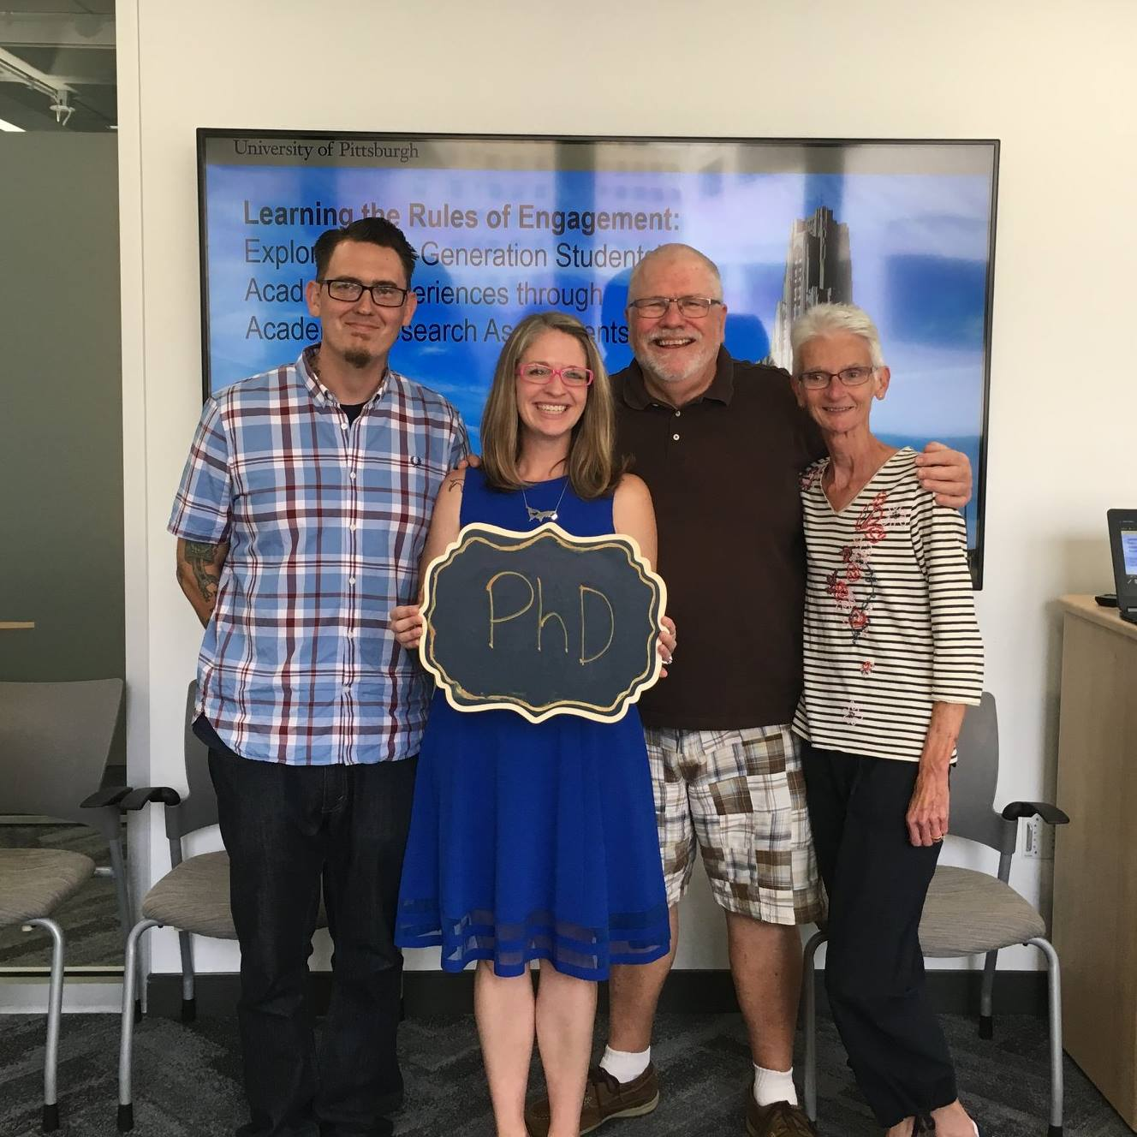
Amanda Folk

Slide 4
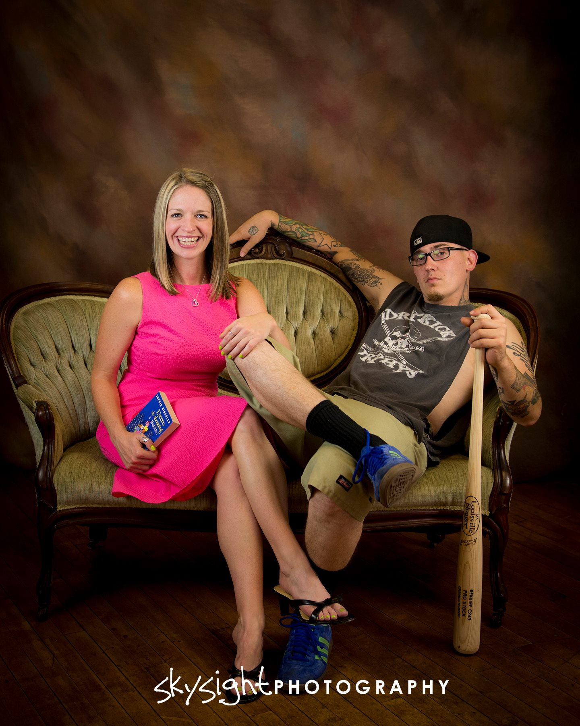

Slide 5
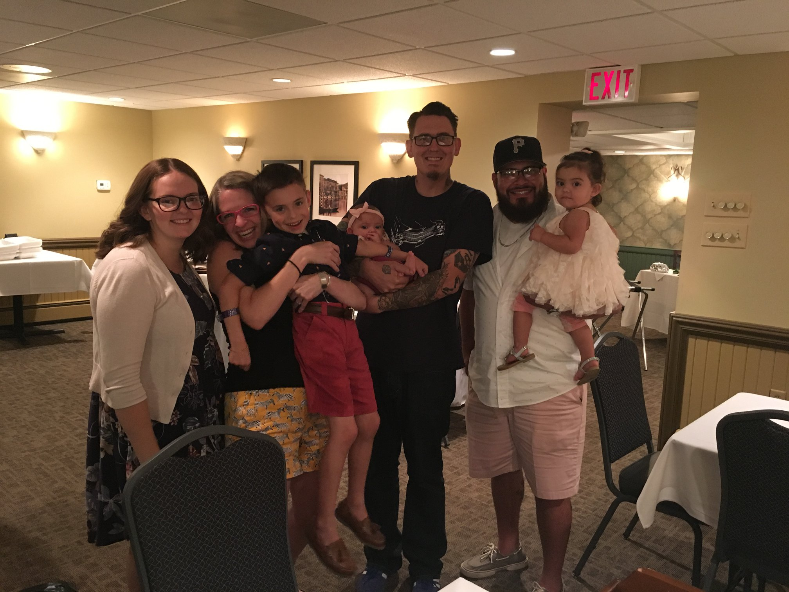

Slide 6
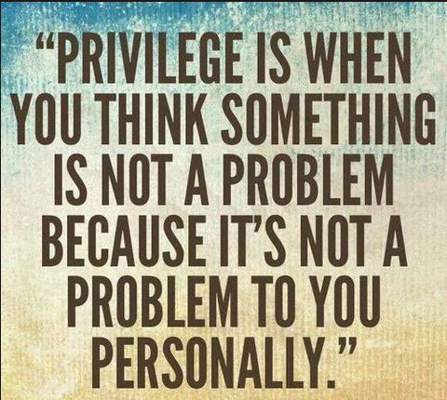
Notes:
.

Slide 7
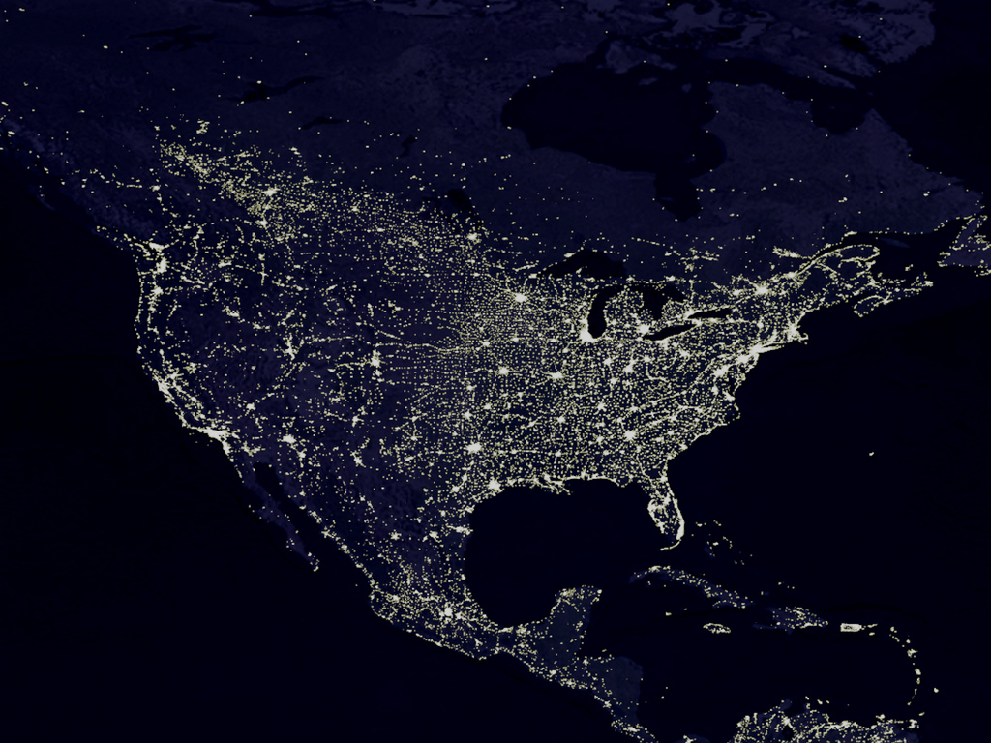
Where I’m from
(it’s complicated)
Image courtesy of vectorstock.com

Slide 8
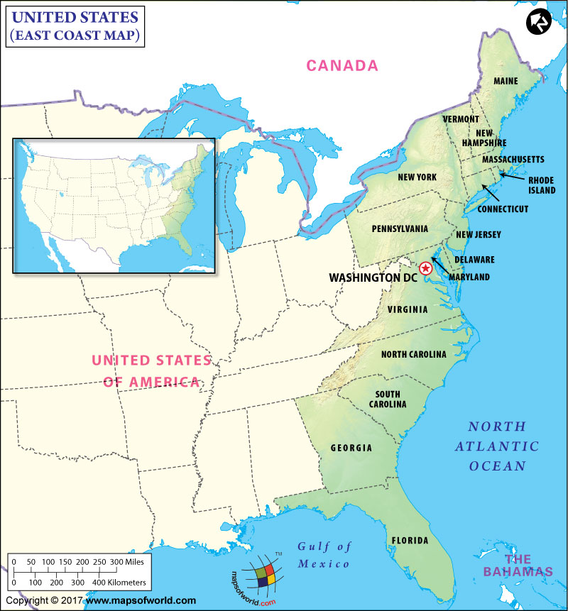
1964: NJ
1966: NC
1971: GA
Notes:
[

Slide 9
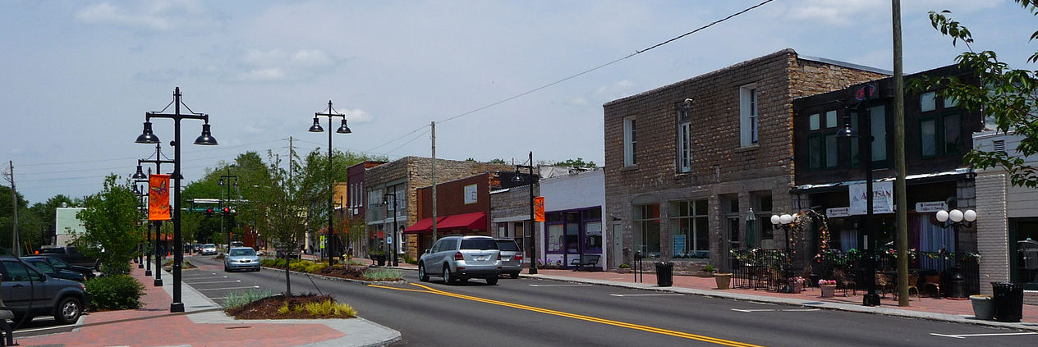

Slide 10
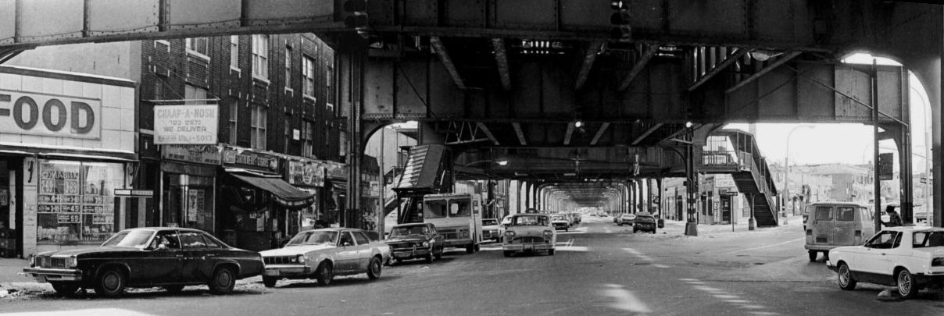

Slide 11
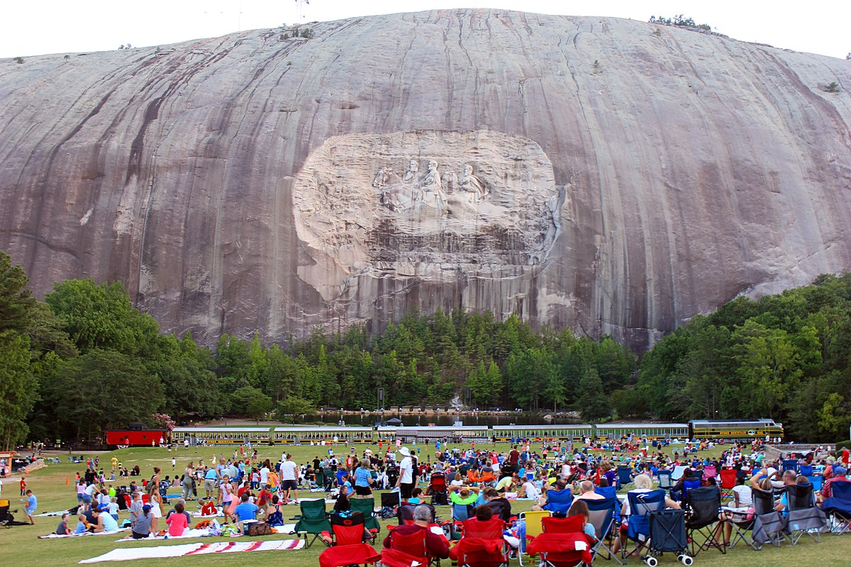

Slide 12
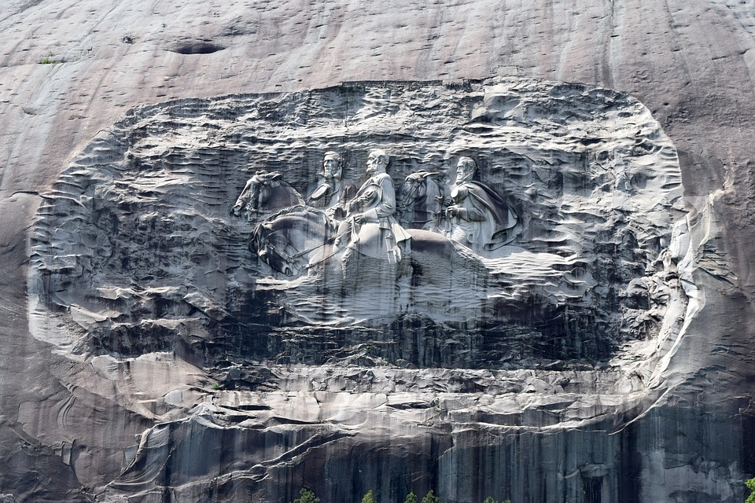

Slide 13
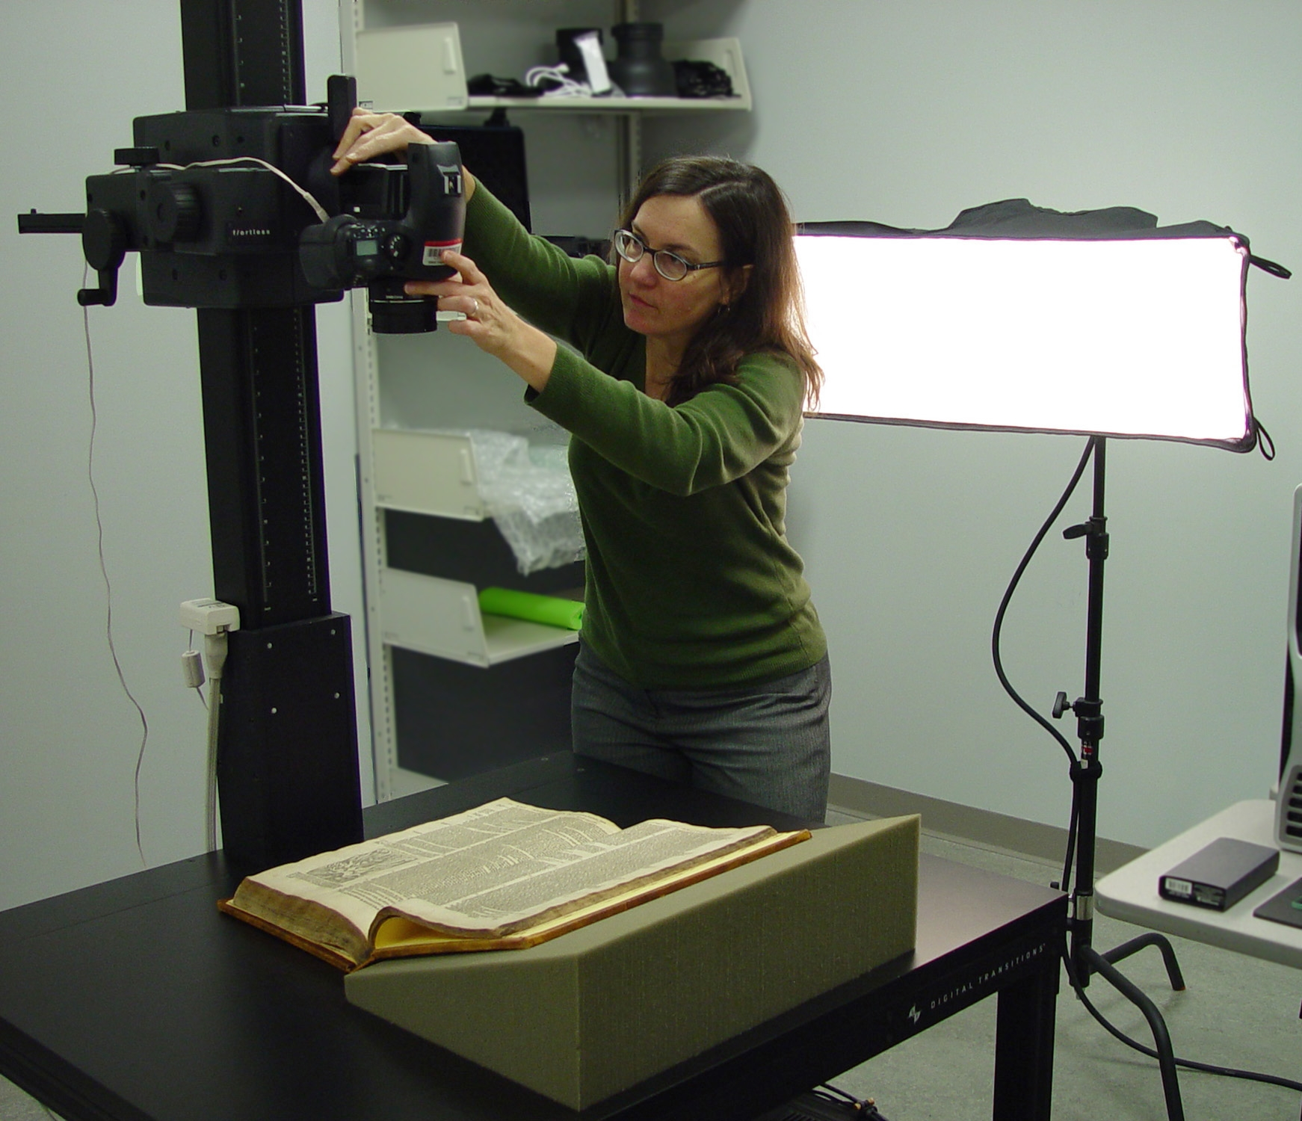
EDI and Social Justice at OSUL
My role at OSUL: Digital Imaging of cultural heritage items from the University Libraries’ collections

Slide 14
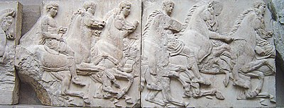
EDI and Social Justice at OSUL
Cultural heritage:
Whose heritage
and
whose description?

Slide 15

Digital projects
Popol Wuj
the book of the people

Slide 16
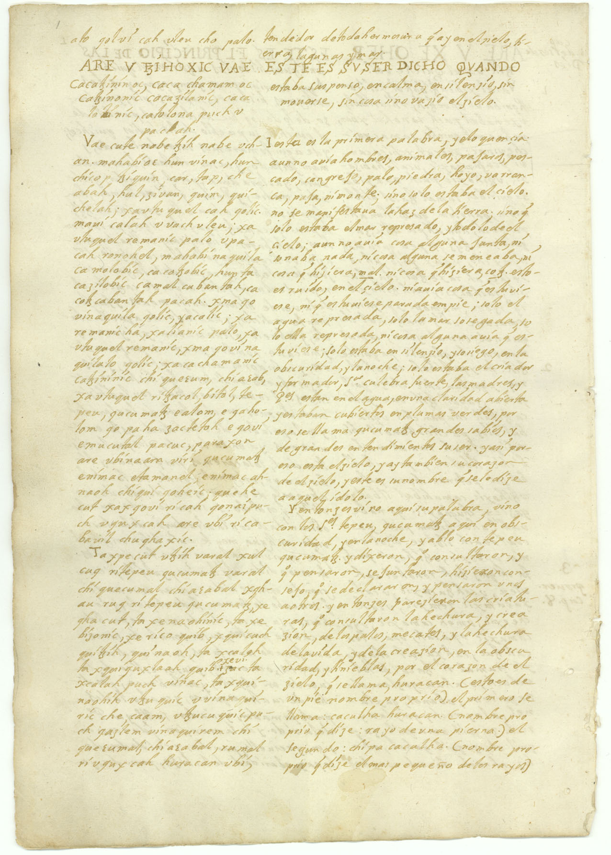
Digital projects
Popol Wuj
the book of the people
Notes:
Later, the transcription was stolen, and turned up in a private collection in Europe. Eventually it was sold, and the buyer donated the manuscript to the Newberry Library in Chicago, where it was digitized. OSU Libraries obtained copies of the digital pages, and I worked with the Department of Spanish and Portuguese to build a website to host the manuscript.

Slide 17
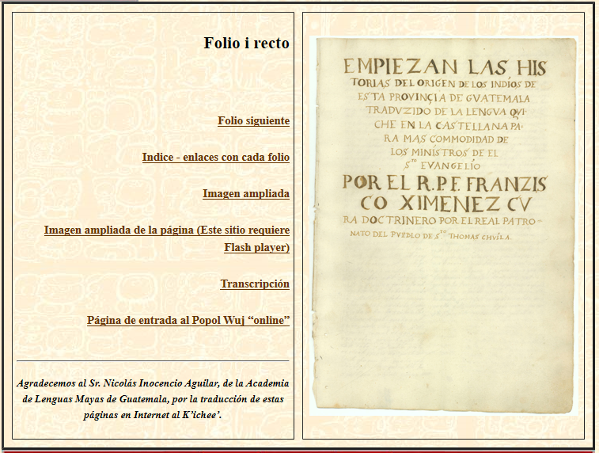
Digital projects
Popol Wuj
(Spanish)

Slide 18
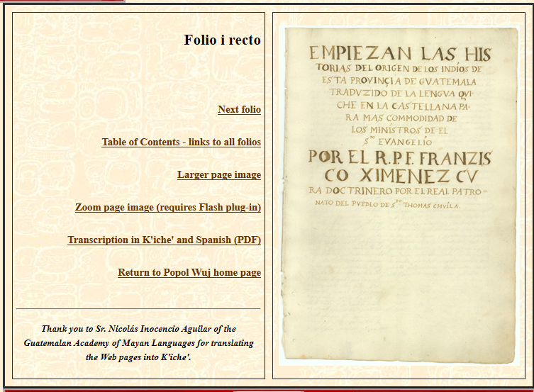
Digital projects
Popol Wuj
(English)

Slide 19
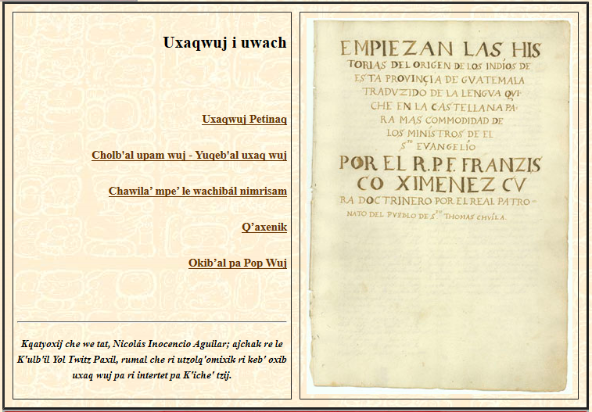
Digital projects
Popol Wuj
(K’iché)

Slide 20
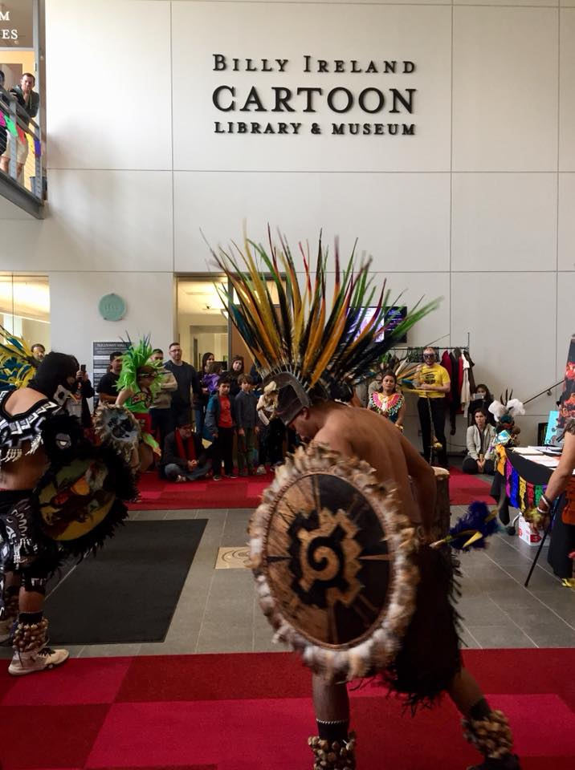
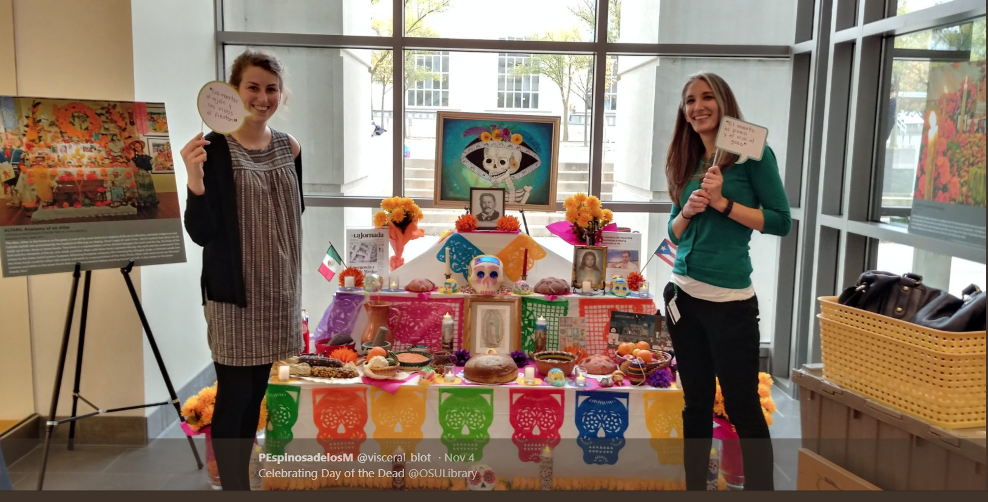

Slide 21
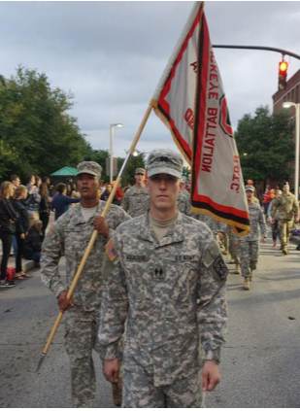
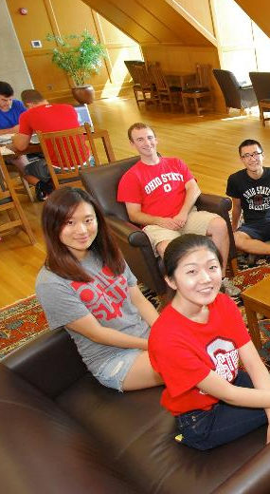
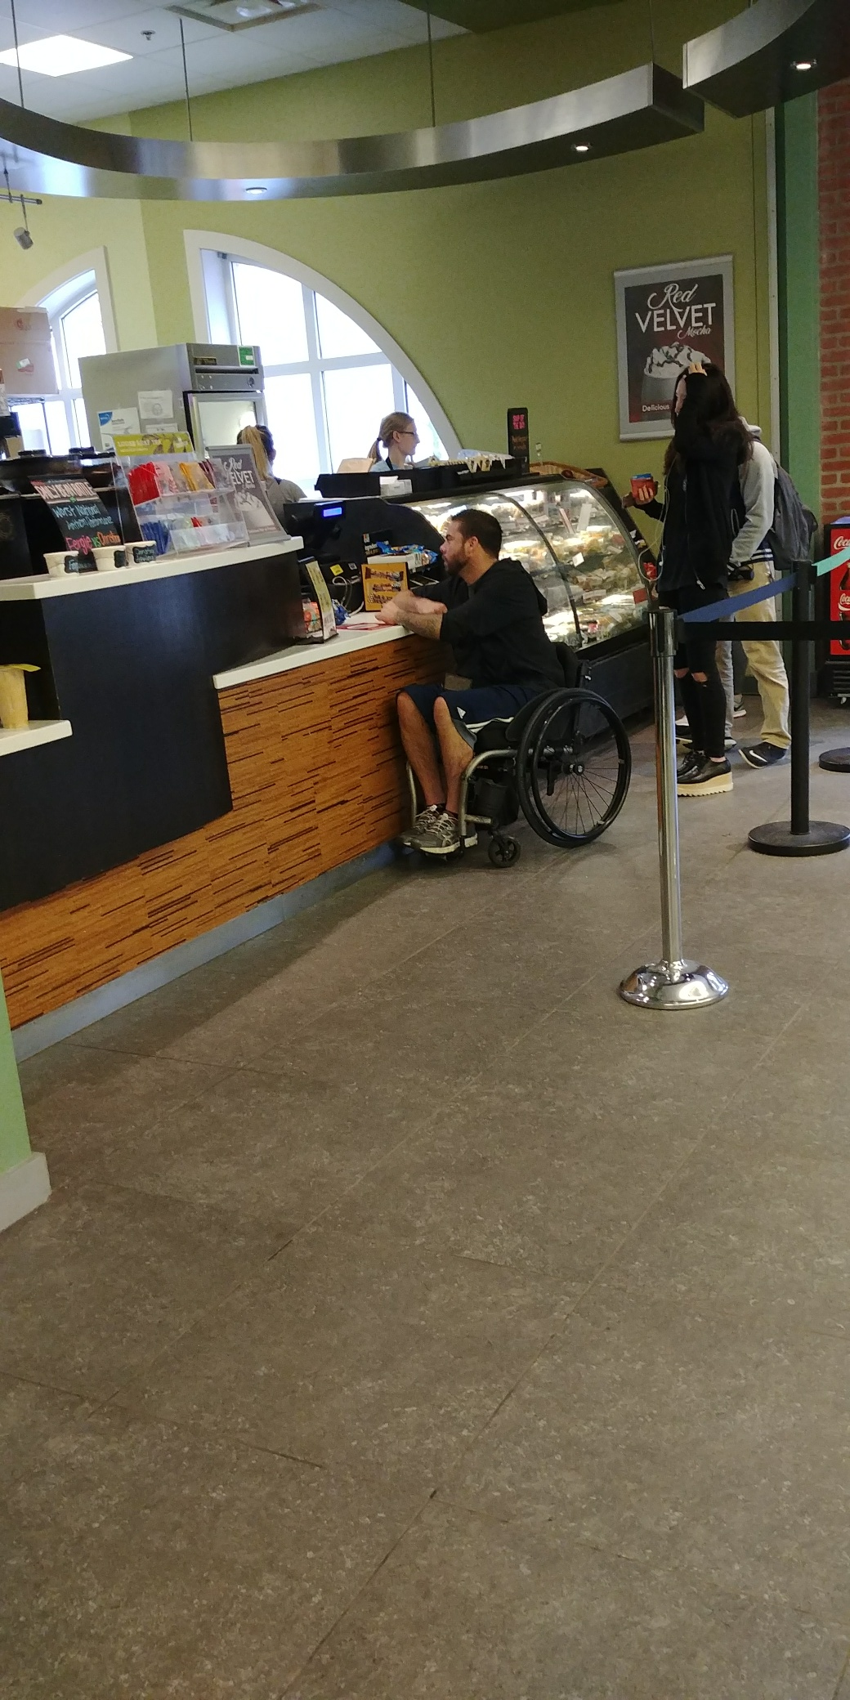
Who are our users?

Slide 22
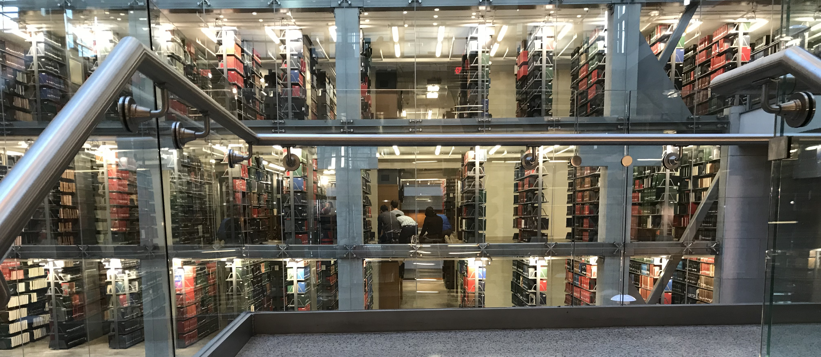

Slide 23
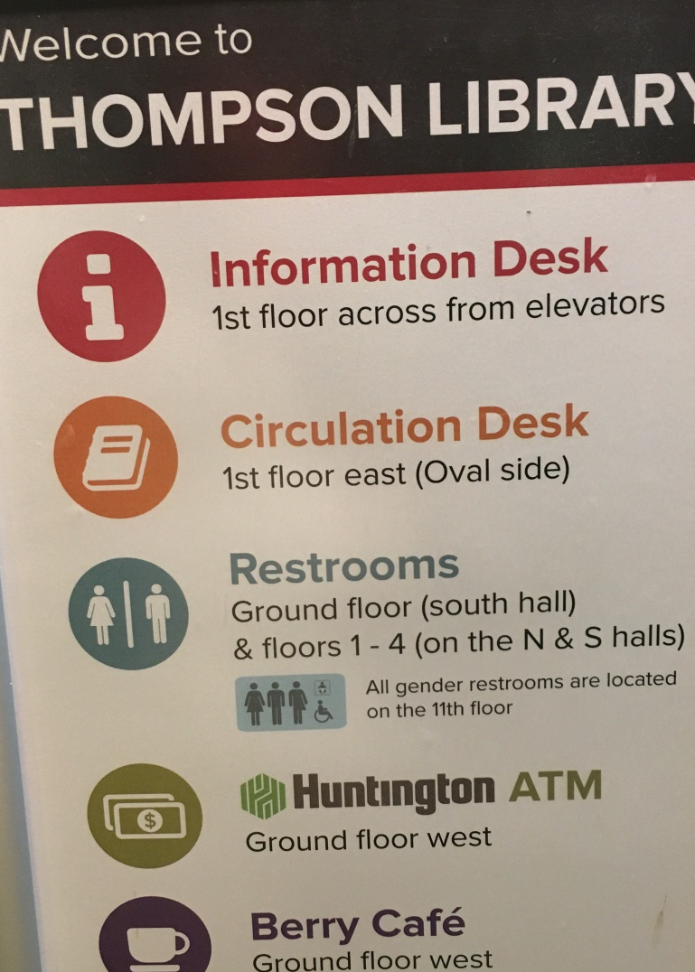

Slide 24


Slide 25
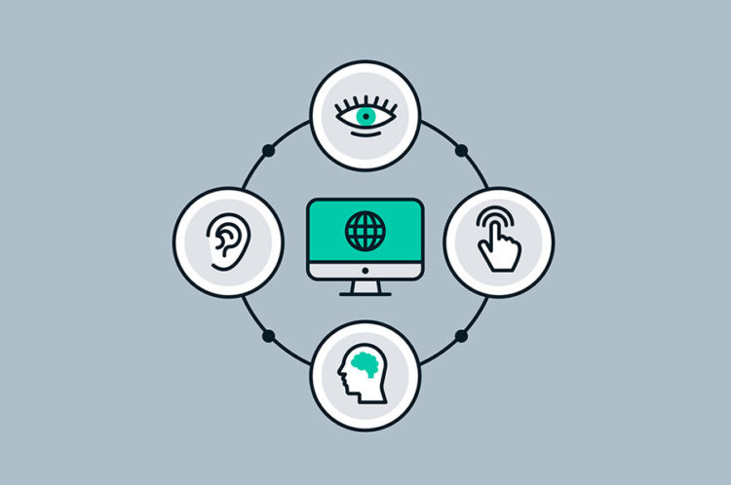

Slide 26
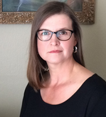
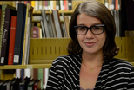
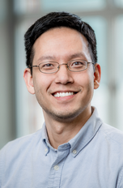
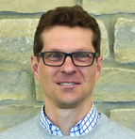
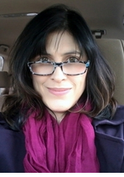
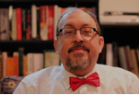
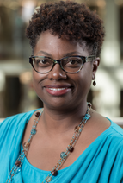
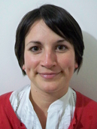
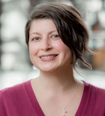
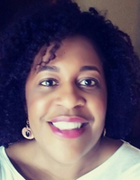
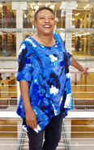
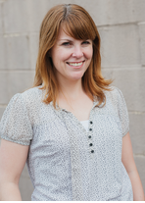
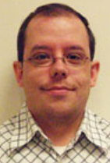
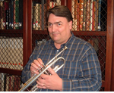
UNIVERSITY LIBRARIES

Slide 27
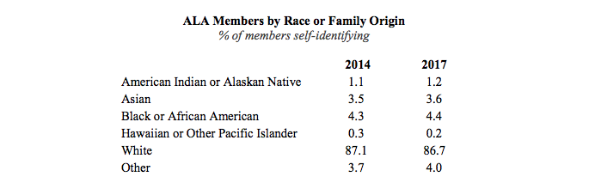
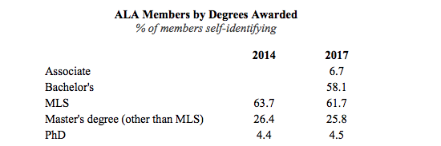
LIS Demographic
RACE or Family Origin: WHITE
Degree: MLS
*Hispanic/Latino 3.9% 4.7%
*In 2014 2.8% disclosed a disability; 2.91% in 2017

Slide 28
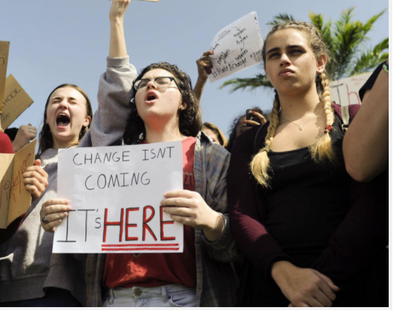
Credit: Courtesy of TNS, 2018

Slide 29
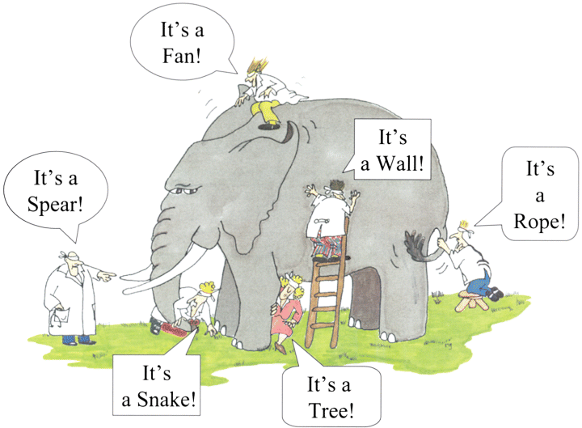
IDENTITY THE MAIN CONCEPT
PERCEPTION AND DEFINITIONS FOR
EQUITY
DIVERSITY
INCLUSION
SOCIAL JUSTICE

Slide 30
IDENTITY THE MAIN CONCEPT
PERCEPTION AND DEFINITIONS FOR
EQUITY
DIVERSITY
INCLUSION
SOCIAL JUSTICE

Slide 31
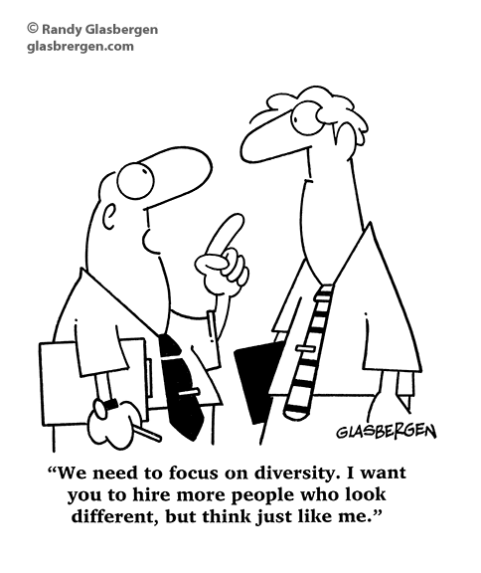
IDENTITY THE MAIN CONCEPT

Slide 32
IDENTITY THE MAIN CONCEPT
To Diversity

Slide 33
Inclusion

Slide 34
Notes:
AMY

Slide 35
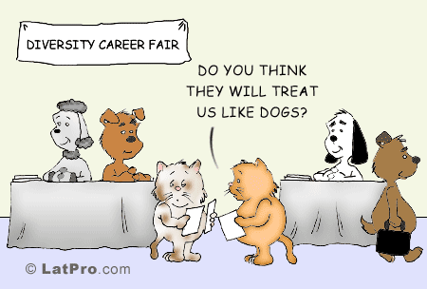
Inclusion

Slide 36
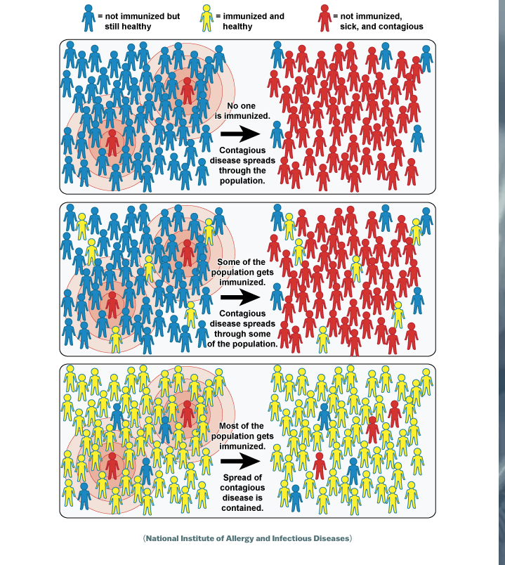

Slide 37
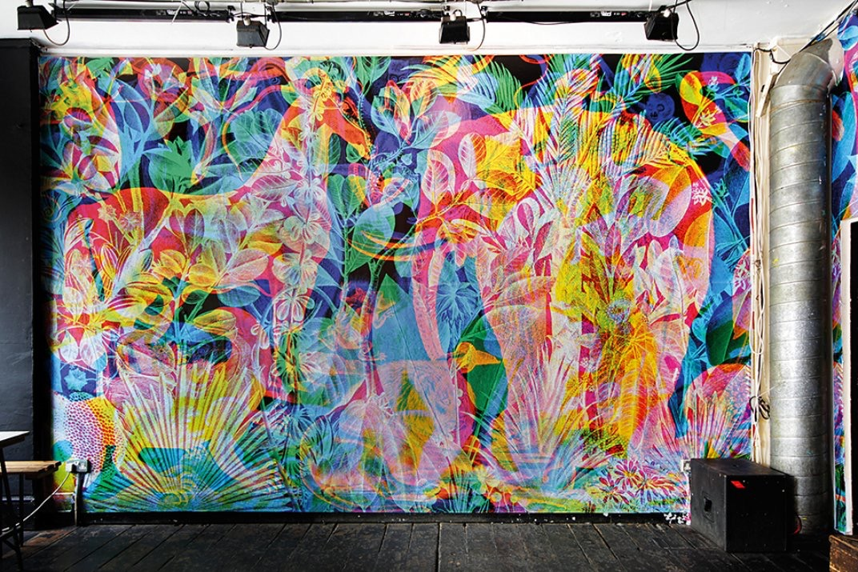

Slide 38
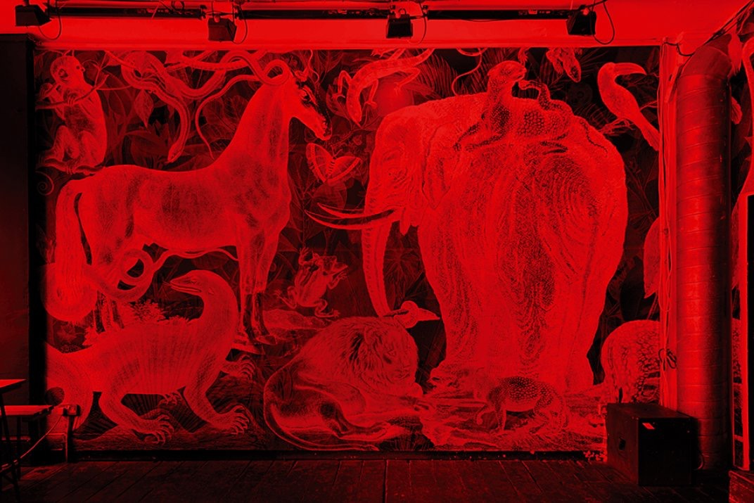

Slide 39
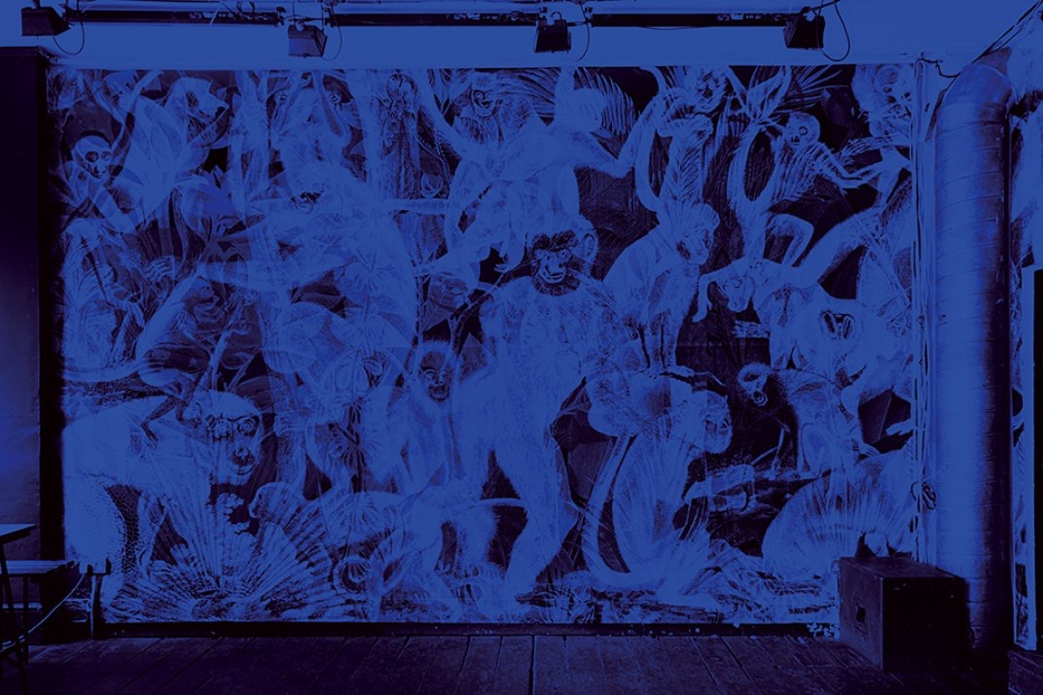

Slide 40
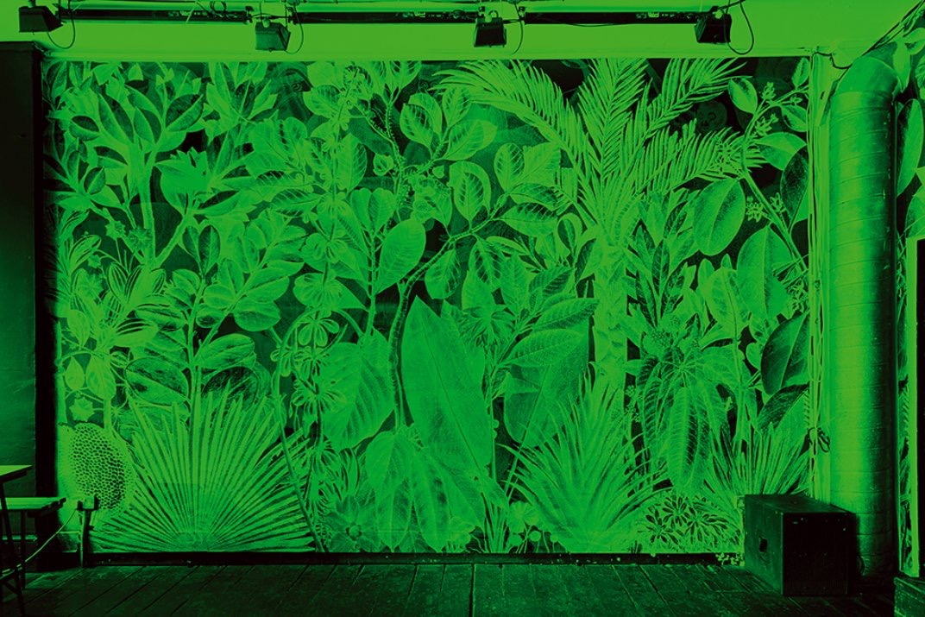

Slide 41
The knowledge to understand cross-cultural phenomena.
The mindfulness to observe and interpret particular situations
The skills required to adapt behavior to act appropriately in a range of situations.
Cultural Intelligence

Slide 42
Cultural Awareness

Slide 43
“We have come to this hallowed spot to remind America of the fierce urgency of now. This is no time to engage in the luxury of cooling off or to take the tran­quilizing drug of gradualism. Now is the time to make real the promises of democracy.”
- Martin Luther King, Jr. (1963)

Slide 44
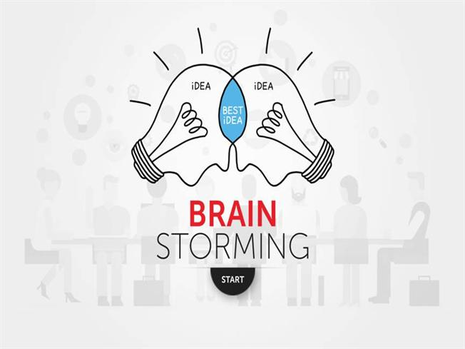

Slide 45
Workshop Agenda
Part 2: Workshop
V. Group brainstorming and capture discussion; select scribe
VI. Discussion round one
VII. Discussion round two: Unpack ideas and final capture as bullet points
VIII. Groups report out

Slide 46
Workshop Questions:
What does it mean to you to have an inclusive, equitable, and diverse organization?
What are ways you can personally advance equity, inclusion, and diversity in your department?
What have been OSUL’s biggest challenges in advancing EDI efforts? What are the library’s gaps in resources for supporting EDI?
What EDI-related programs, activities or training have been successful and have made a positive impact towards EDI organizational goals?

