Slide 1

EDI + Social Justice@ OSUL
designing an EDI strategy for OSUL
University Libraries
The Ohio State University
Stephen Cassidy & Sandra Enimil

Slide 2
OBJECTIVE
Library work with EDI in mind
Notes:
STEPHEN
I want to start our workshop by acknowledging that for many of us, the topics of today’s discussions are not easy.
We may feel that we cannot speak to these issues or conversely, we are the only ones that can speak to these issues because of our identity and affiliation with a minority or majority group.
In advance, we want to thank you for being here and participating in a candid discussion with your colleagues.

Slide 3
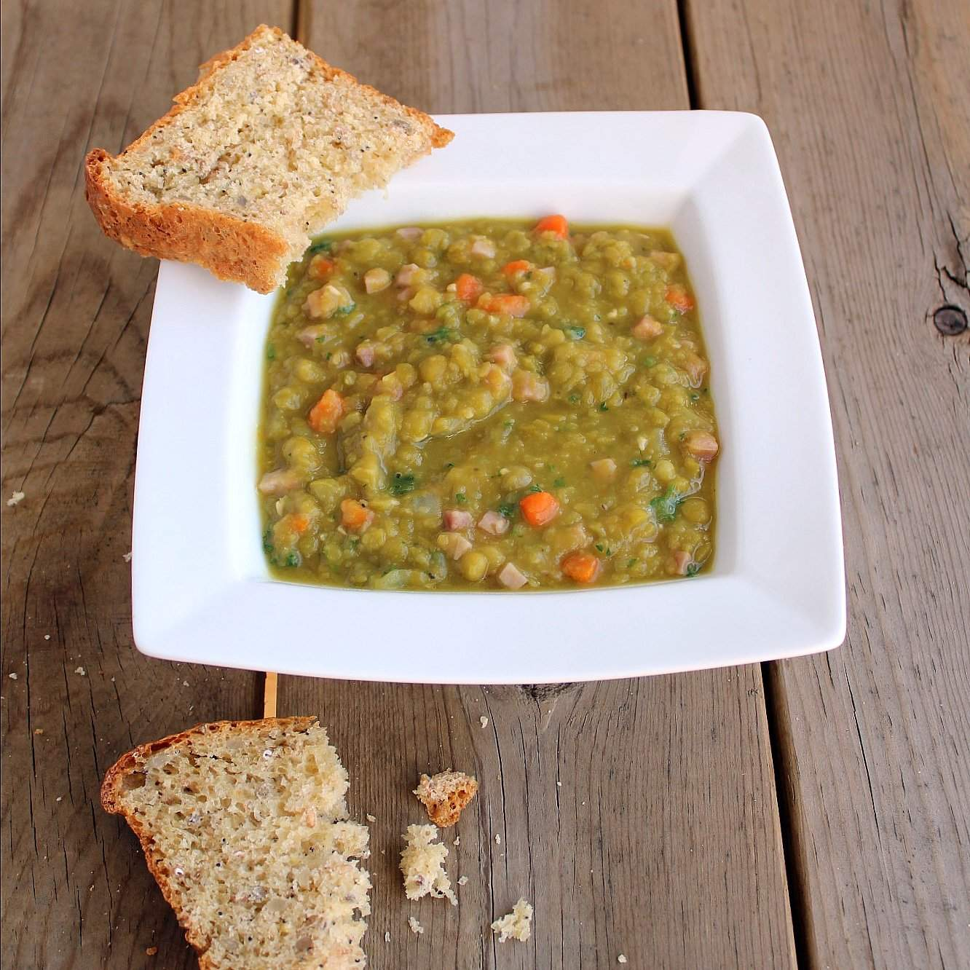
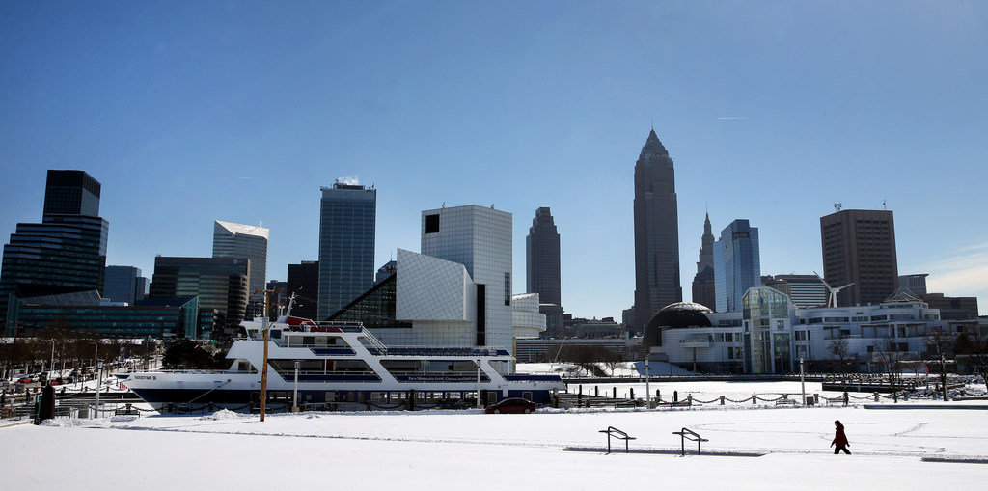
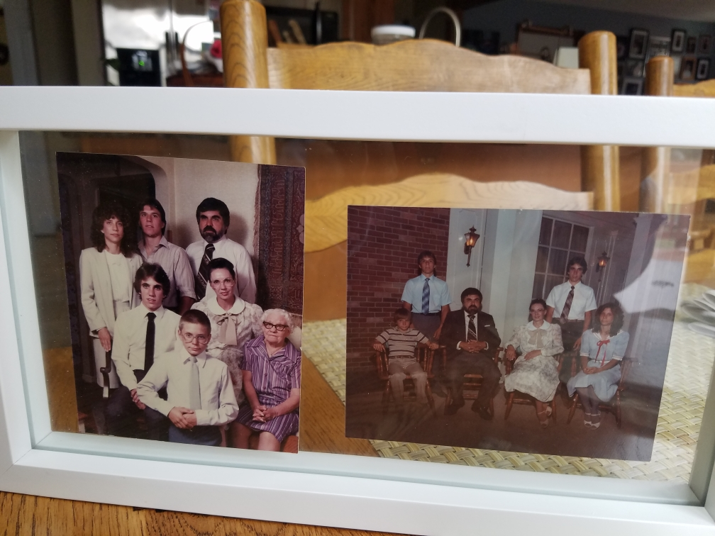
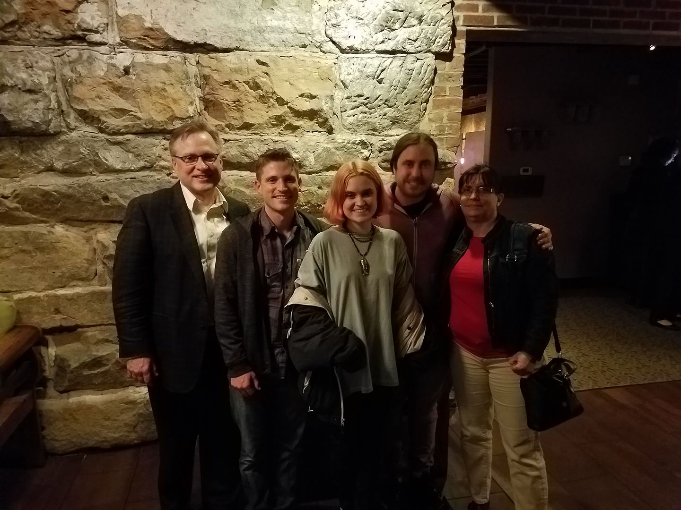


Slide 4


Slide 5
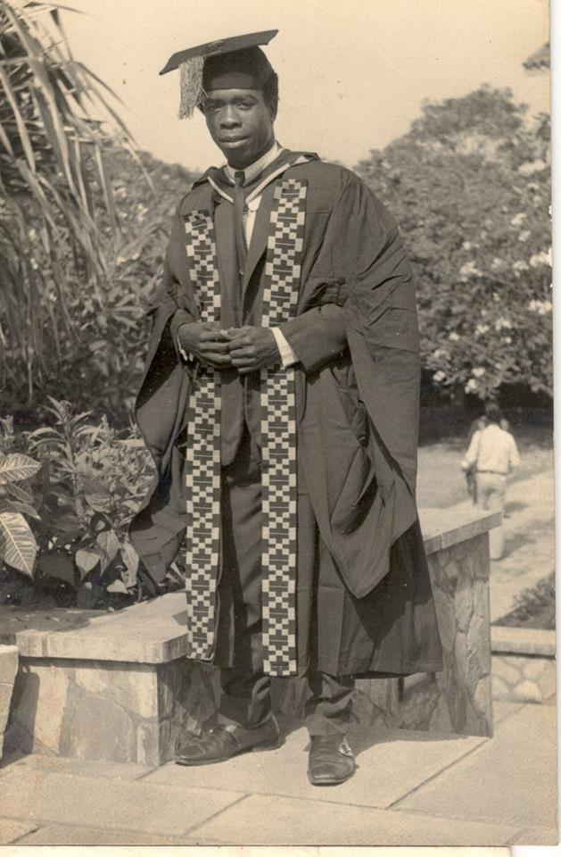
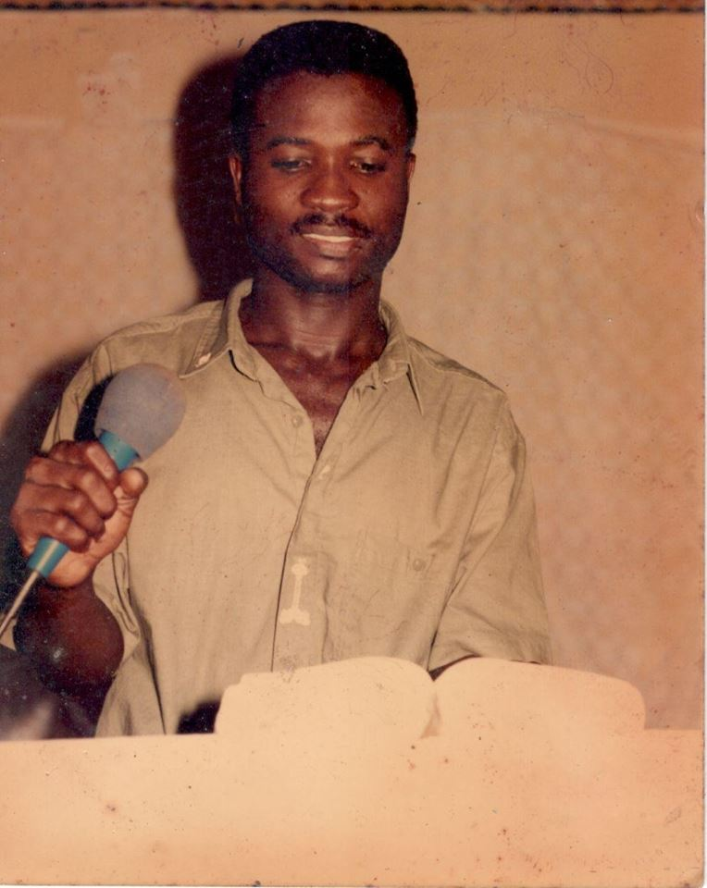
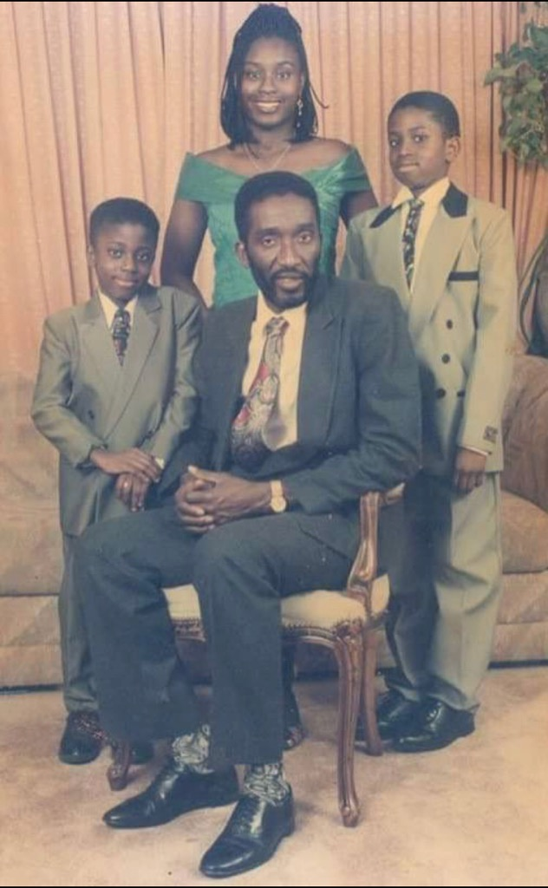
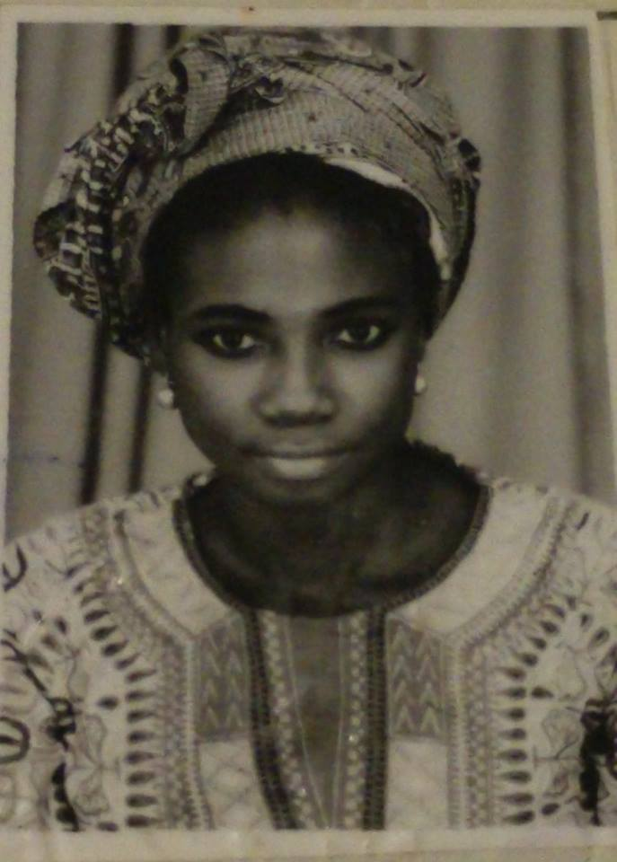
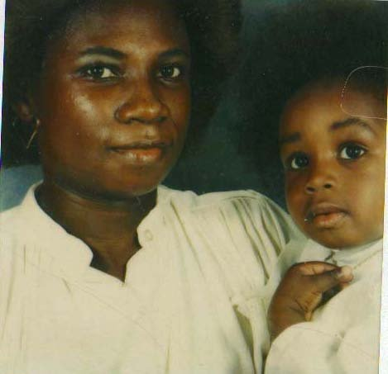
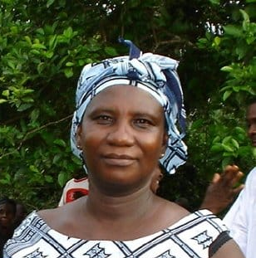
Notes:
SANDRA
My parents immigrated from Ghana, West Africa before I was born. I was born in Washington, DC in 1976 no less. An ALL American baby (kinda)!

Slide 6
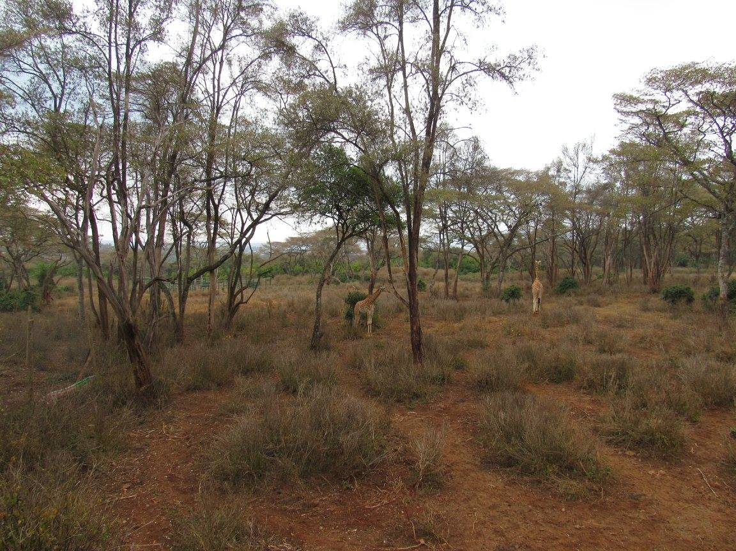
Notes:
SANDRA
I am interested in this work because for most of my life I’ve dealt with bias, stereotypes and misperceptions about Africa. Many people think of this when they think of the 54 countries on the continent. And this beautiful photo absolutely does represent some parts. BUT

Slide 7
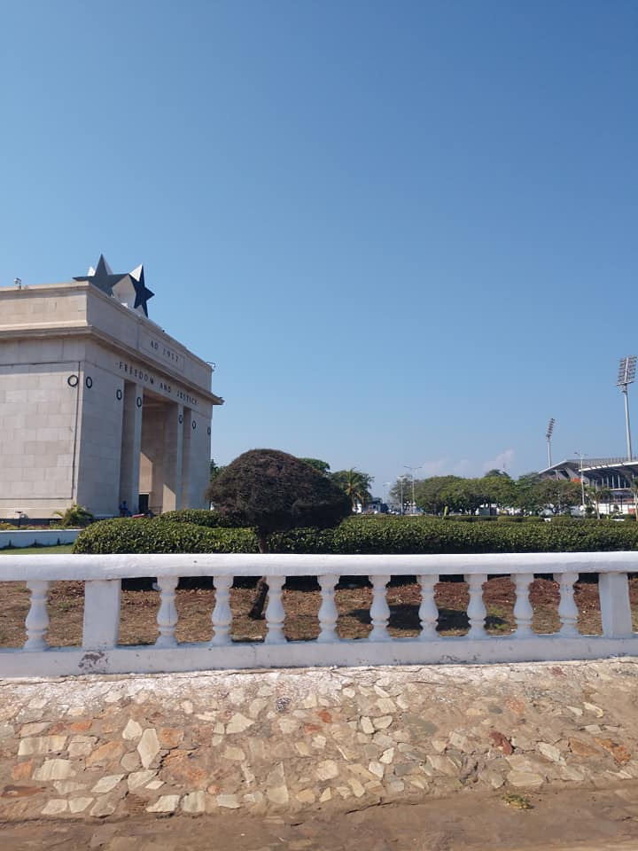
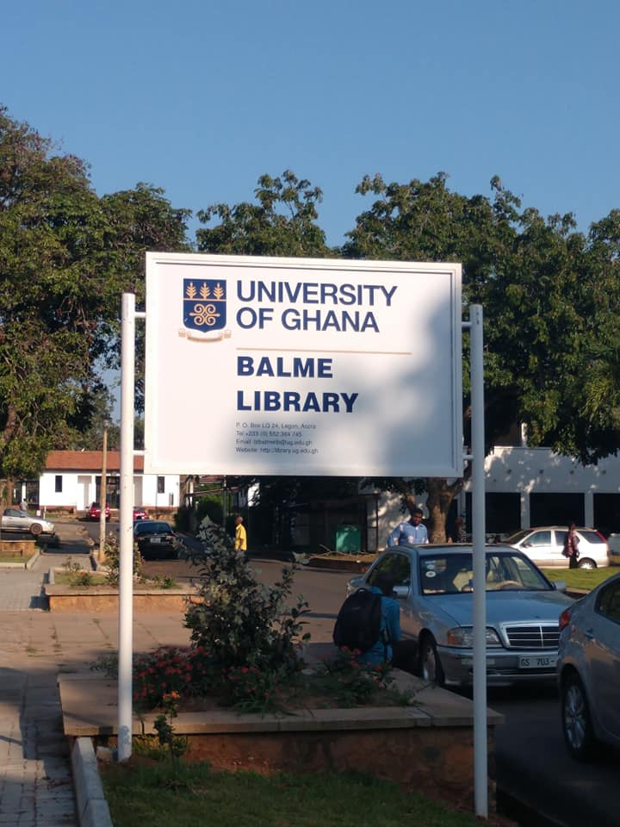
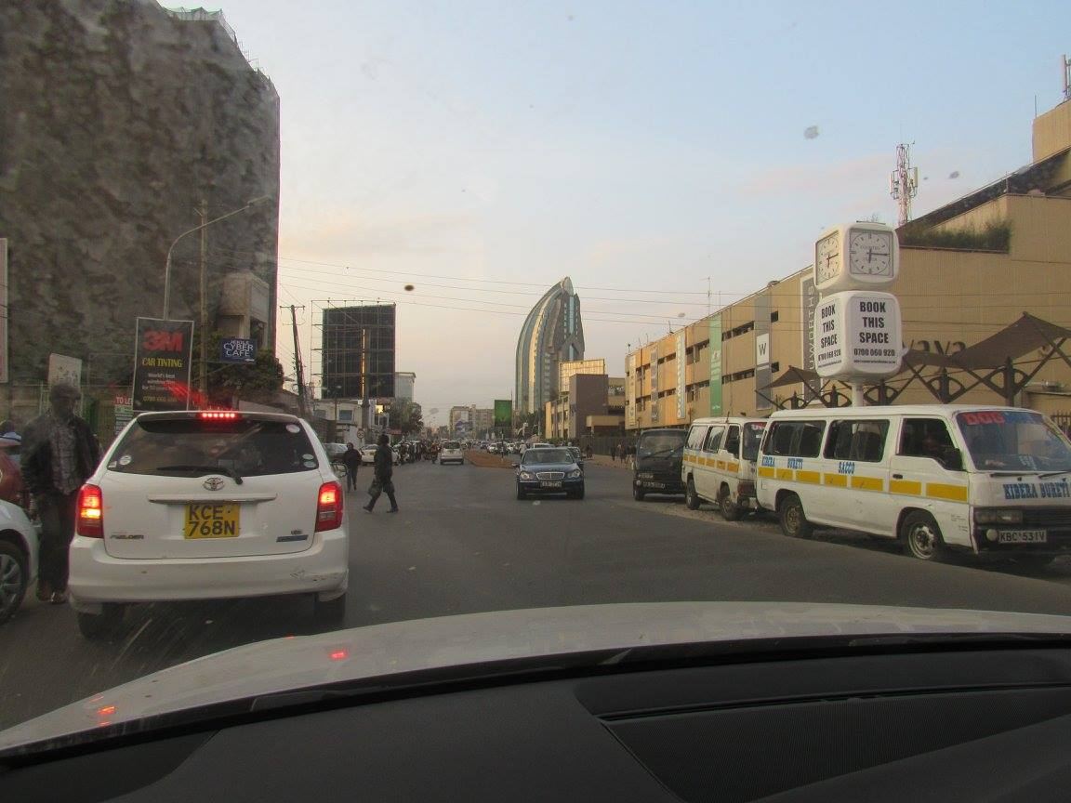
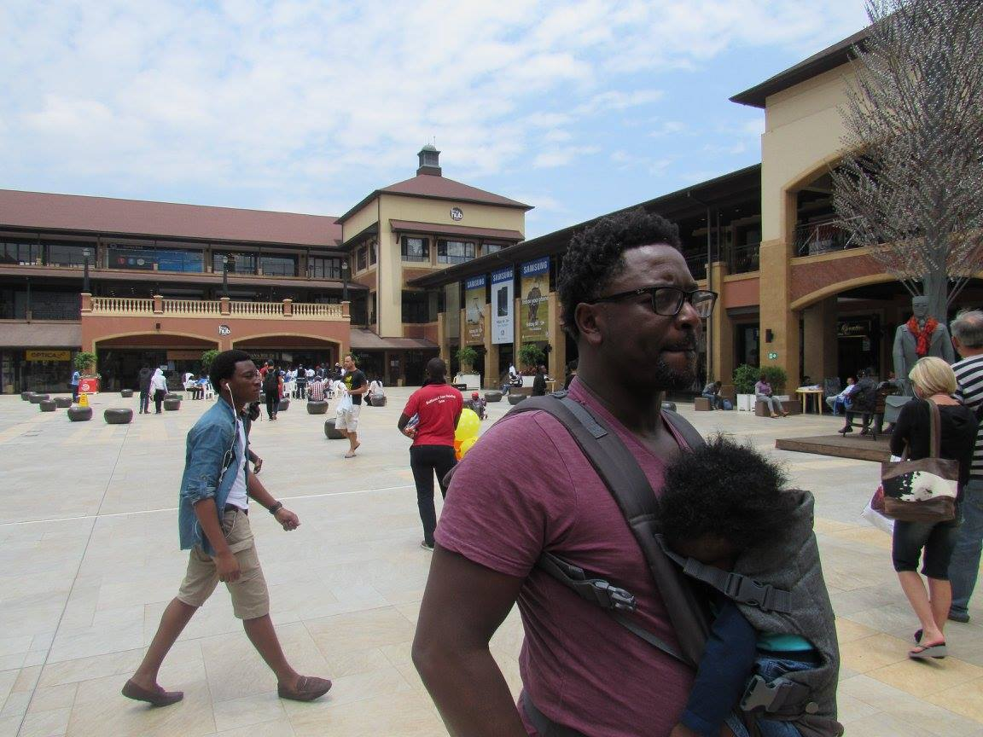
Notes:
SANDRA
So does this.

Slide 8
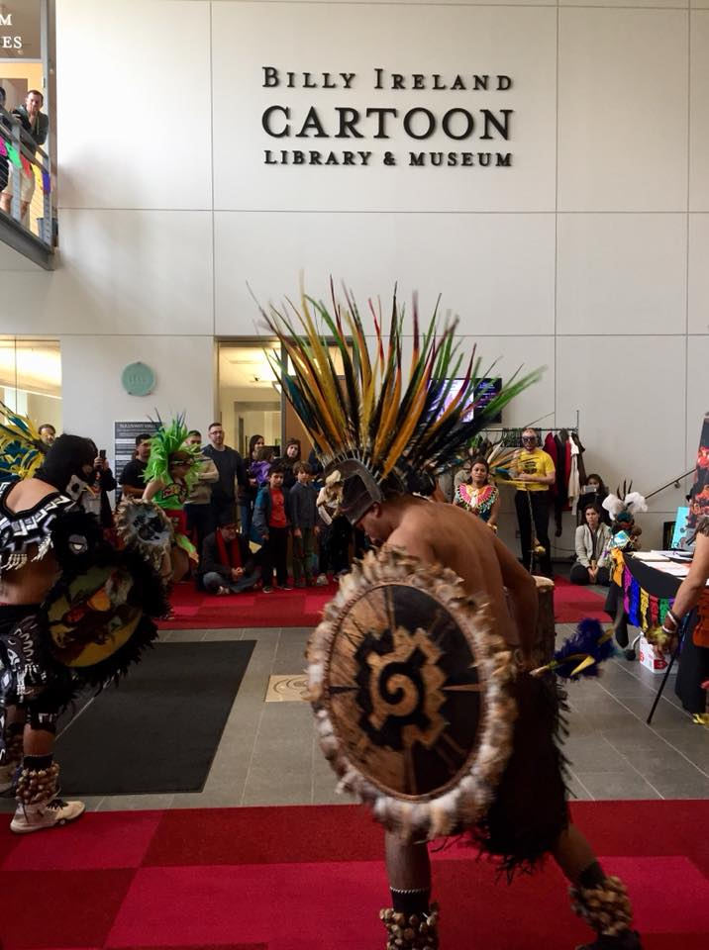
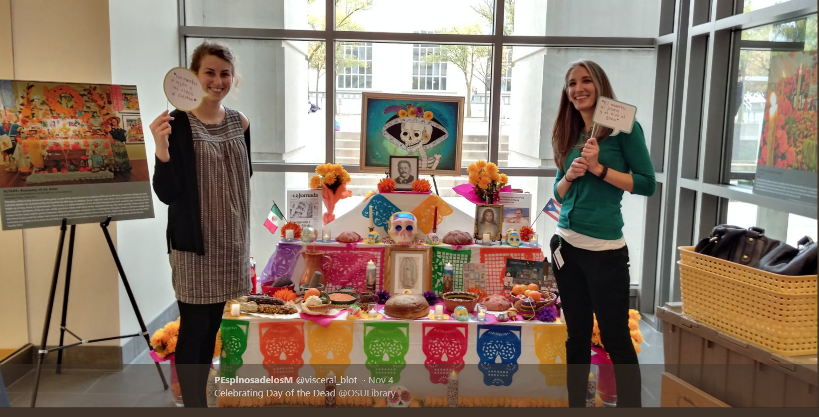
Notes:
STEPHEN
I want to start our discussion with some observations. Although I did not capture the moments that I’m about to display, I think most of us at some point in our time as library employees have had similar observations.

Slide 9
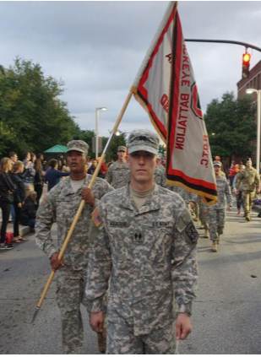
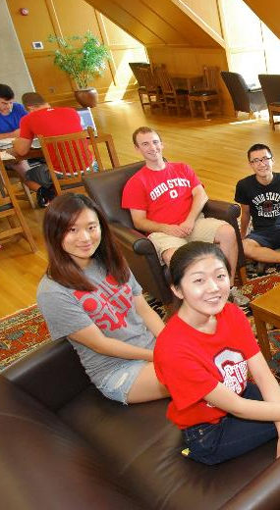
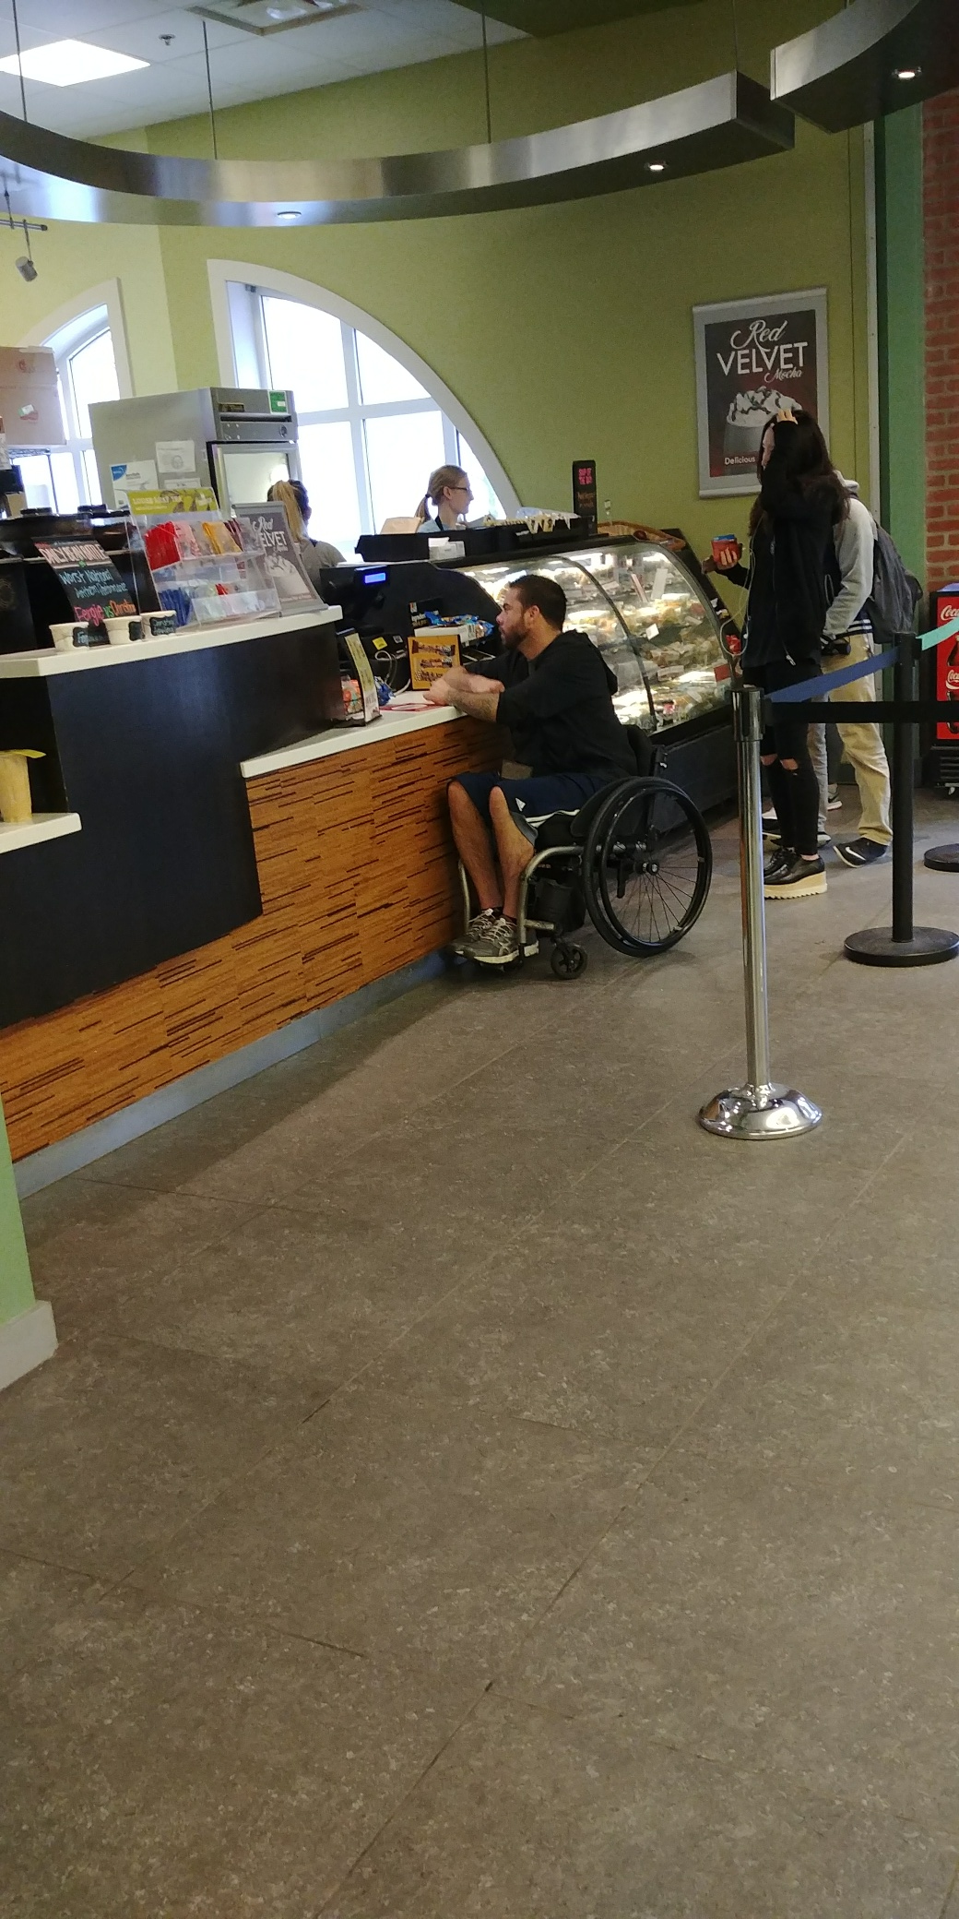
Who are our users?
Notes:
STEPHEN
I want you to consider our library community and reflect on who are our users, who uses our collections, our spaces, our services. What does diversity look like among our users?
Diversity is a 27-year-old marine with a traumatic brain injury explaining to their librarian the limitations they may encounter in the classroom.
Diversity is an undergraduate student maneuvering through narrow ropes juggling his wallet and chips while reaching for a drink that was not designed with him in mind.
A Japanese international student misreading an active shooter text and a lock down in the library. That student would later ask to stay in the area studies suite because they did not want to go home to an empty apartment.

Slide 10
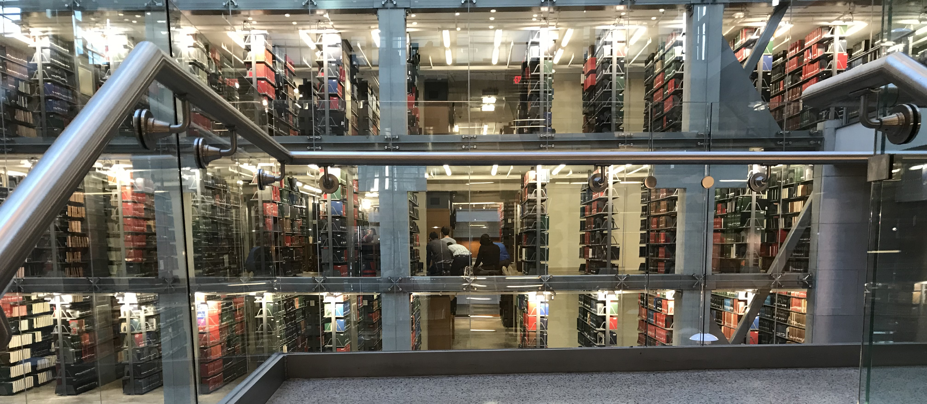
Notes:
STEPHEN
Diversity is a group of Muslim men praying openly in the stacks during finals week

Slide 11
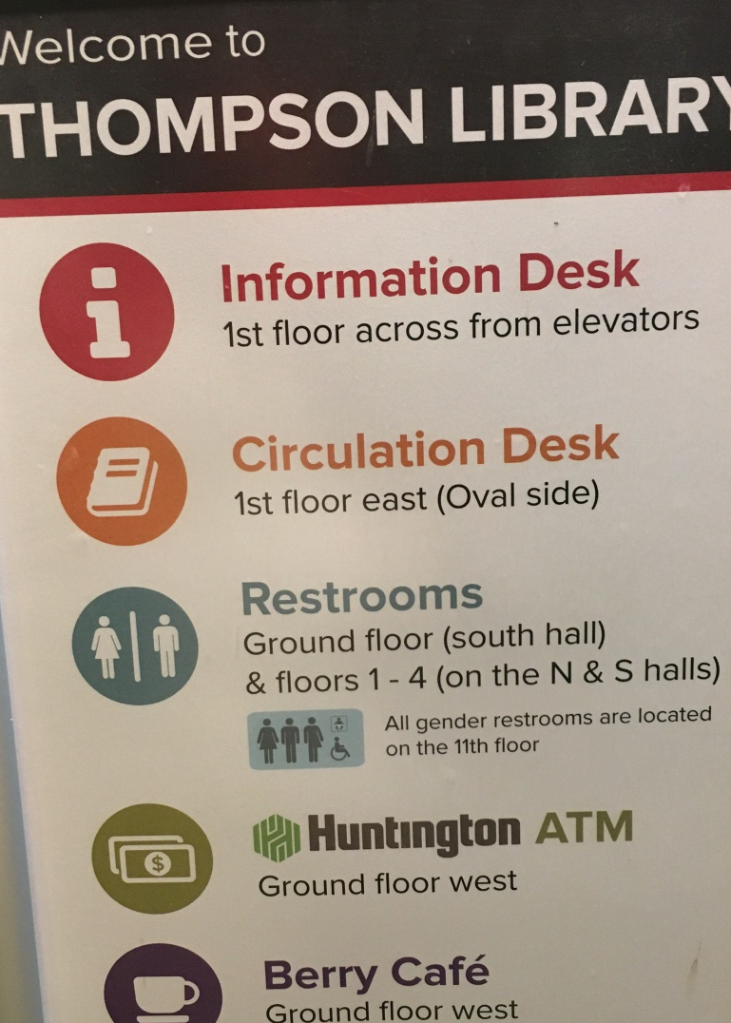
Notes:
STEPHEN
Progress towards inclusion and equity means that our trans and genderqueer colleagues and patrons no longer have to go to the 11th floor to access all-gender restrooms.

Slide 12


Slide 13
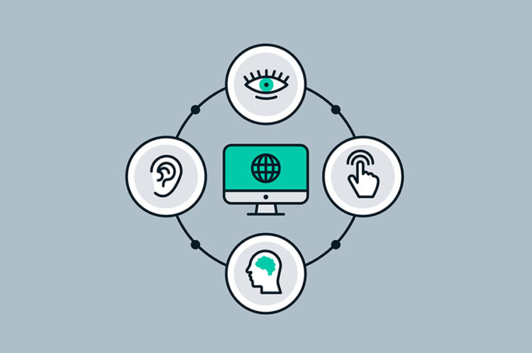

Slide 14
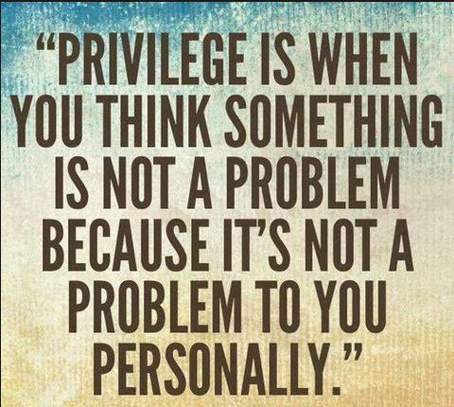

Slide 15
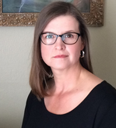

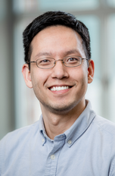

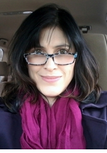
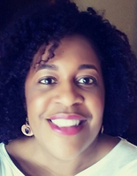
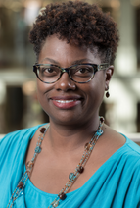
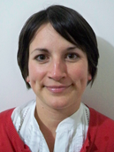



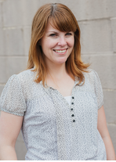

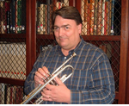
UNIVERSITY LIBRARIES
Notes:
STEPHEN
Let’s not forget how diverse of an organization we are!

Slide 16
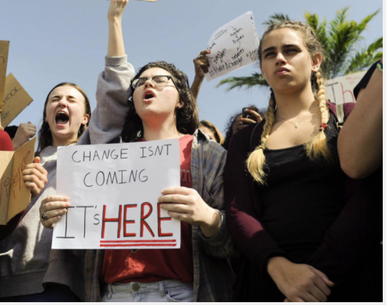
Credit: Courtesy of TNS, 2018
Notes:
AMANDA
Unlike other eras, we are living in a time where we can design or redesign our systems and institutions to be more inclusive and equitable. Systems that may have previously been design to ignore, exclude or at worse oppress, can now be upgraded be inclusive of all people that work and serve them. We have immense power, like never before to do this, but to get started we have to first get on the same page, we first have to start with our definitions regarding equity diversity and inclusion.

Slide 17
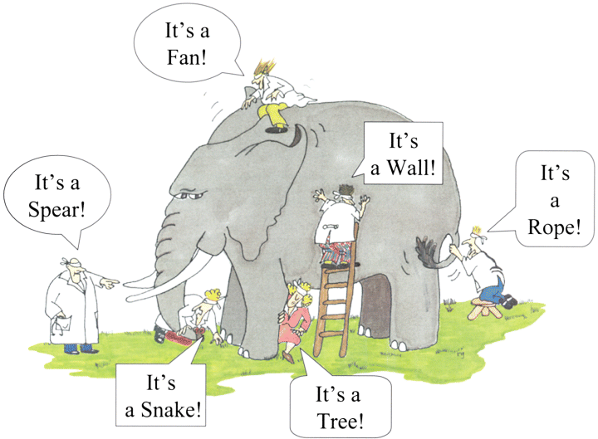
IDENTITY THE MAIN CONCEPT
PERCEPTION AND DEFINITIONS FOR
EQUITY
DIVERSITY
INCLUSION
SOCIAL JUSTICE
Notes:
SANDRA
We each come to the table with our own definitions for these words. What they mean to us personally and in turn subjective definitions that may influence our professionally behavior and contributions to EDI work.

Slide 18
IDENTITY THE MAIN CONCEPT
PERCEPTION AND DEFINITIONS FOR
EQUITY
DIVERSITY
INCLUSION
SOCIAL JUSTICE
Notes:
SANDRA
Diversity can mean many things. The definition itself is a form of diversity.
Diversity can refer to a demographic variable (such as race, religion, gender, nationality, sexual orientation, age, education and skills). Diversity can refer to visible or invisible individual characteristics. In the context of EDI, diversity refers to accounting for the differences that may exist between people and among group of people, and placing a positive value on those difference.
Part of what will help us move forward with a strategic direction of EDI goals is to define what diversity is going to mean for us (the organization).
Does it mean hiring individuals that are minorities or specifically individuals from underprivileged background*, serving international students, inclusion of staff personnel in library decision making?
In essence, what does diversity explicitly mean for this organization? A collective definition may assist to inform a strategic direction for our organization and help prioritize actionable steps towards EDI goals.

Slide 19
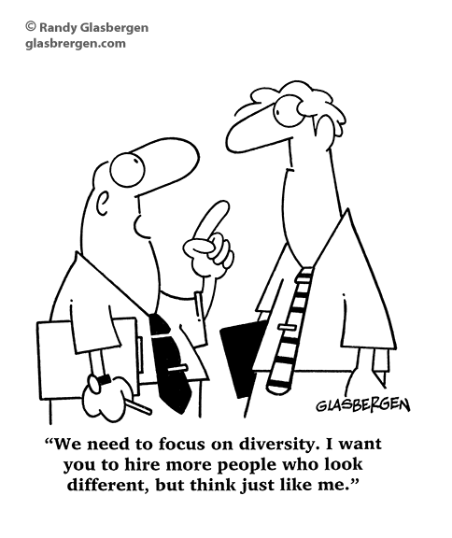
IDENTITY THE MAIN CONCEPT
Notes:
SANDRA
At its worse, diversity, without inclusion or equity, can be the arbitrary and limited inclusion of anyone, especially those that look “different” with the expectation that these individuals will thrive in the same environment and will think and be like the majority group.

Slide 20
IDENTITY THE MAIN CONCEPT
To Diversity
Notes:
SANDRA
But diversity is not charity, it is a reciprocal investment that benefits the individual and the team.
It is an interdependent relationship in which distinct members bring distinct perspectives and skills to the organization and in-turn all the organizational members learn and grow from working with a diverse population.
Using the X-Men Team as an example (provide some context if necessary)
It is not just the most powerful character that fight the bad guys. Instead the leaders of the group actively include and leverage the unique powers of each member to overcome insurmountable obstacles. The collective participation of all its members, regardless of their position, abilities, limitations and at-times weaknesses, contributes to the collective strength of the team.
The goal is to develop an ecosystem, an organization, that is enhanced by diversity. Along with it, we create a system that provides the resources for difference/diversity to thrive in a collective community.

Slide 21
Inclusion
Notes:
SANDRA
As a public serving institution, our cultural intelligence and competency is very important, as it is often our task to design the conditions and the manners in which our users and colleagues will work and perform.
As you look at this image, it’s easy to wonder “how will the fish accomplish this? Can the fish accomplish this?” Let’s also look at this and think about what is the monkey thinking?

Slide 22
Notes:
SANDRA
As considerate colleagues, we also need to understand that inclusion is not a one size fits all approach; different people need different tools to gain access and have equal opportunity.

Slide 23
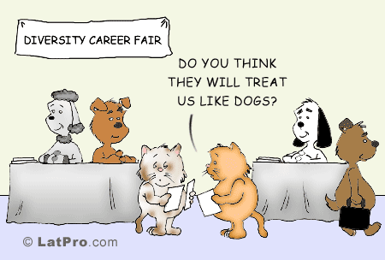
Inclusion
Notes:
SANDRA
And also an understanding the inclusion is not a one size fits all approach, different people need different tools to have equal opportunity.

Slide 24
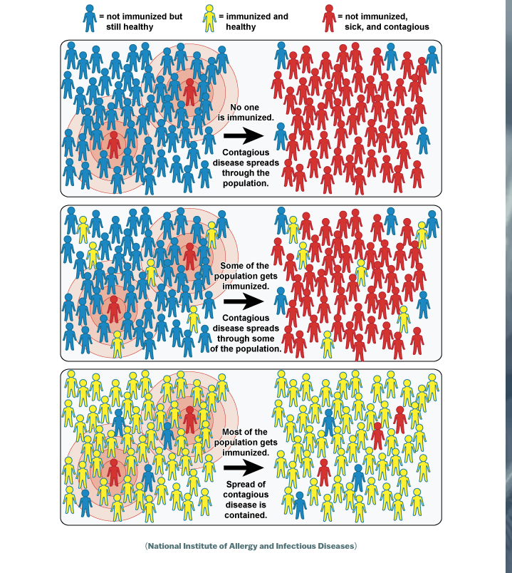
Notes:
SANDRA
When thinking about cultural intelligence for our organizations, it is important to consider that cultural competency only works if we all have it. This is not what black and brown people do in a corner. My cultural competency or presence in this organization, does little to nothing for all users in the organization at all times.

Slide 25
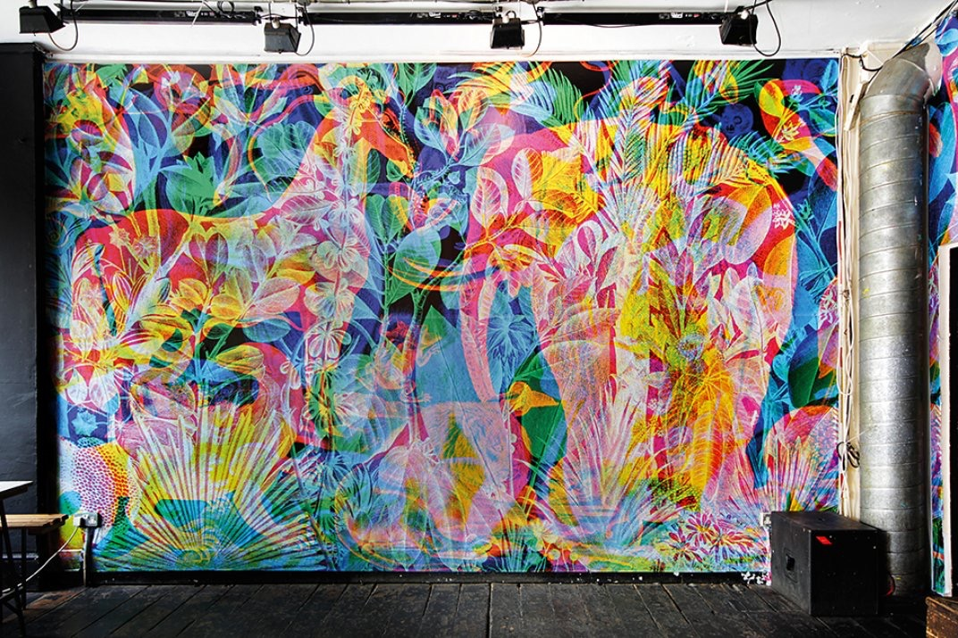
Notes:
STEPHEN
This is an artwork titled “Jungle” by La Selva Carnovsky. I use this art piece as a metaphor for describing identity and culture.
Depending on our cultural lens we may see, perceive and experience the world in a particular way...
...We do not see the world like others because we are bad or stupid people...We are limited to experience the world as an individual, limited by our experiences, our preferences, our education, and sometimes by how other perceive us.
EDI work is seeking to understand the different ways in which people perceive their world.

Slide 26
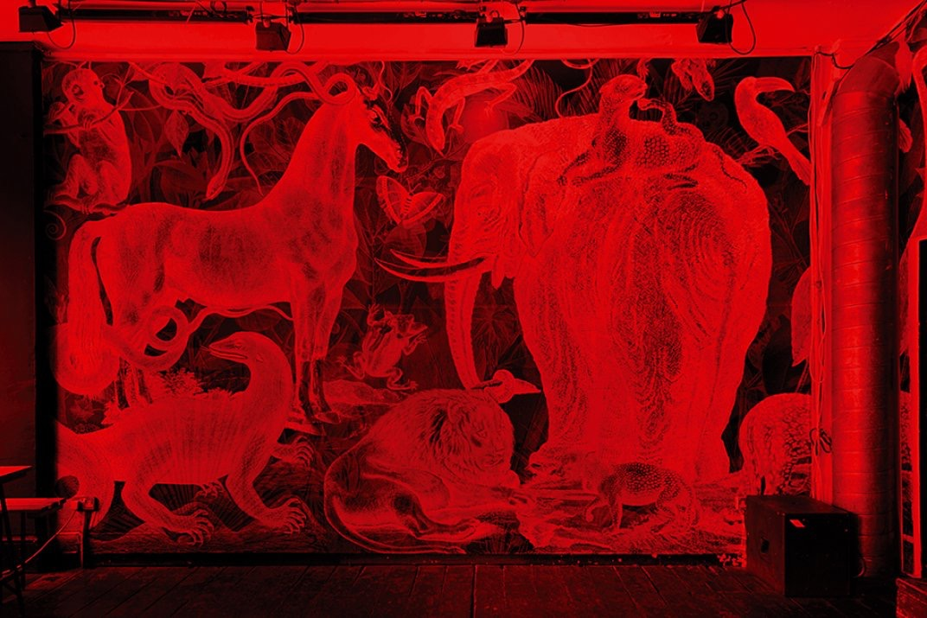

Slide 27
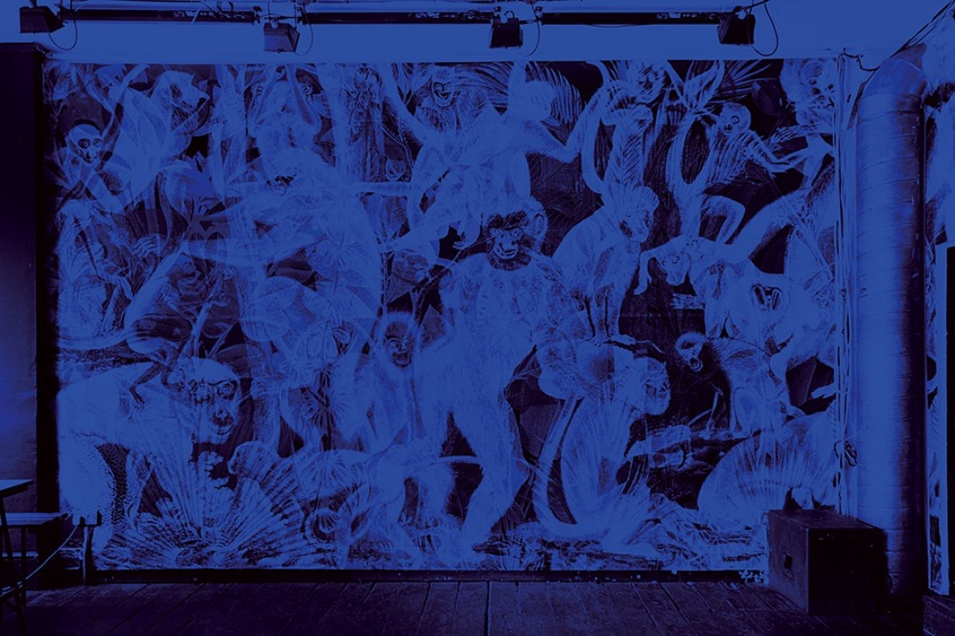

Slide 28
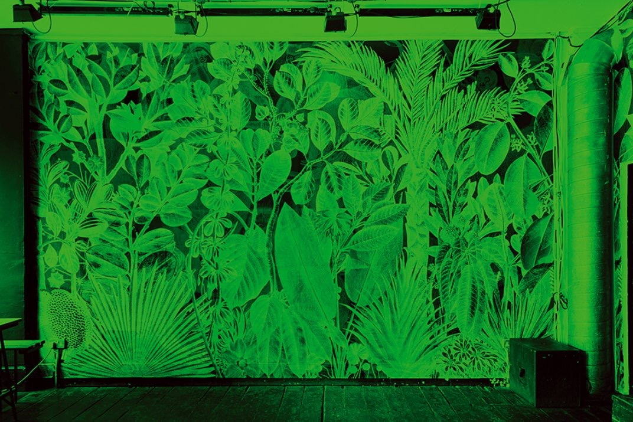

Slide 29
The knowledge to understand cross-cultural phenomena.
The mindfulness to observe and interpret particular situations
The skills required to adapt behavior to act appropriately in a range of situations.
Cultural Intelligence
Notes:
STEPHEN
So what is Cultural Intelligence? Cultural Intelligence is:
The knowledge to understand cross-cultural phenomena.
The mindfulness to observe and interpret particular situations
The skills required to adapt behavior to act appropriately in a range of situations.
Unlike IQ and ethnic/racial identity, cultural competency/intelligence is something that can be learned and mastered.
Contrary to popular belief, cultural competency/intelligence does not require you to learn and be proficient in all the languages and cultures of the world, frankly who has time for that.

Slide 30
Cultural Awareness
Notes:
STEPHEN
The best way to get started it actually by learning about one’s own culture, what is it? when is it a strength? when is it a weakness? How do I like to learn and receive information? What are my expectations of the world around me? Do I communicate or extend these assumptions to my colleagues? Do I assume people around me have the same interpretations of our shared environment?

Slide 31
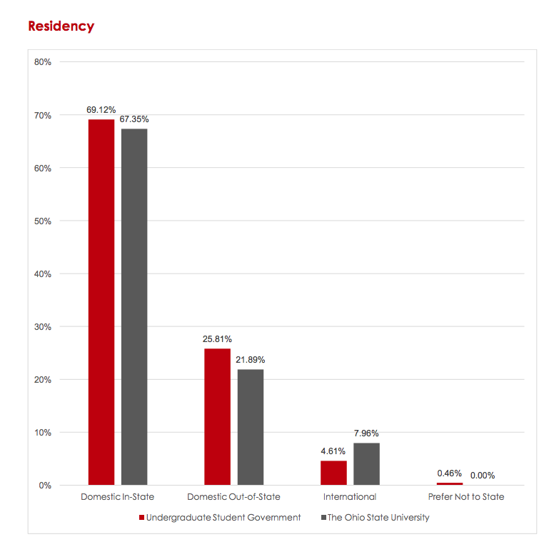
OSU Demographics
Notes:
STEPHEN

Slide 32
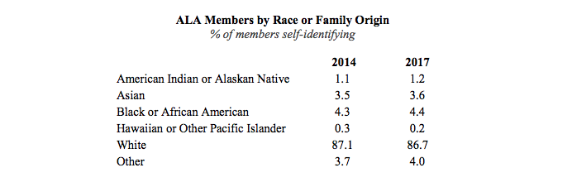
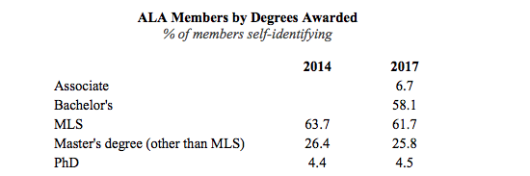
LIS Demographic
RACE or Family Origin: WHITE
Degree: MLS
*Hispanic/Latino 3.9% 4.7%
*In 2014 2.8% disclosed a disability; 2.91% in 2017
Notes:
STEPHEN
In 2014 3.9% responded as Hispanic/Latino; 2017 4.7%
In 2014, 2.8% disclosed a disability; 2.91% in 2017

Slide 33
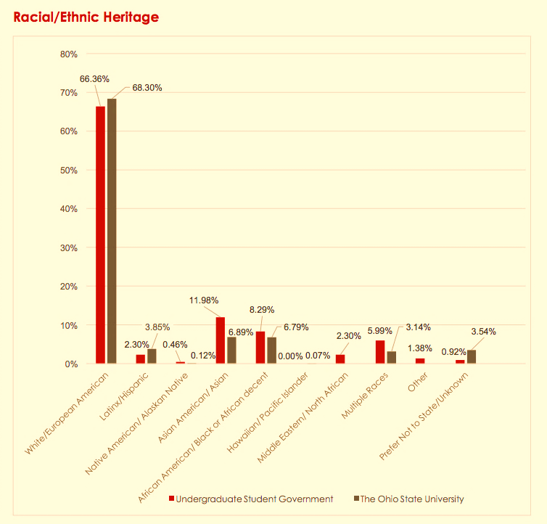
OSU Demographics
*Hispanic/Latino (also listed in White) 3.9% 4.7%
Notes:
STEPHEN
Here is a quick glance at our
Compared to 87.6% White in LIS field; 3.6 Asian; 6.79% African American

Slide 34
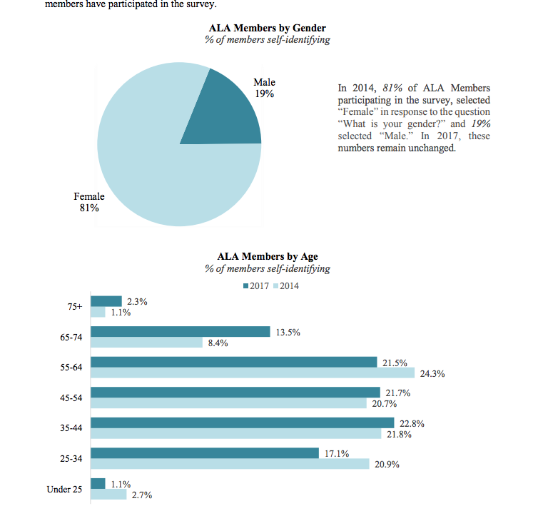
LIS Demographic
AGE: 55-64
GENDER: FEMALE
Notes:
STEPHEN
If it is important for us to be inclusive, then we may need to reflect on systems and active practices that will help all voices to come through in order account for their needs, ideas and services of users that use our services and colleagues that work here.
As of January 9, 2017, 37,666 current members have participated in this voluntary, self-selected survey representing 74% of current membership (ALA, 2017).

Slide 35
“We have come to this hallowed spot to remind America of the fierce urgency of now. This is no time to engage in the luxury of cooling off or to take the tran­quilizing drug of gradualism. Now is the time to make real the promises of democracy.”
- Martin Luther King, Jr. (1963)

Slide 36
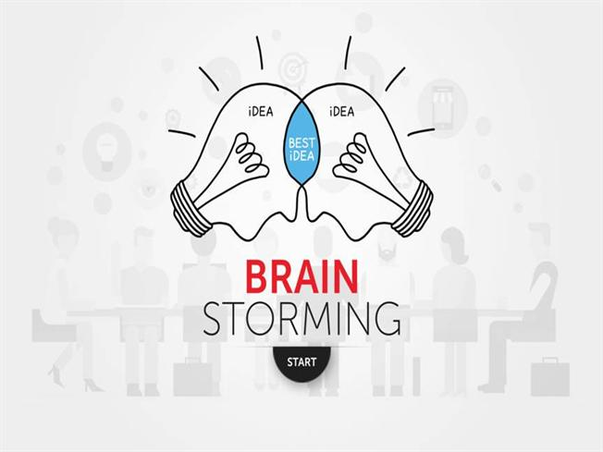

Slide 37
Workshop Agenda
Part 2: Workshop
V. Group brainstorming and capture discussion; select scribe
VI. Discussion round one
VII. Discussion round two: Unpack ideas and final capture as bullet points
VIII. Groups report out
Notes:
SANDRA

Slide 38
Workshop Questions:
What does it mean to you to have an inclusive, equitable, and diverse organization?
What are ways you can personally advance equity, inclusion, and diversity in your department?
What have been OSUL’s biggest challenges in advancing EDI efforts? What are the library’s gaps in resources for supporting EDI?
What EDI-related programs, activities or training have been successful and have made a positive impact towards EDI organizational goals?

