Slide 1
Website Redesign Project
Robyn Ness Sue Beck Jason Michel

Slide 2
Where we’re headed

Slide 3
Project Milestones + Where We Are
Content analysis of current site (WI 2017)
OSUL functionality discussions (WI 2017, iterative)
User needs surveys (WI 2017, iterative)
Form a user experience (UX) cohort; start user testing (SP 2017, testing iterative)
Initial draft of information architecture (SP 2017, rework based on testing)
Training and content migration (late-SP 2017, ongoing)
Release early preview site for public feedback (mid-SU 2017)
Replace old site with new site (as soon as January 1, 2018, depending on content readiness and user testing results)

Slide 4
Content Migration Strategy
Agree on scope of site / navigation
Review outline of content for each section
Meet individually or by sections of the site to discuss mapping old content to new site
Receive training and access to new site
Migrate content over the summer and into the fall
If needed, work with UX Writer to adjust content

Slide 5
Another View of Where We Are
Explore the
Problem Space
Explore the
Solution Space
Observing & Synthesizing
Ideating & Prototyping

Slide 6
Reminder – This is a draft.

Slide 7
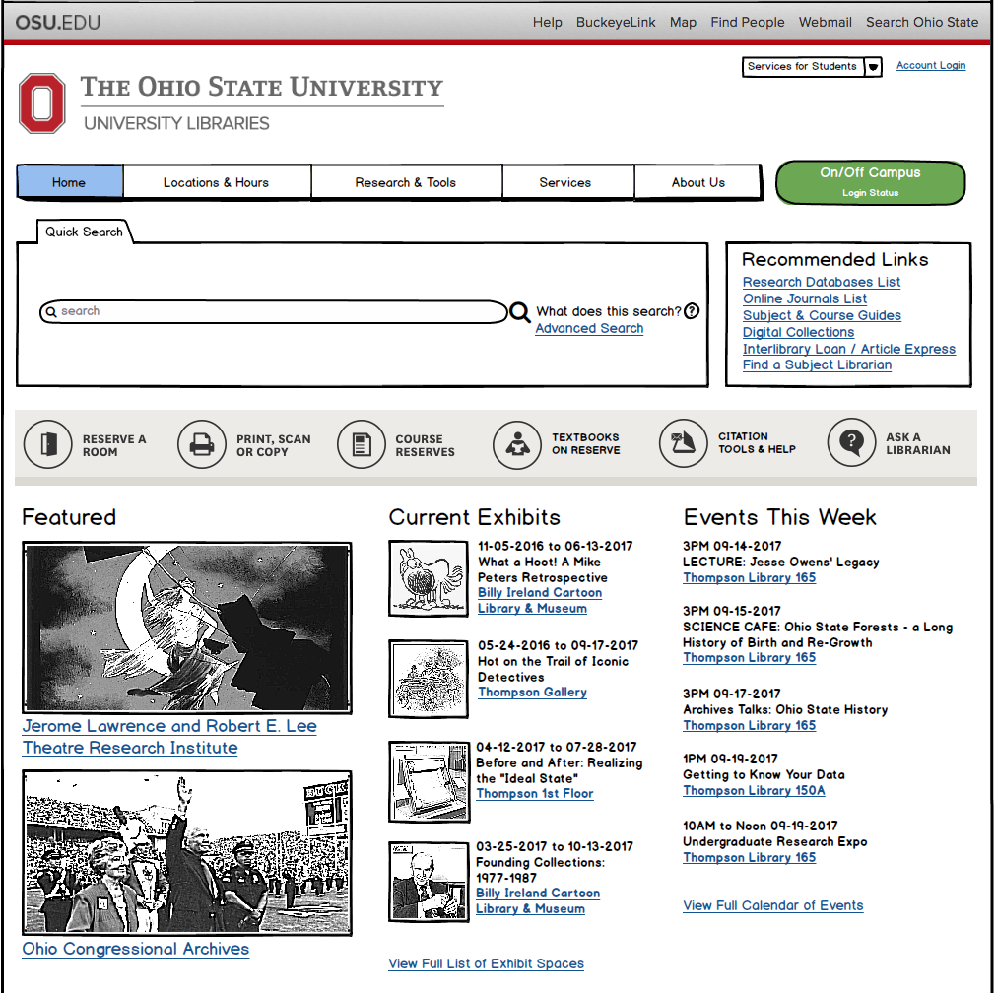

Slide 8
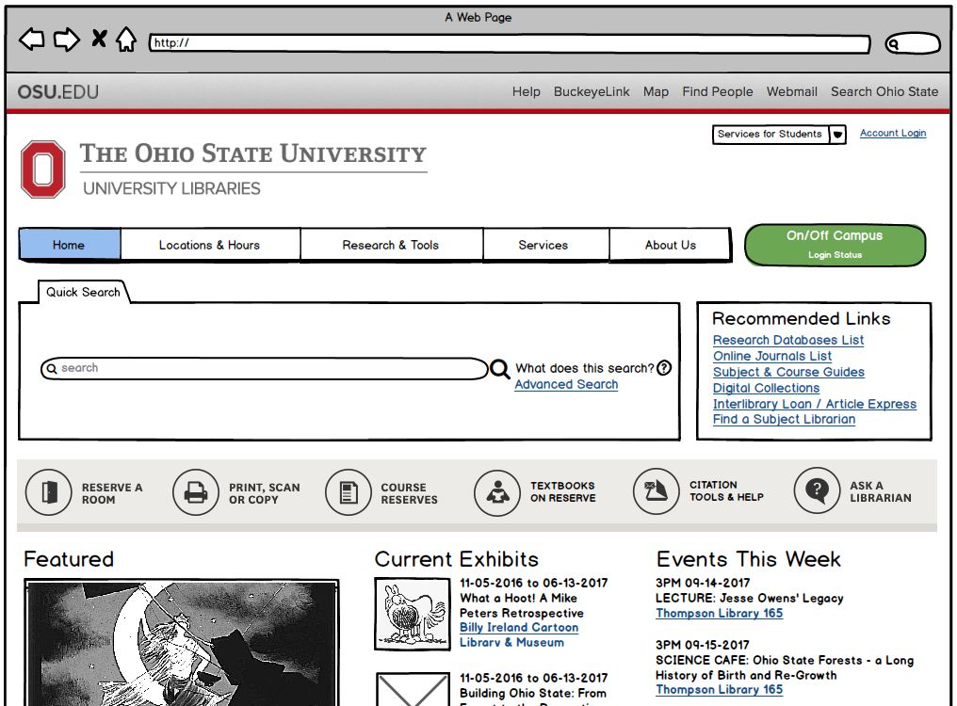

Slide 9
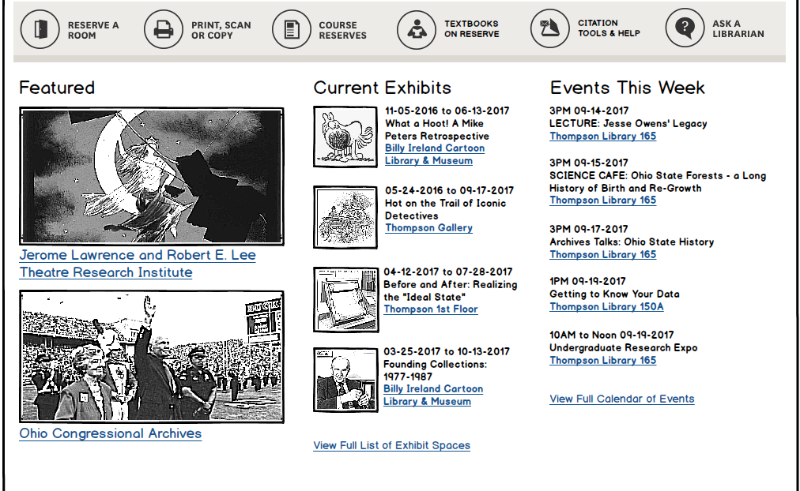
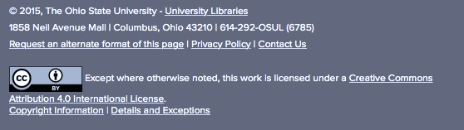

Slide 10
Navigation & Content Outline
Locations & Hours | Research & Tools | Services | About Us
Thompson Library • Thompson Gallery • Creighton Special Collections Reading Room 18th Avenue Library Architecture Library Billy Ireland Cartoon Library & Museum Biological Sciences & Pharmacy Library Fine Arts Library Food, Agricultural, and Environmental Sciences Library & Student Success Center Geology Library Music & Dance Library Veterinary Medicine Library University Archives Partner Libraries: Health Sciences Library Law Library Regional Campus Libraries Location-Based Services: Reserve a Group Study Room Services by Location Report a Maintenance Issue | Tool Help: (Various systems) Find It! Citation Finder etc. Research Process Help: Research FAQ Search Help / Best Practices Citation Help & Tools etc. Request Forms: Trial eResource Request Streaming Media Request Free Electronic Resource Request etc. Specialized Resources: Byrd Polar Archive Cartoon Collection Hilandar Research Library Lawrence and Lee Theatre Research Institute Ohio Congressional Archives Rare Books and Manuscripts Library • Charvat Collection University Archives Global Studies Resources Government Documents Digital Exhibits | Circulation ILL / Article Express Reference / Ask Us Subject Librarians / Specialists Copyright Resource Center Publishing & Repository Services Instructional Services • Items? Course Reserves Research Tutoring Research Commons Textbooks on Reserve Facilities Rental University Records Management | From the Director News & Events Mission, Vision, Values, Initiatives Org Chart Division & Department Descriptions: Office of the Director Content & Access Research & Education Special Collections & Area Studies Information Technology Planning & Administration Staff Directory Jobs & Recruiting Friends of the Libraries Giving to the Libraries Contact Us

Slide 11
What Content Goes Where?
One common question during Functional Expert Meetings: Where to place public vs. internally-focused content?
The answer – or the place to look: “What Content Goes Where” document
Online at: http://go.osu.edu/osul-wcgw

Slide 12
What’s in it for me?

Slide 13
Benefits for Library Users
Simplified navigation
Fewer layers reduce user confusion
Responsive & accessible design
Better system performance
Taxonomies for sorting and filtering
Aesthetically appealing design
Clear display for quick consumption of critical content

Slide 14
Benefits for Library Staff
Better system performance
Easier to create appealing content
Ability to upload and link documents
Cascading changes
No need for multiple page visits and edits
Flexible with content types
No need for html hand-coding
Plugins for additional features

Slide 15
Demo Time
Notes:
Paragraph
Special Collections

Slide 16
Other Announcements
Another round of user testing
June 19, 27, & 29
Audience Focus: Faculty/Staff & Graduate Students
Design Focus: Navigation for Services, Research & Tools; Main Page
Bio writing workshops
July dates TBA
Preview site release
Coming soon!

Slide 17
Thank you!
What questions do you have?

