Slide 1
Discovery Project User Testing
Robyn Ness & Meris Mandernach
April 2017

Slide 2
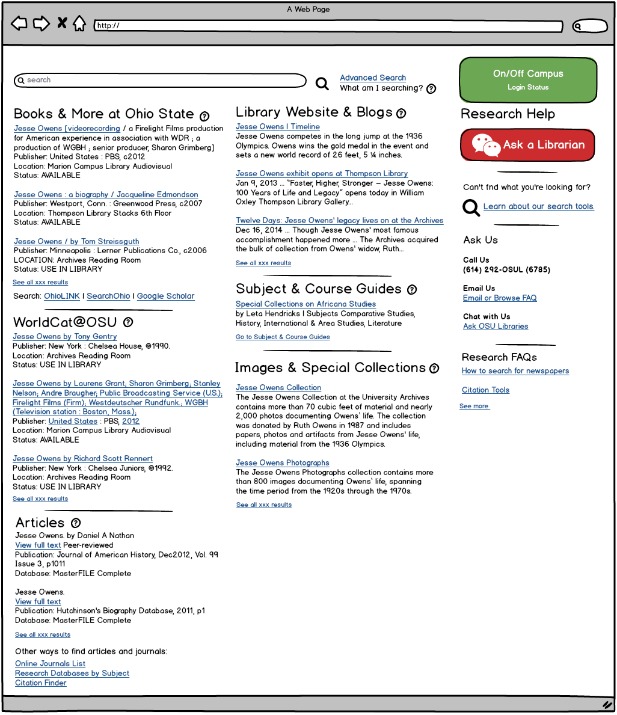
Discovery Mockup
9 participants viewed a possible version of the discovery interface proposed in the SU2016 DSWG proposal.
Search results reflect a search for “Jesse Owens” for which we have a wide range of materials.

Slide 3
Observations
Many found the mockup overwhelming.
Some felt images of book covers would help break up the text-heavy presentation.
A couple asked for the information to be presented in one column with filters to limit.
Nearly all gravitated to the Articles section.
Some were also interested in books.
Several asked "What is WorldCat?”
Scannability of results listing is desired.
Some found this particular example hard because too many results were simply titled “Jesse Owens” and there were no distinguishing features shown (other than author and year).

Slide 4
Observations (continued)
Most were not interested in images, videos, blogs, or special collections because:
a perception they weren't academic enough for assignment use (especially blogs, even from our special collections)
would take too much time to get or work with (especially videos or special collections)
be hard to cite (blogs, special collections materials)
Some felt that an item from a digital exhibit, links to a special collection, or related blog articles might be more fun (or more a diversion than appropriate for coursework); though one said the images would be helpful if a presentation were required.
None had used Subject or Course Guides previously and didn't choose to review that search result. (Note: the info returned by the LibGuide search and used in the mockup was not particularly easy to interpret.)

Slide 5
Observations (continued)
Most liked the Status indication ("available", "use in library"), but said "use in library" sounded time consuming or difficult
Most would not use the question icon help buttons, saying that the section labels should be clearer or subtitles added to avoid clicking.
Most had to be prompted to look at the third column. When they did, they liked the idea of help and the items suggested (citation, especially), but they wouldn't have noticed it.

Slide 6
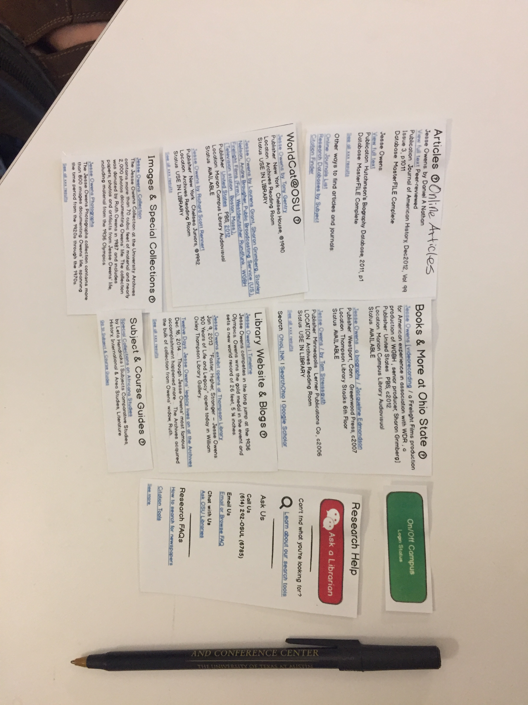
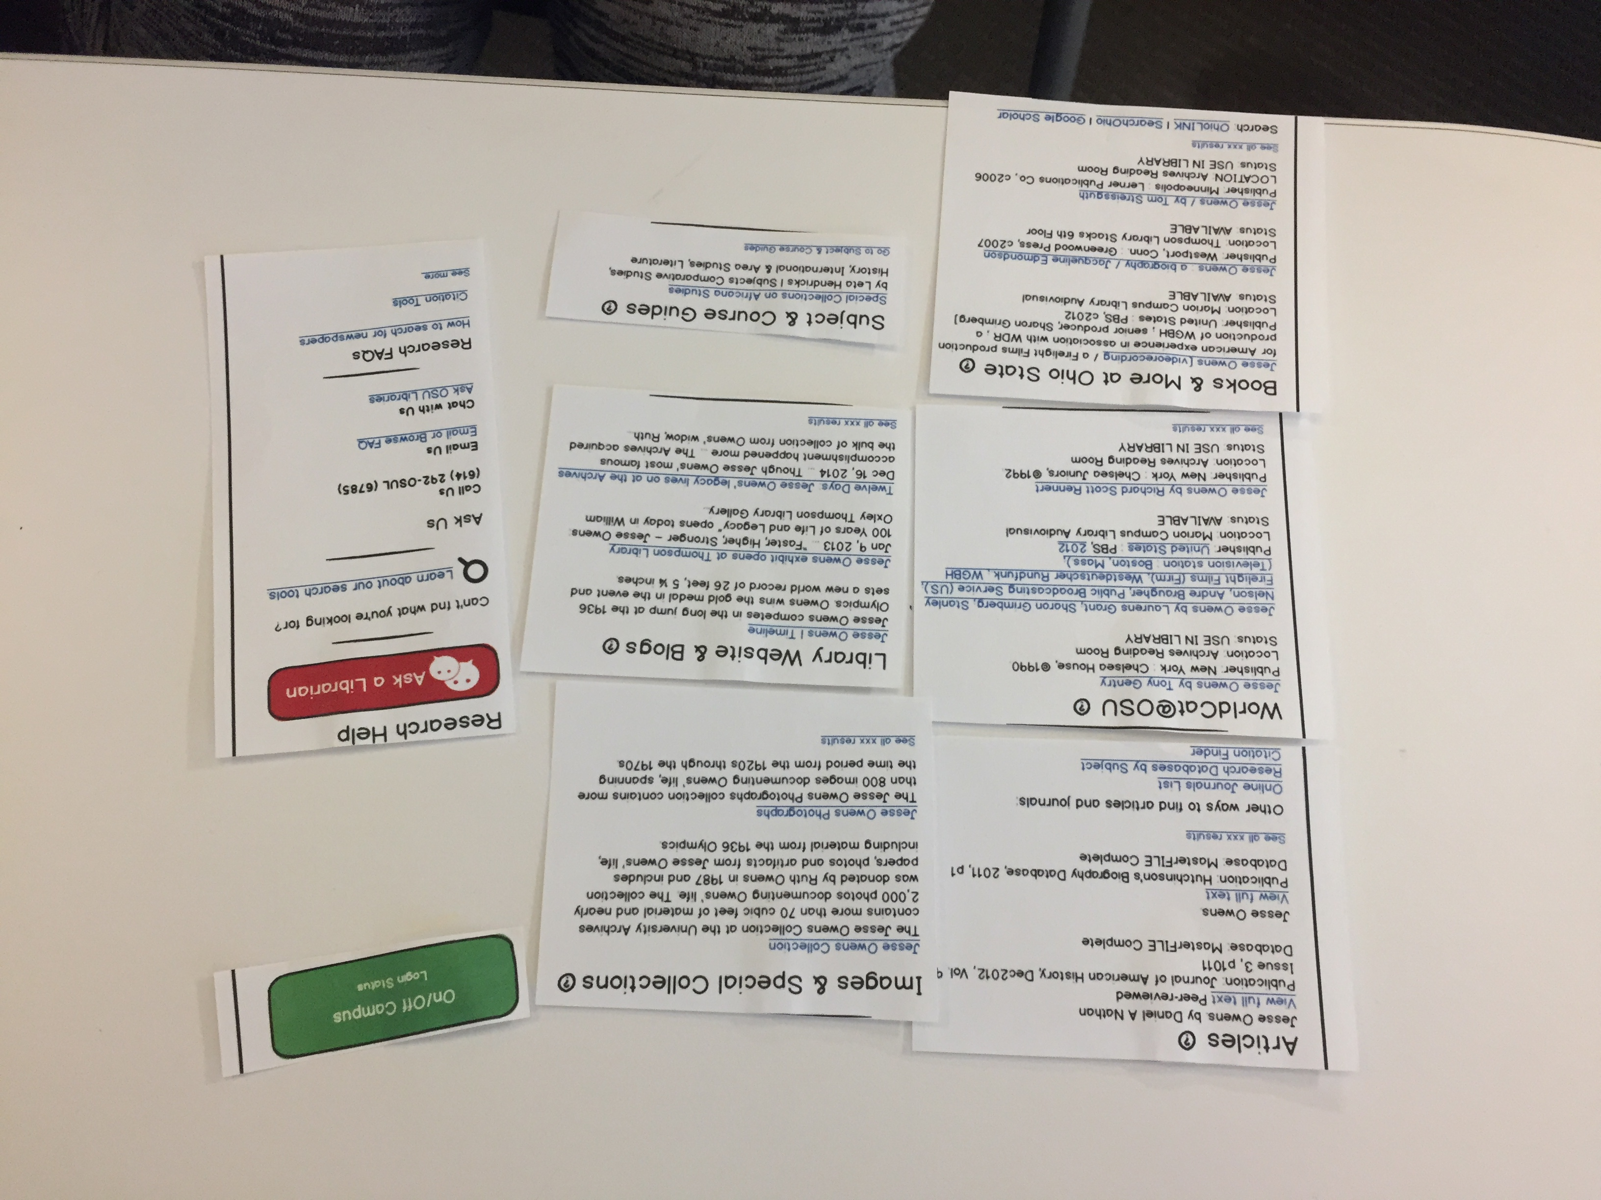
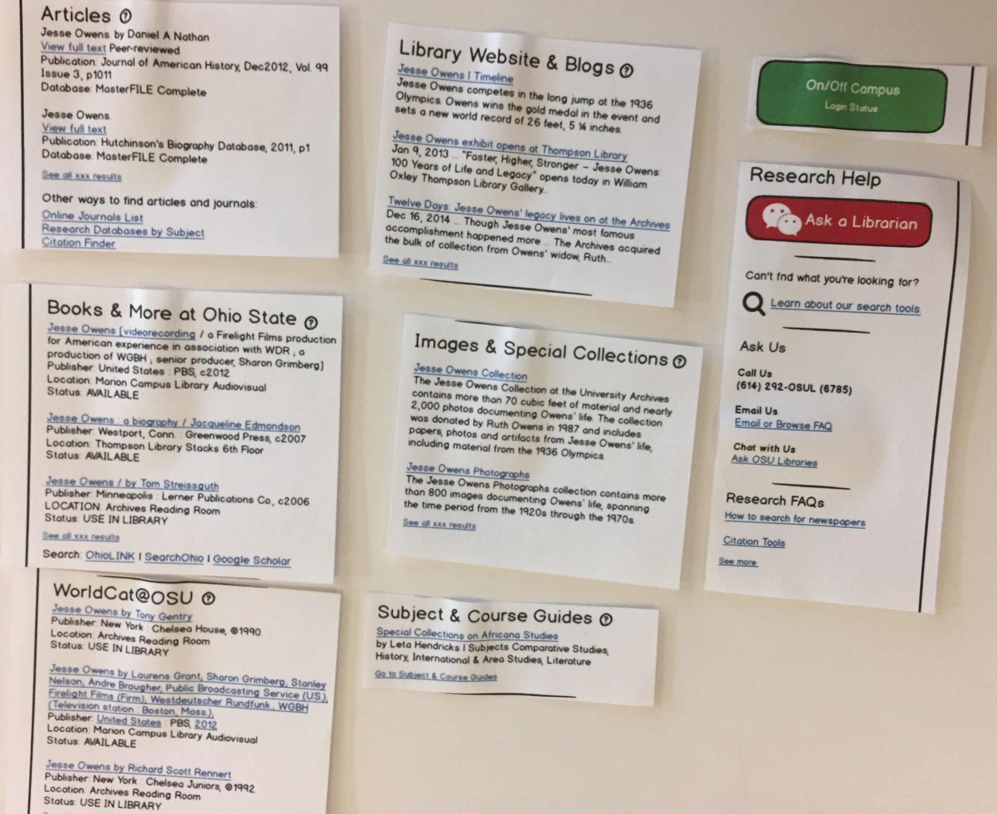
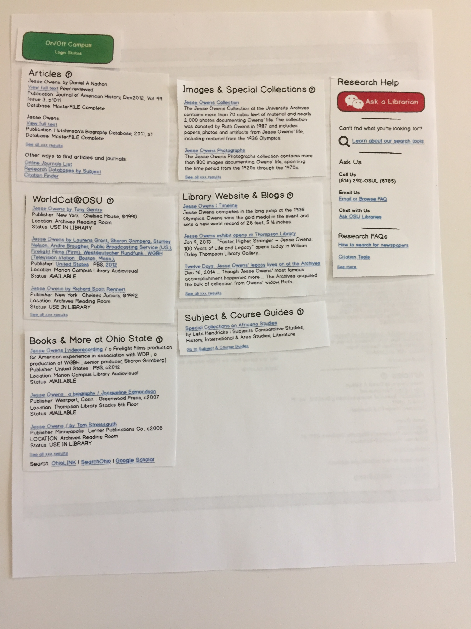
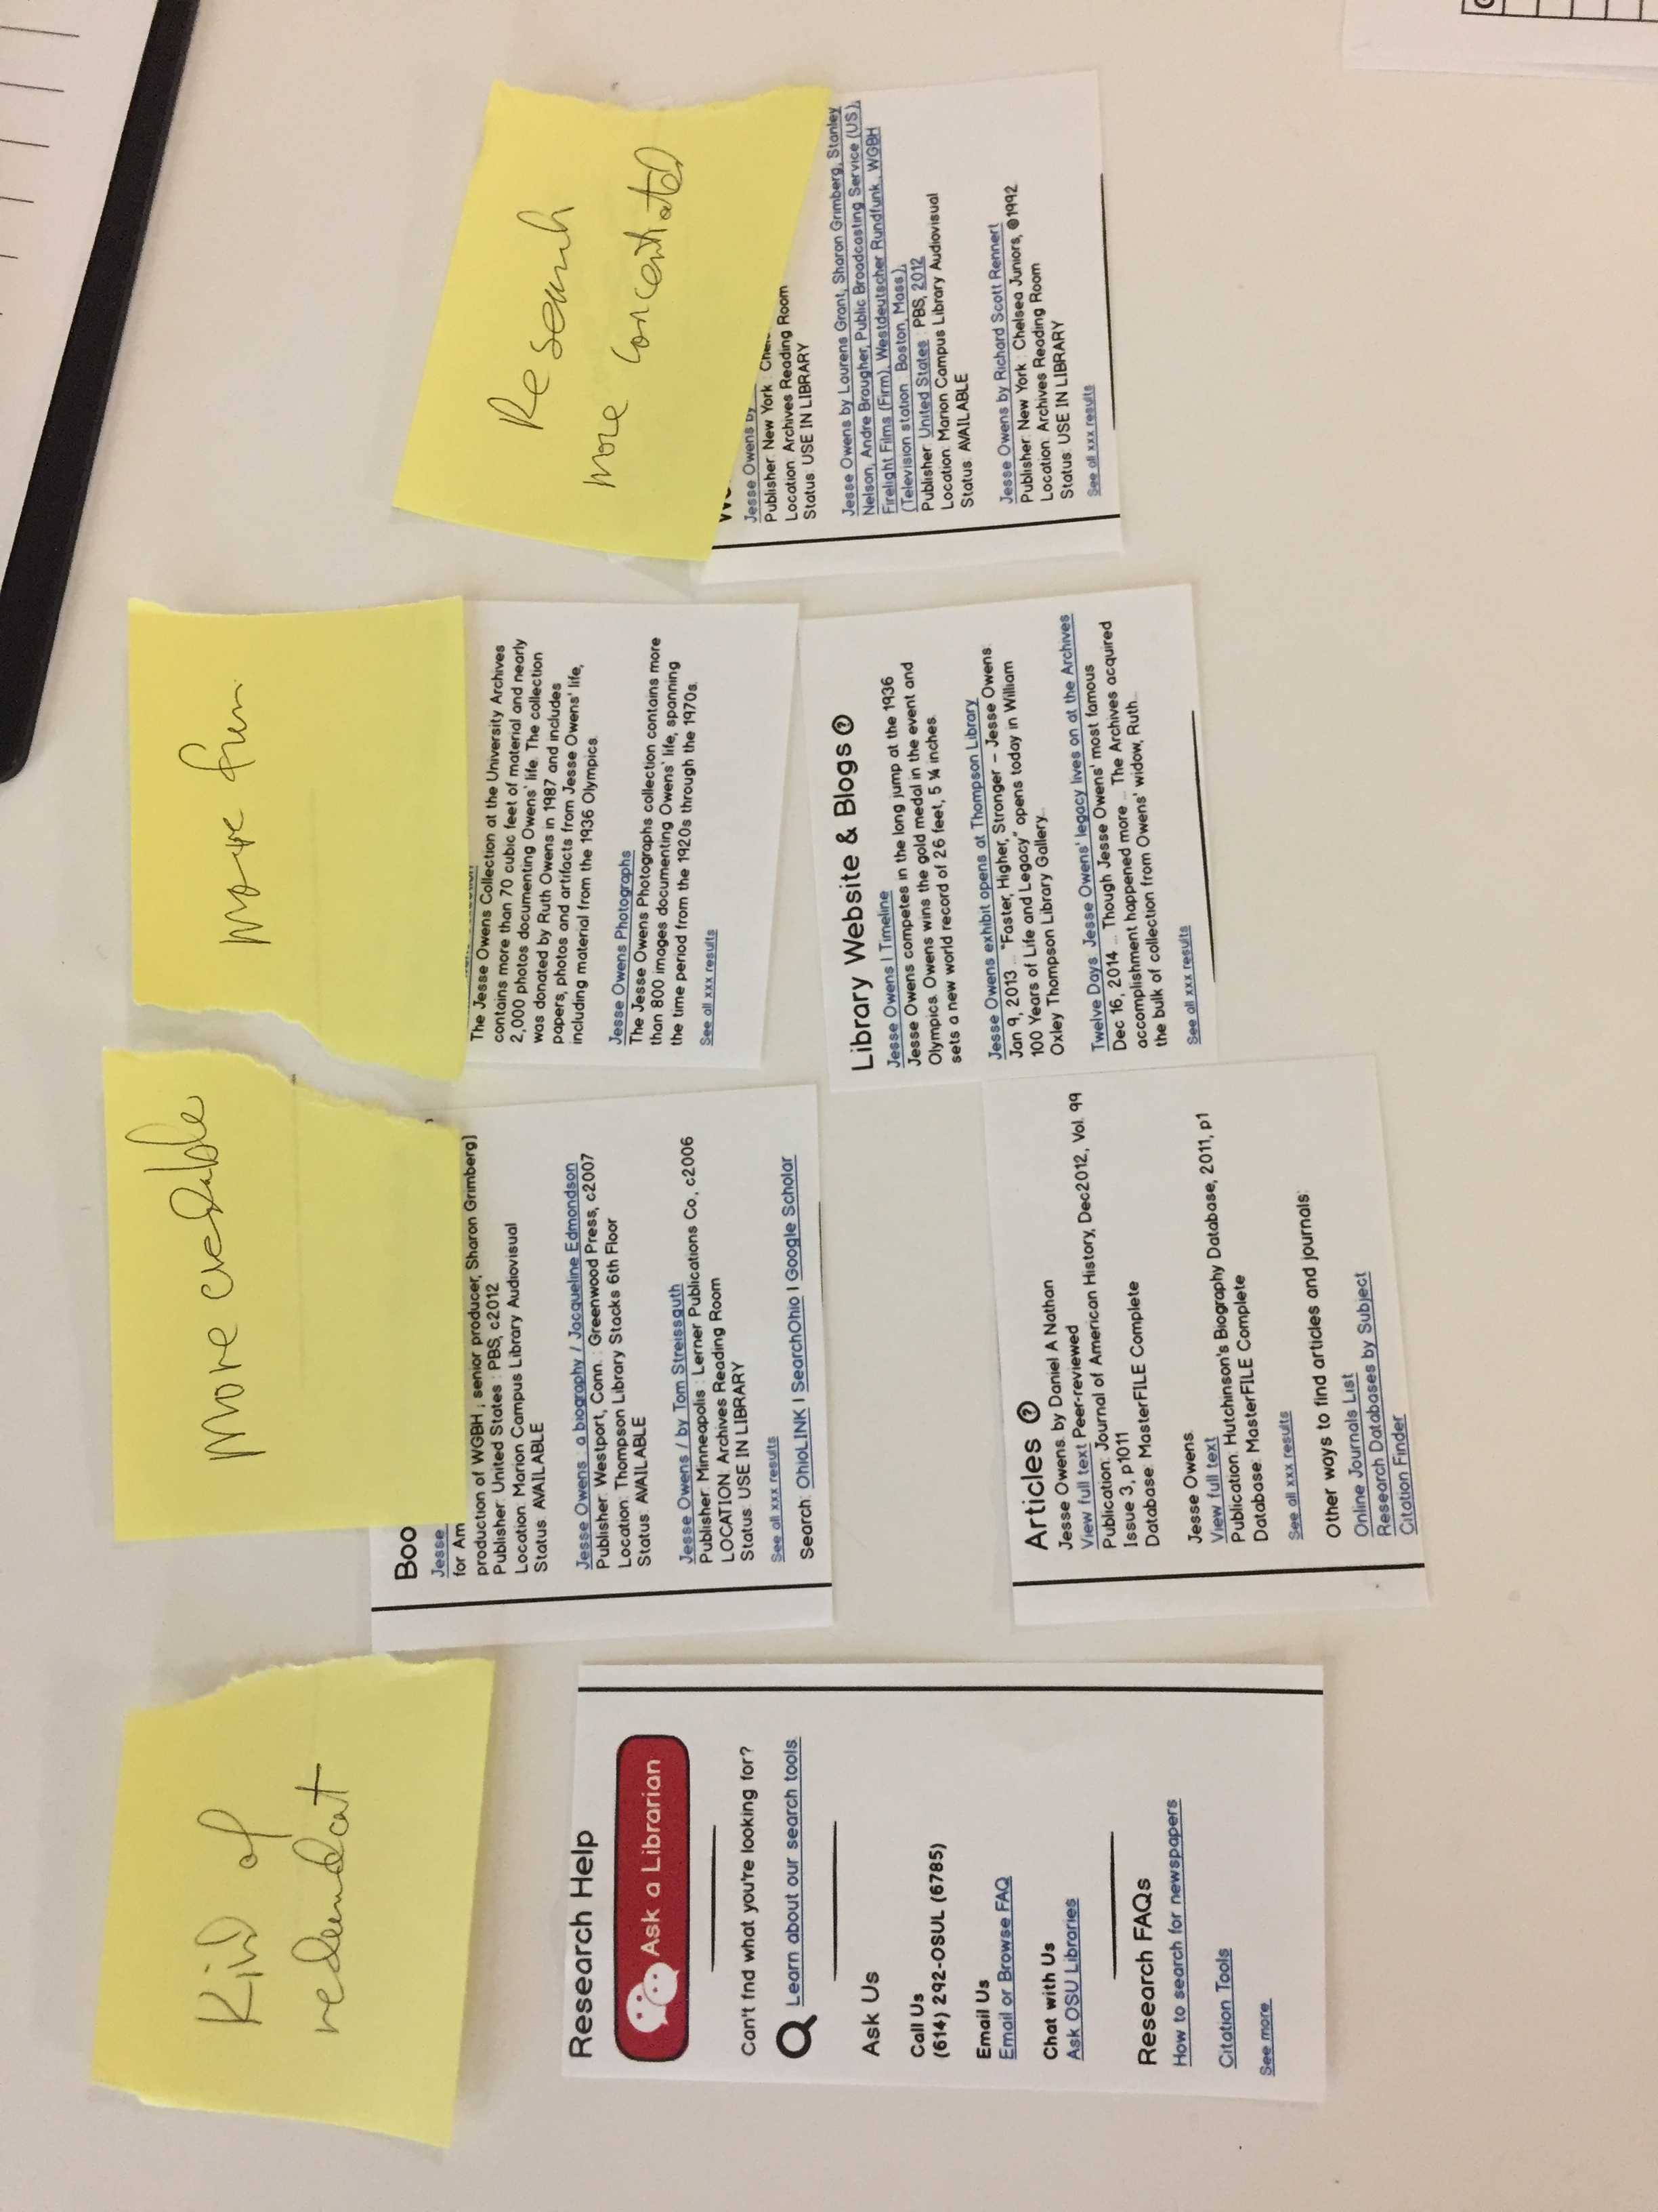
Subtask: Arrange the Elements
5 of the 9 participants were asked to position the elements the way they would want to see them.

Slide 7
Patterns in Arrangement Task
When asked to arrange the page elements to suite them, 4 of 5 led with articles.
Most put subject guides last or left it out.

Slide 8
Summary of Findings
Students have one-track minds when doing research for courses – they want peer-reviewed sources
They aren’t looking for background information.
They aren’t looking for diverse sources.
Vague labeling in the search interface or a weird first item can lead student to skip an entire section of content.
If they can’t immediately tell what something is or is good for, they will skip it.
i.e., subject Guides, blogs, special collections
Individual search records need to contain information to help a user determine value / usability
Too little information to select a given item (i.e., title alone was not helpful)
Status (“available”) was appreciated

Slide 9
Follow Up and Next Steps
More work to do on:
Page layout
Individual search records

