Slide 1
Web Redesign Project: Functional Expert Meetings
Robyn Ness, March 2017

Slide 2
Project Goals
Redesign library.osu.edu in a way that is easy for users to navigate.
Apply user-centered design and iterative development to achieve this.
Communicate openly about decision making and progress.

Slide 3
Project Milestones + Where We Are
Content analysis of current site (WI 2017)
OSUL functionality discussions (WI 2017, iterative)
User needs surveys (WI 2017, iterative)
Form a user experience (UX) cohort; start user testing (SP 2017, testing iterative)
Initial draft of information architecture (SP 2017, rework based on testing)
Drupal training and content migration (late-SP 2017, ongoing)
Release early preview site for public feedback (mid-SU 2017)
Replace old site with new site (as soon as January 1, 2018, depending on content readiness and user testing results)

Slide 4
Functional Expert Groups (for now)
Public physical locations and reading rooms
Borrowing, lending, textbooks, and reserves
Teaching and student support
Research support, collections management, scholarly publishing, and data & document management
Outreach, visitors, and donors
Subject, departmental, special collections, and area studies librarians
Branch library circ supervisors + attendees who couldn’t attend other sessions

Slide 5
DRAFT: Content Migration Strategy
Review outline of content for each site section
Meet individually or by sections of the site to discuss mapping old content to new site
Receive CMS training and access to new site
Migrate content over the summer and into the fall
If needed, work with UX Writer to adjust content

Slide 6
Another View of Where We Are
Explore the
Problem Space
Explore the
Solution Space
Observing & Synthesizing
Ideating & Prototyping

Slide 7
Another View of Where We Are
Explore the
Problem Space
Explore the
Solution Space
Observing & Synthesizing
Ideating & Prototyping

Slide 8
Personas
A persona is a realistic character sketch representing one segment of the Website’s targeted audience.
- Mulder & Yaar (2010)

Slide 9
(extensio.com)

Slide 10
Why Personas?
Personas summarize research findings and bring that research to life in such a way that a company can make decisions based on these personas, not based on themselves.
- Mulder & Yaar (2010)

Slide 11
Designing Your Persona
Think of a specific user of your services or collections. (Or think about someone who has asked a common question recently.)
Think about his or her motivations and goals.
Think about his or her frustrations and limitations (technical and knowledge).

Slide 12
Persona Questions…
(based on usability.gov)
Personal
What is the age of your person? What is the gender of your person?
What is the highest level of education this person has received?
What is your person’s professional background? How much experience does your person have?
Technical
When and where will your person access the site? Through what technological device does your user primarily access the web?
What technological devices, software, or applications does your person use on a regular basis?
Motivation & Goals
What is your person motivated by? Why will he or she come to the site? What is your person looking for or trying to do?
Where (or from whom) else is this person getting information about your issue or similar programs or services?
What will annoy your person? What will delight your person?

Slide 13
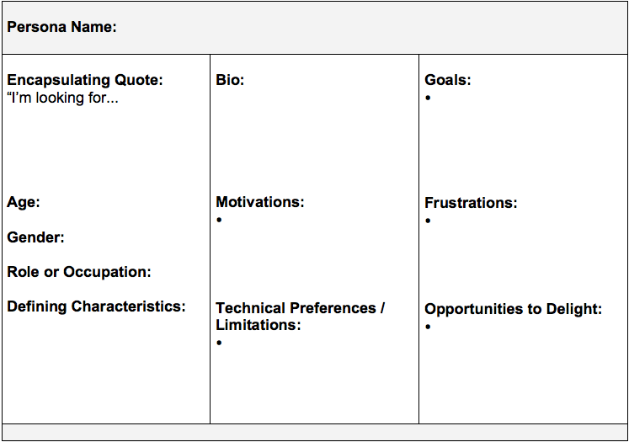

Slide 14
OSUL Website Needs Discussion
Thinking about our website as a path to our services and resources, what do you and your persona care about?
Share examples of experiences, good and bad, with the current website.
Share good examples from other library or university sites.

Slide 15
Next Steps
Areas for targeted followup?
Who you would invite to user testing or focus groups — maybe a user you used for your persona?
General questions?

Slide 16
Citations
Tim Brown (2009). Change By Design.
Mulder & Yaar (2010). The User Is Always Right: A Practical Guide to Creating and Using Personas for the Web.
Inspiration from Tempelman-Kluit (2012). Persona Most Grata: Invoking the User from Data to Design.
usability.gov
xtensio.com

