Slide 1
OSUL Web/Discovery User Testing
Robyn Ness & Meris Mandernach
April 2017

Slide 2
Web Project Milestones + Where We Are
Content analysis of current site (WI 2017)
OSUL functionality discussions (WI 2017, iterative)
User needs surveys (WI 2017, iterative)
Form a user experience (UX) cohort; start user testing (SP 2017, testing iterative)
Initial draft of information architecture (SP 2017, rework based on testing)
Drupal training and content migration (late-SP 2017, ongoing)
Release early preview site for public feedback (mid-SU 2017)
Replace old site with new site (as soon as January 1, 2018, depending on content readiness and user testing results)

Slide 3
Participants
10 undergraduates (7 women, 3 men)
Volunteered for participation during user priorities survey
Compensated with $10 target cards
Sessions
One group of 3, all sophomores
One group of 2
Five single-participant sessions
Participant notes:
Several participants worked at OSUL OR had friends, roommates or relatives who worked in libraries and who had taugh them helpful things.
Even the two participants who work in OSUL didn’t have perfect views of the organization or what things were.

Slide 4
Observation Group
Meris and Robyn ran the sessions in the room with participants.
The UX Cohort was invited to view testing remotely.

Slide 5
Tasks
Cardsort
Alternate Task: Name That Category
Discovery Mockup
Subtask: Arrange the Elements
Homepage Mockup

Slide 6
Cardsort (5 participants)
64 cards representing pages in the current site
6 category cards:
About Us, Collections, Locations, My Account, Research, and Services that were based on a research paper about trends in library website design.
Also a “Not Sure” label
Ability to create new categories if desired

Slide 7
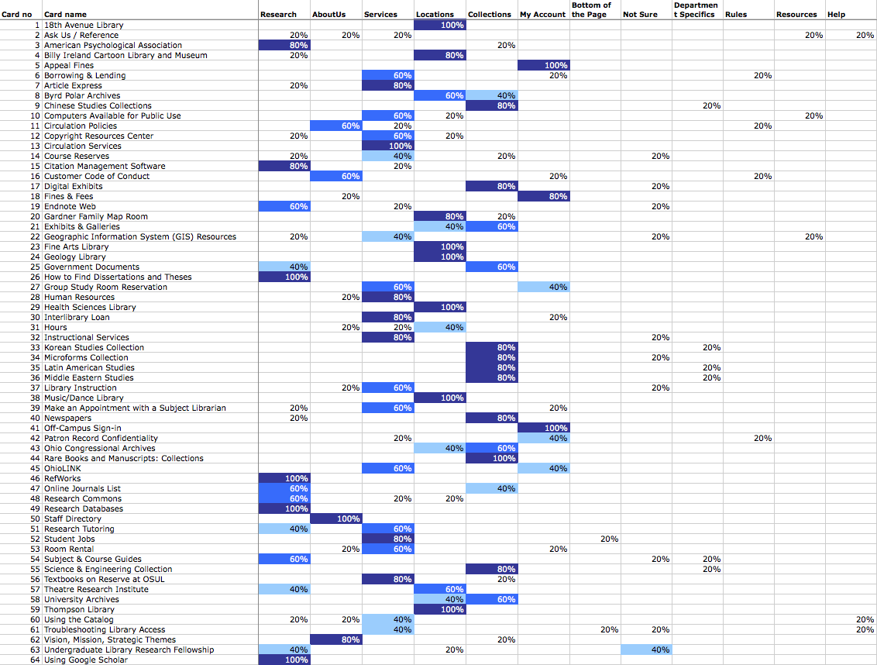

Slide 8
Expectations for Category Cards
My Account:
Things of all kinds requiring login (room reservations, off-campus sign-in), things related to fines, including policy.
Locations:
Mostly easy for students, except for services that sound like places or location-based services that could be either.
Collections:
Mostly easy for students, except where they really didn’t know what a page title was.
Research:
Students seems to interpret this as information/help type content “because Collections is stuff.” The most vague category, some students just put all cards with the word Research in it here.
Services:
Students interpreted this as help from people
About Us:
About Us was represented by fewer cards, many with strong placement agreement (Staff Directory, Mission-Vision-Values). Different student thoughts: “more fundamental, basic things” (sometimes including policies and basic help files), “more related to Thompson”

Slide 9
Difficult Concepts
Difficult page titles or terms:
Troubleshooting Library Access (a participant suggested “Library Login Help”), GIS, microfroms, circulation (for some), course reserves, Article Express (“sounds like Google at hyper-speed”), Citation Management (preferred “Citation Help and Tools”, RefWorks, Endnote Web
Things that sound like locations:
TRI, Copyright Resources Center, Congressional Archives
Things that sound like academic departments, not collections:
Latin American Studies and other special collections
Things students don’t often use:
HR, instructional services, Archives (“Is this how the university works?”)
Things that seem similar or related (but might not be):
Room Reservations vs Room Rental, Patron Confidentiality vs. Customer Code of Conduct

Slide 10
Other Observations
Students added categories for:
Department Specifics, Rules, Resources, Help
Some students talked about the “bottom of the page” as a place to look for additional help or things like job links
There were differences in experience level (first year vs. later) for things like:
ILL, off-campus sign in

Slide 11
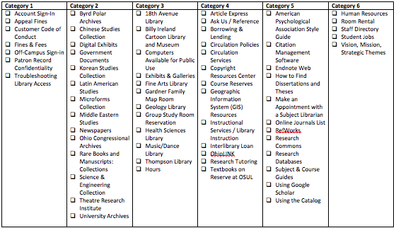
Alternate Task: Name That Category
2 Participants viewed a categorized version of the “page” cards from the cardsort and were asked to name the category.

Slide 12
Observations
Easy to label:
Account, Collections, “Libraries” (Locations)
Hard to label:
Services – although the participants said the word services about the items, they didn’t arrive at that as a label
Research – the students called this “Guides”
About Us – there were fewer items in this category
Even for hard to label categories, the participants mostly felt the items went together.
The categories they felt they use most were Account, “Libraries” (and hours), and the unnamed services category.

Slide 13
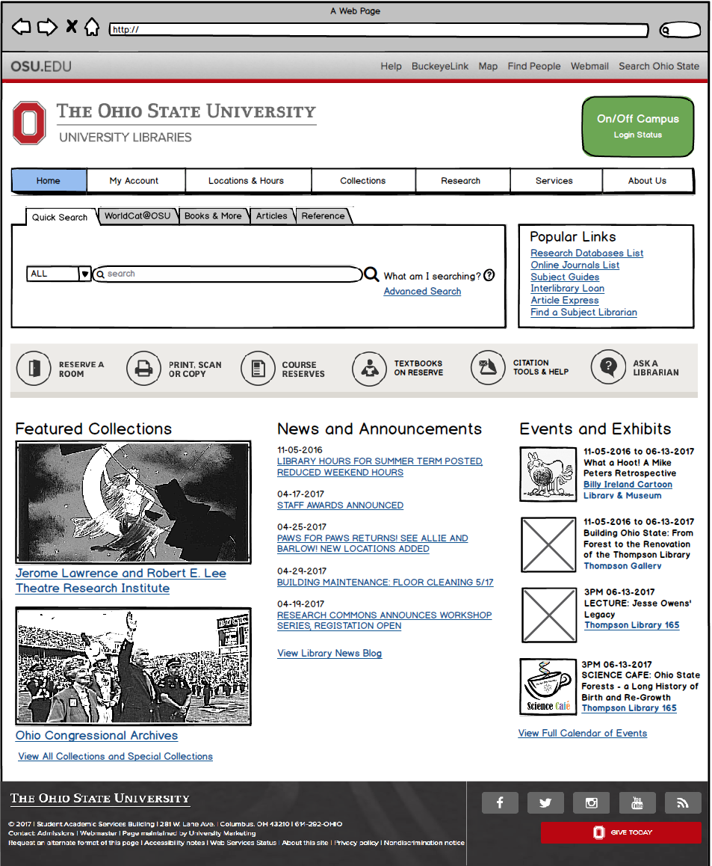
Homepage Mockup
X participants viewed a possible version of library homepage built from feedback received in the user priorities survey and based on several example sites.

Slide 14
Observations
“They liked a simple/clean looking search box.
They liked the general number of tabs and the labels, though some were vague and would require clicking.
Most looked for My Account and were happy it was first.
“Locations & Hours is great!”
The icon row and popular links were the right items.
Some students didn’t immediately notice these things, focusing instead on the navigation, but a majority did.
In the icon row, Room Reservations, textbooks on reserve, and citation help and tools got the most comments.
The option to print from your own computer was not familiar to most, but when one found out she proclaimed it “life-changing.”
The students liked the Research Database List in the popular links, but said the icon row reflected their needs more.
“Find a Subject Librarian” was seen as risky and a last resort.

Slide 15
Observations (continued)
Many students liked the lower half of the page with events and announcements.
They liked including links to locations with events so they could find them.
Students want news about when 11th Floor is closed, things they can do, things that effect them.
Prominence of Off-Campus Sign In was good.
Computer availability as a feature would be awesome.
Some students wanted a “mega footer” that acted as a sitemap.
The footer is also where they would look for job links

Slide 16
Observations (continued)
Several students remember their 1st year workshops.
Most said they would NOT watch tutorial videos.
On one session with 3 participants, each preferred a different mode of getting information: video, workshop, textual help
If videos, narrate at normal to slightly fast speed with a pleasant voice; people can always rewatch, but dragging is horrible.
They were not opposed to FAQs as long as they were true questions, and not marketing tone or cheesy.
Social Media channels: Facebook, Twitter, maybe Instragram
Other channels: Peer Mentor Monthly Newsletter
“Life-changing” messages:
Printer drivers to print from your own computer, locations/hours/room reservations, citation tools and help, search tips/tools
CML for Overdrive use and leisure reading?

Slide 17
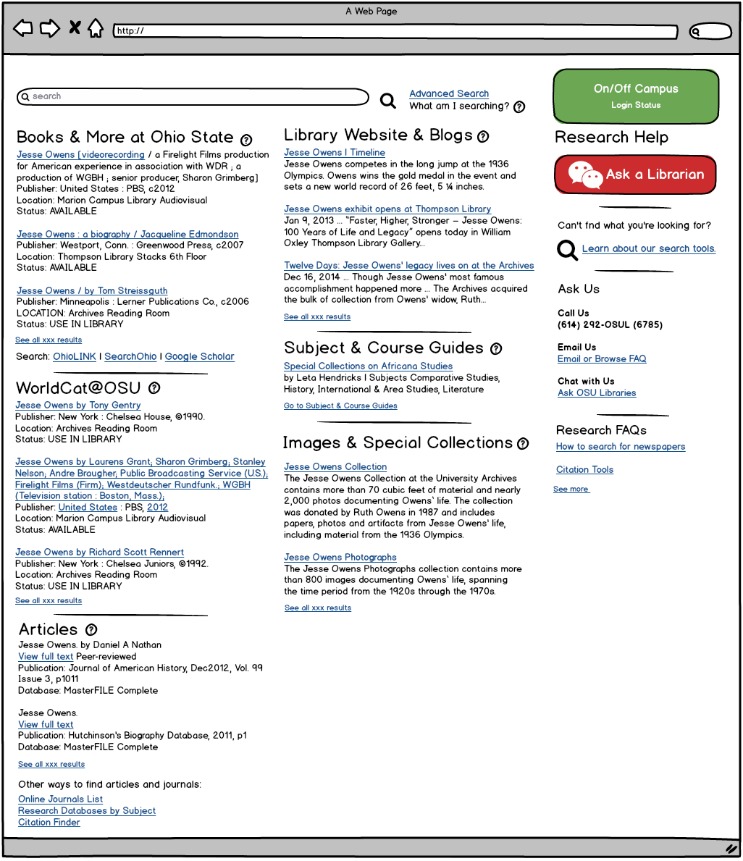
Discovery Mockup
X participants viewed a possible version of the discovery interface proposed in the SU2016 DSWG proposal. Search results reflect a search for “Jesse Owens” for which we have a wide range of materials.

Slide 18
Themes from Comments

Slide 19
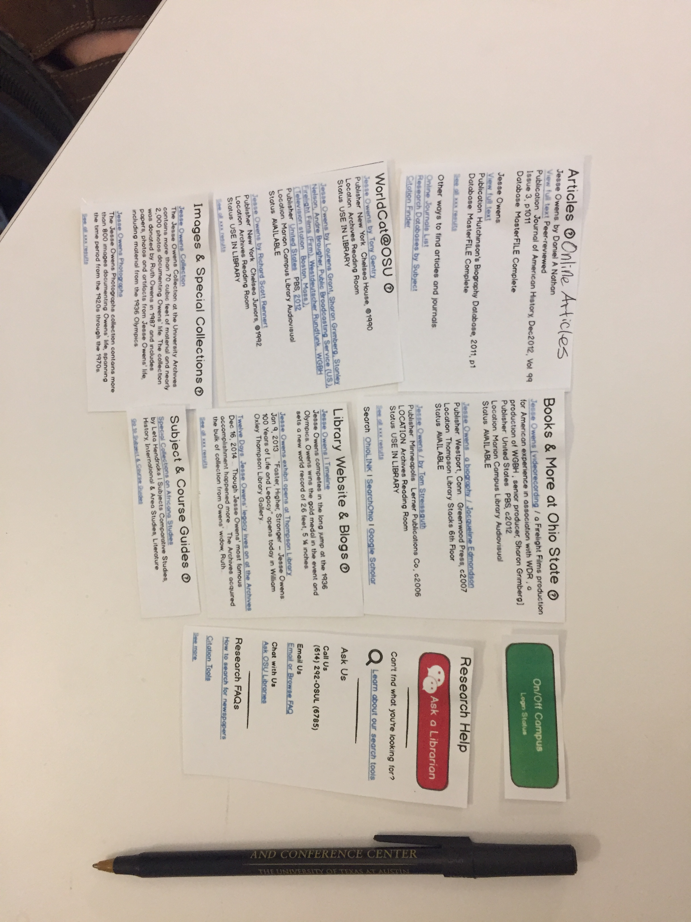
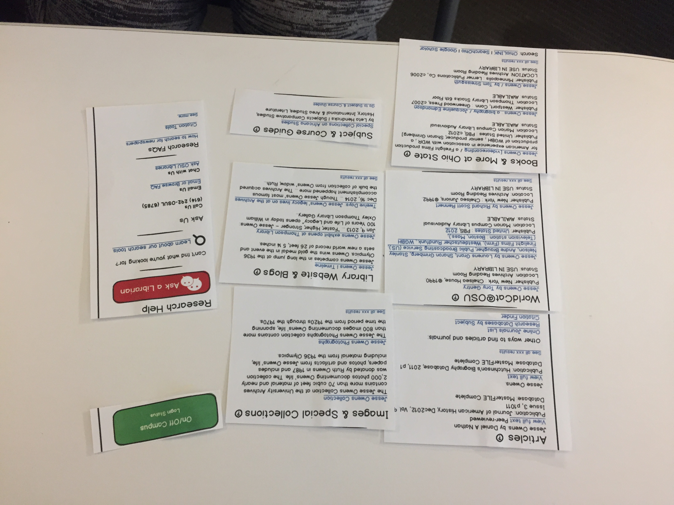
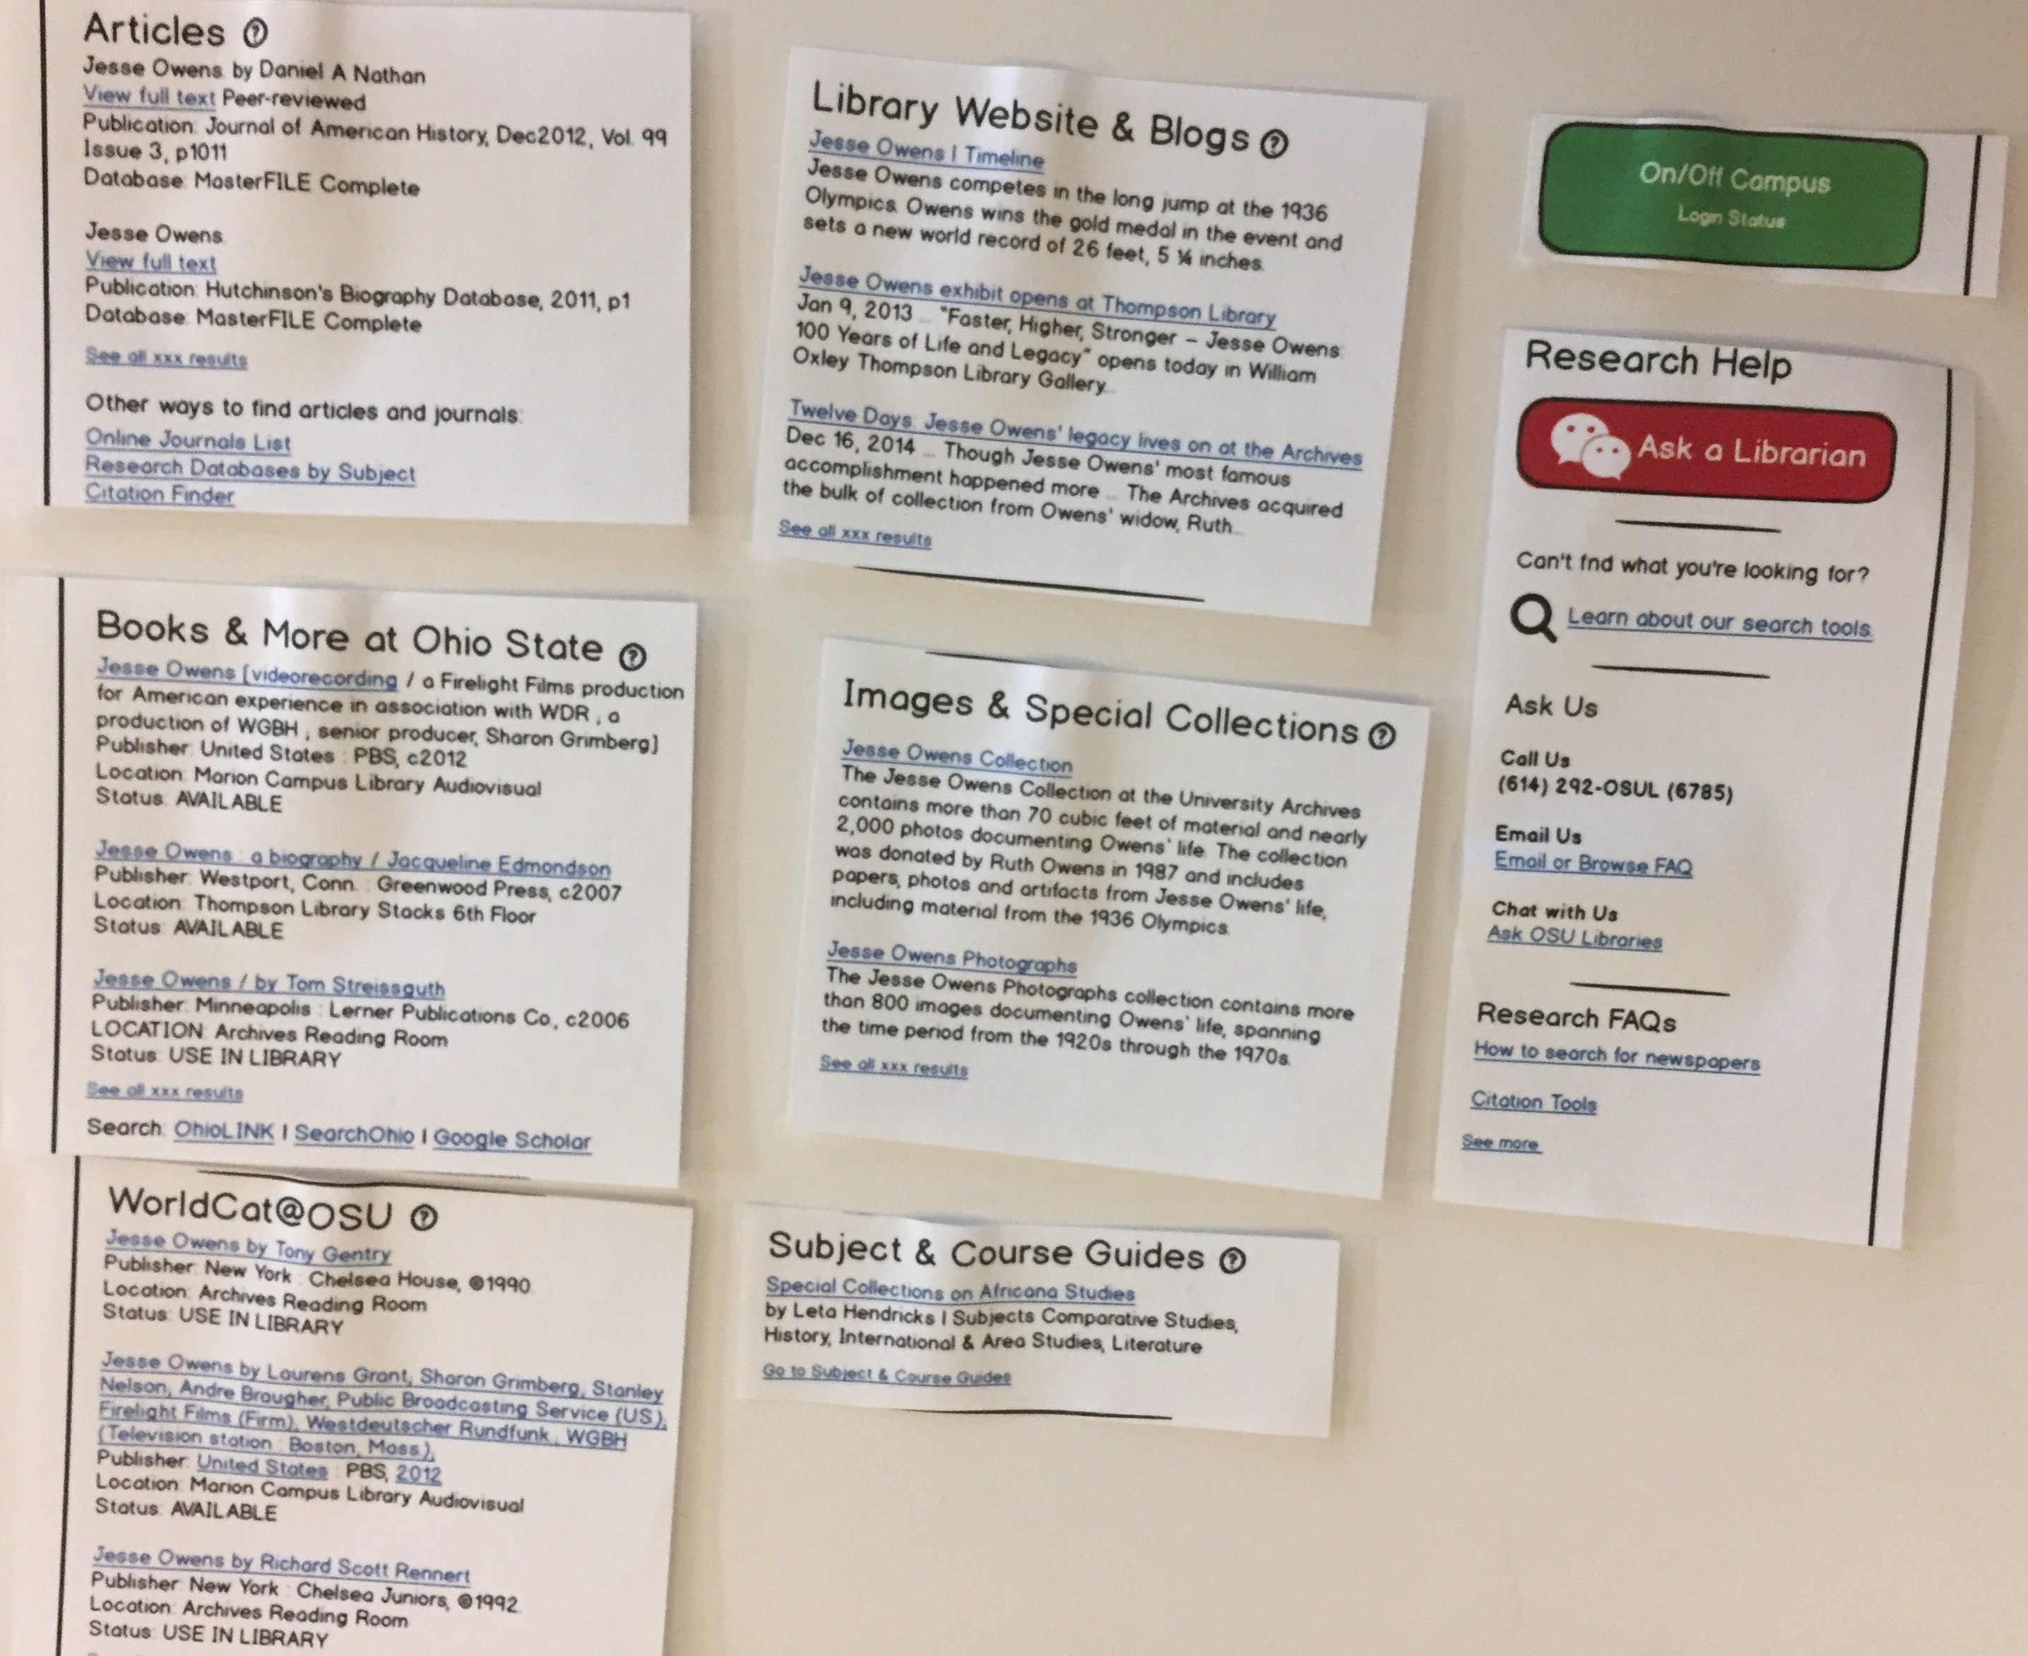
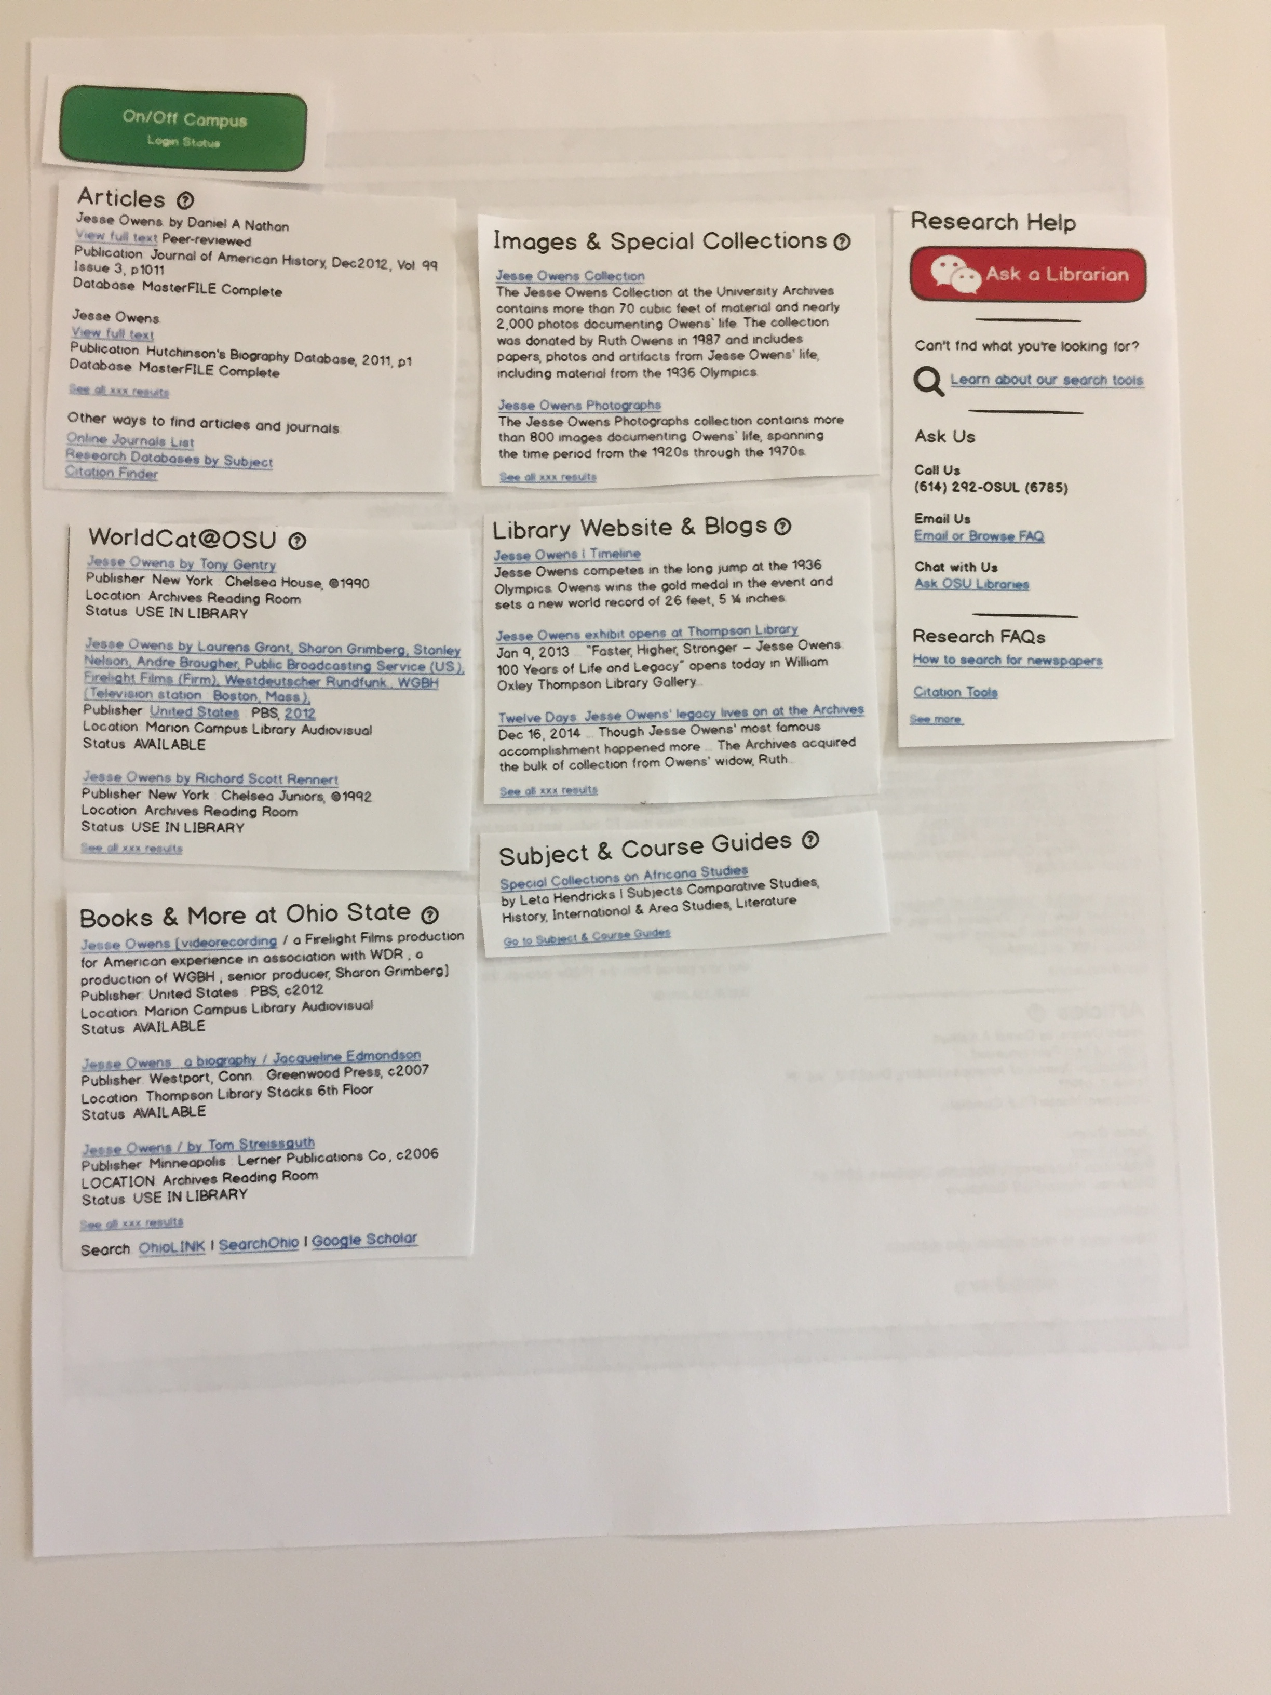
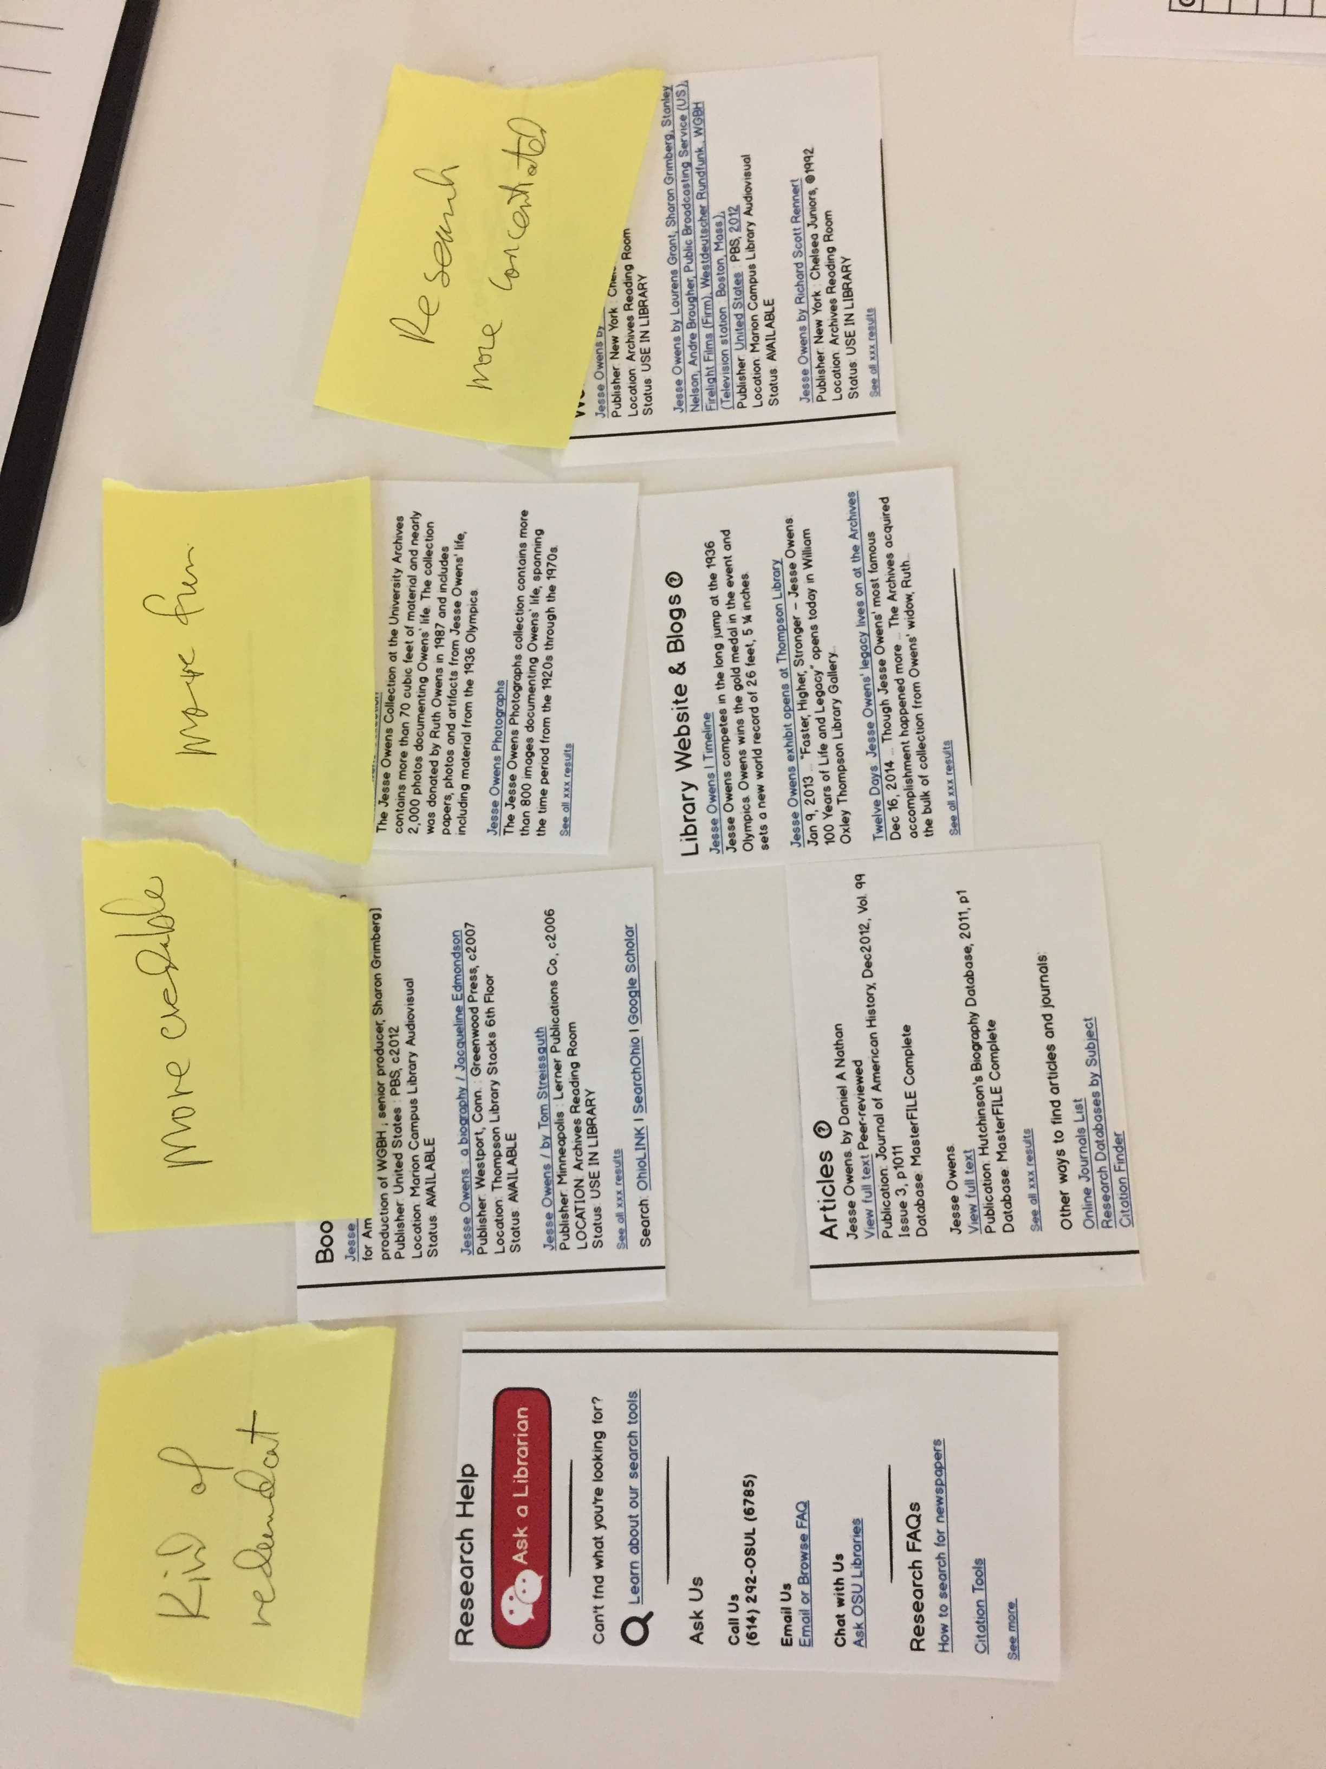
Subtask: Arrange the Elements
5 of the 6 participants were asked to position the elements the way they would want to see them.

Slide 20
Themes from Arranging Task

Slide 21
Summary of Findings

Slide 22
Follow Up and Next Steps

